Slide 1
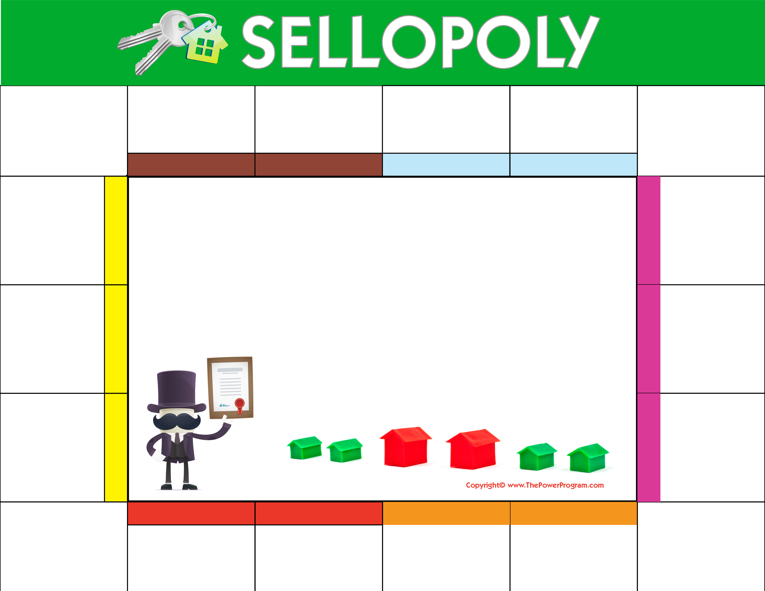
START HERE
DETERMINE
PREPARE
STAGE & PHOTOS
VERIFY
LAUNCH LISTING
The current value of your home on today’s market
Personalized marketing campaign.
Stage home to stand out from competition. Professional photography goes a long way in this game!
Taxes, certificate of occupancy, survey, and all other pertinent information.
Launch listing on MLS, National and Local real estate websites.
CONGRATULATIONS!
SHOWTIME
CELEBRATE! Closing occurs at lending institution or attorney’s office.
Start showing home and host open houses!
FINAL WALK THROUGH SCHEDULED 24-48 HOURS PRIOR TO CLOSING
NEGOTIATE
Your contact information here.
Add name, company, website, email and phone number.
Professional manage offers to obtain maximum value with your sales associate.
TRANSFER UTILITIES OIL, METER READ, CALL THE MOVERS!
QUALIFICATION
Confirm qualification of potential buyers.
TITLE SEARCH
MORTGAGE COMMITMENT
SALE
INSPECTIONS
BANK APPRAISAL
ACCEPTANCE
OF
OFFER!!!
Title search ordered by purchaser’s attorney.
Receive written mortgage commitment.
$$$
Execute contract of sale with attorney.
Home and termite inspections take place.

