Slide 1
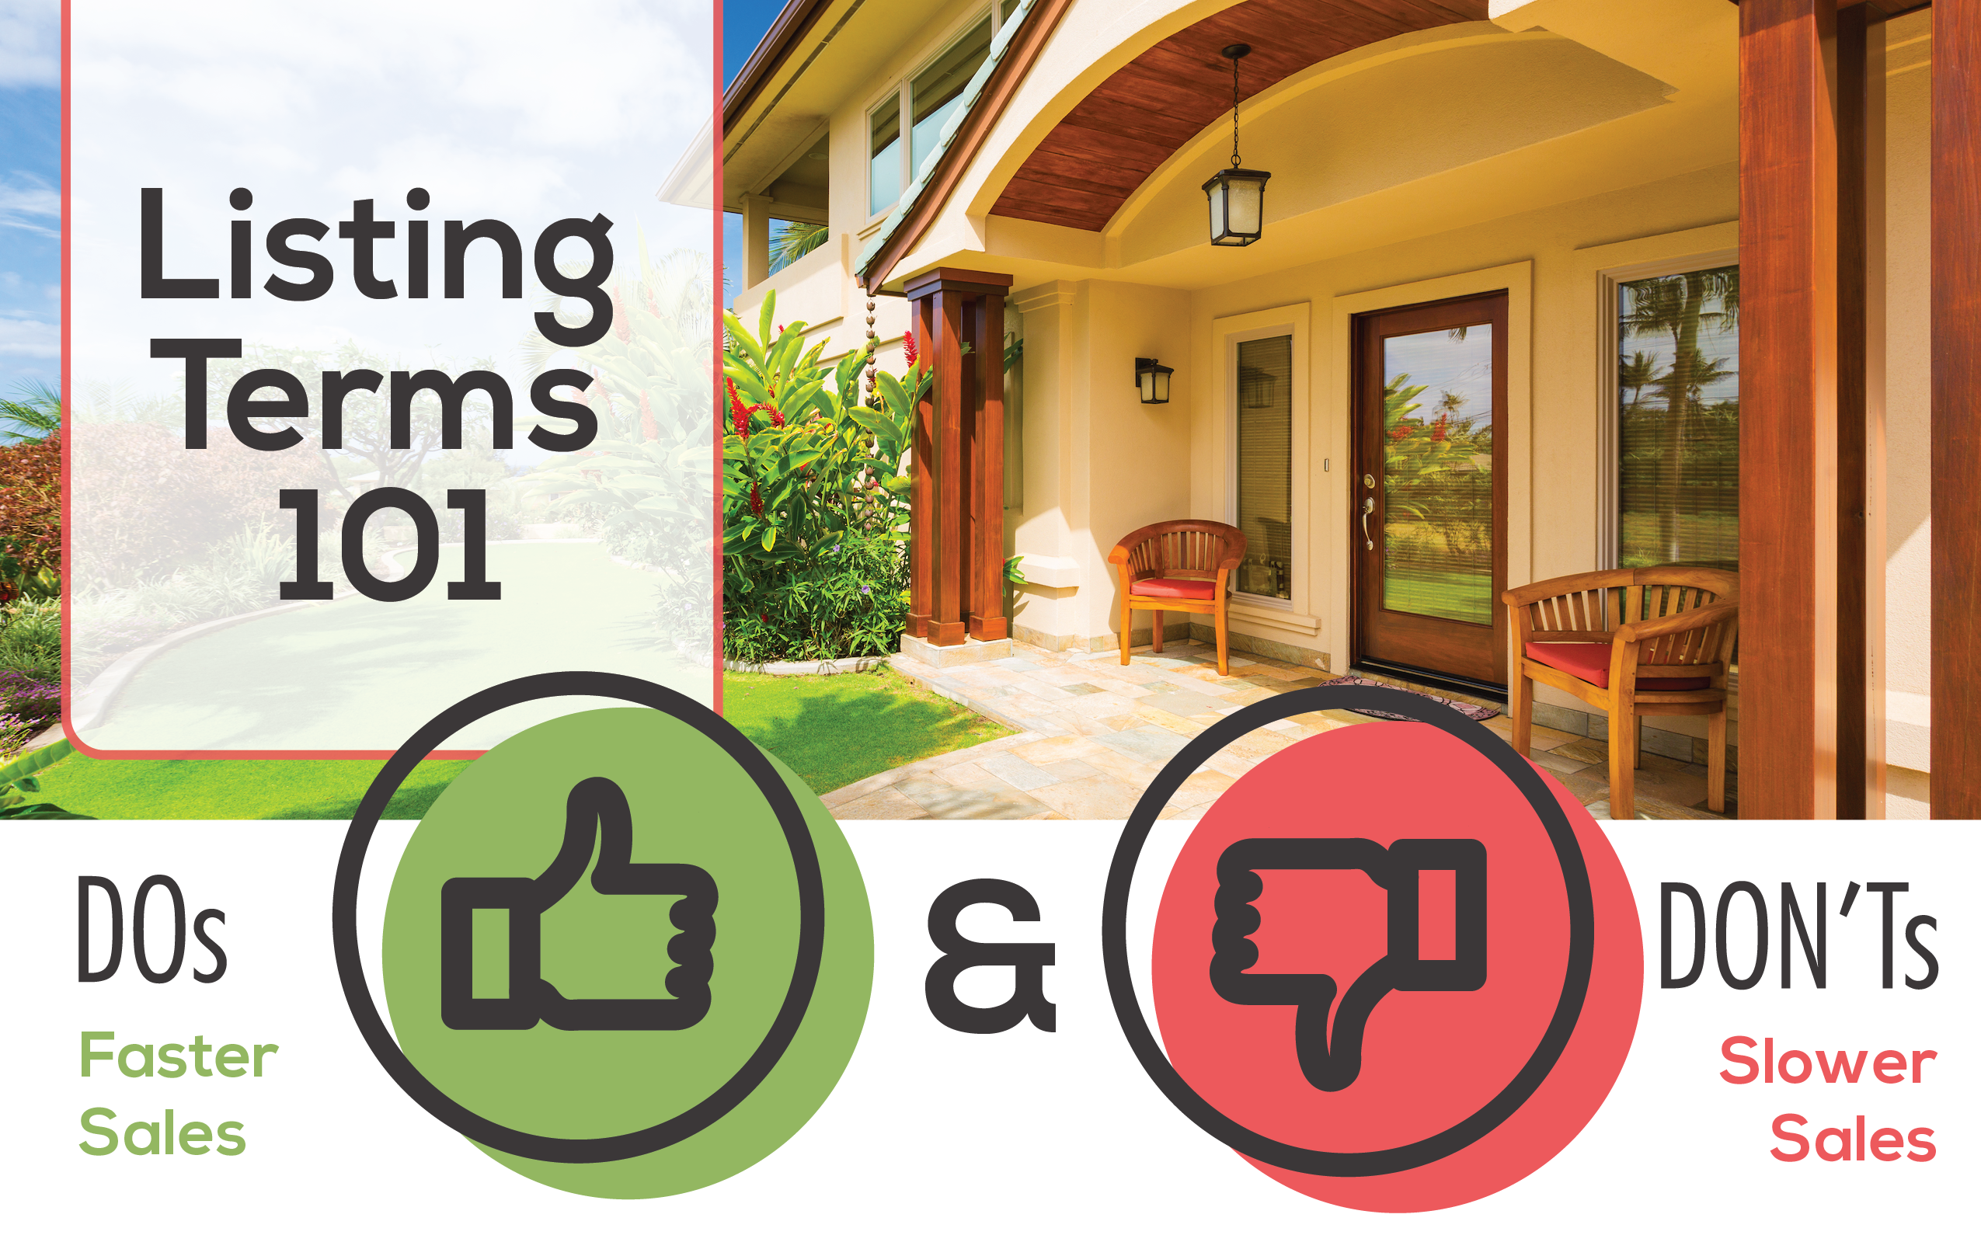
Beautiful - 15% FASTER Sale
Landscaped
Move-in Condition
Good Value
Granite
Maple
Gourmet
Updated
Motivated - 15% SLOWER Sale
Clean
Quiet
New Paint
As-Is
Rental
Starter
Handyman Special
“Must-see”
proves to be
statistically
insignificant
A Great Description Gets a Better Price!
Using positive, accurate words such as “beautiful,” “spacious” or “inviting,” improves sales price and generally sells faster. According to a study by Dr. Bennie D. Waller of Longwood University, each positive word increased the sales price by roughly 1 percent and improved the probability of selling by 9.2 percent.
Agent Contact Info Here.
Sources: Studies by Dr. Bennie D. Waller of Longwood University,
Virginia, and Dr. Paul Anglin, University of Guelph, Ontario.

