Slide 1
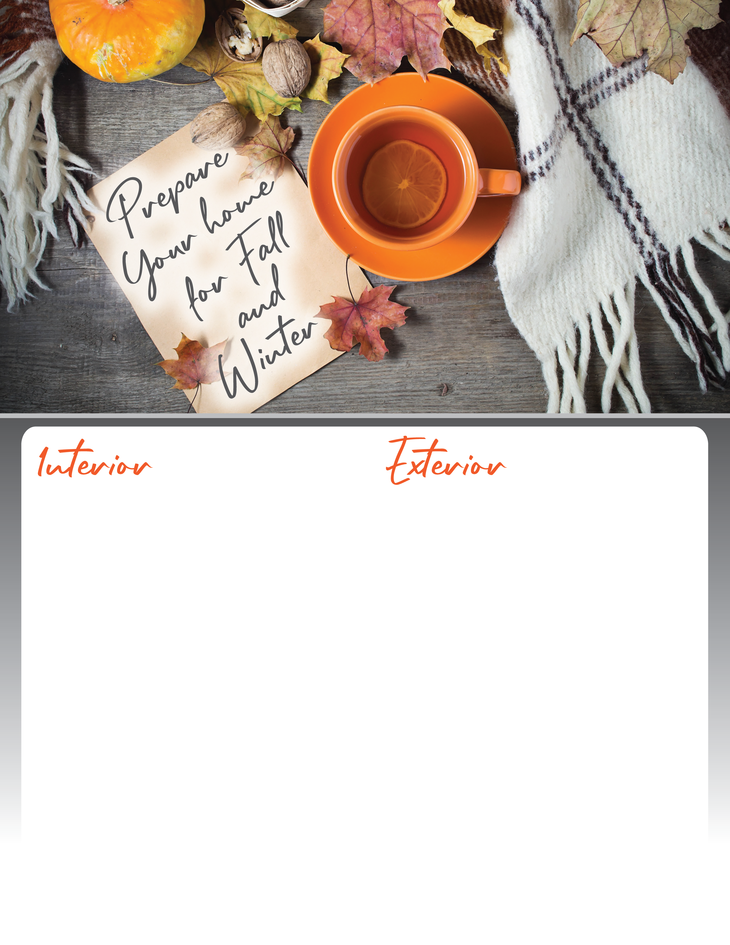

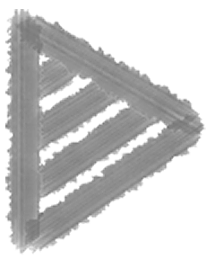
Check for drafts around the edges of windows and doors. If necessary, replace seals and repair caulking, and consider buying heavier drapery for windows.
Have an HVAC professional inspect the heating and cooling systems.
Winterize air conditioning. Remove window air units and cover your outdoor unit.
Replace the batteries in all of your home’s smoke detectors and carbon monoxide devices and test to make sure they are working properly.
Clean out humidifier and filters.
Switch the direction of your fan blades.
Check the roof for missing, damaged or loose shingles and remove leaves and debris.
Clean and repair the gutters.
Service sprinklers and irrigation system.
Apply lawn fertilizer to prevent winter damage.
Put away seasonal furniture.
Cut back bushes, shrubs and flowers as recommended.
Rake and remove leaves from the yard.
Turn off faucets, hoses and drains.
Clean out and organize your shed.
Agent Contact Info Here.

