Slide 1
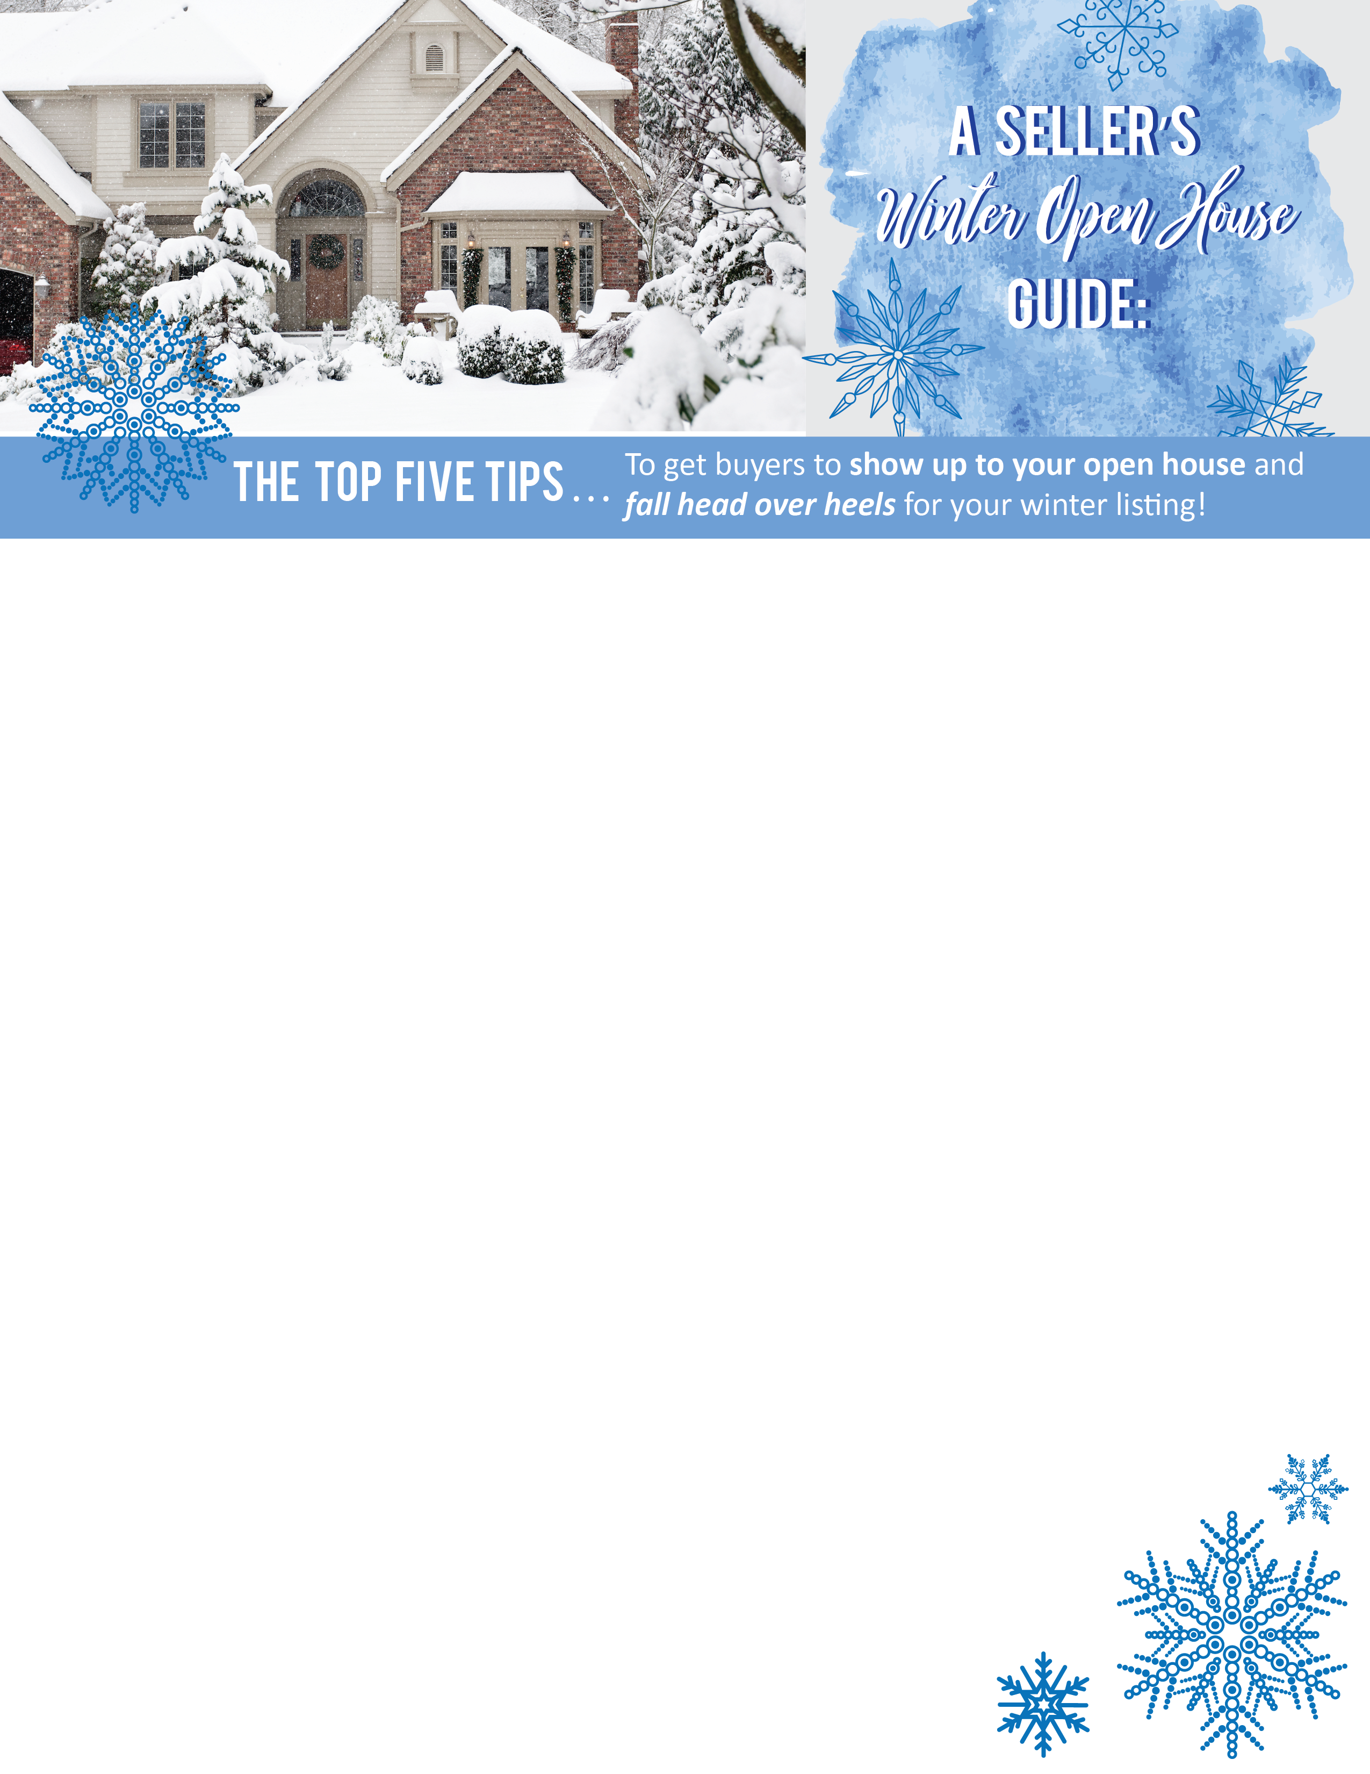
Market warmth. When advertising homes for sale, I cater to the season. For example: in the cold winter months, feature a photo of that fireplace filled with a roaring fire, surrounded by cozy winter colors. No fireplace? Candles and other warm lighting can convey the same inviting feeling that will make buyers want to curl up in your house all winter.
Don’t forget about pathways. The easiest way to turn off a buyer is for them to slip on their way in. If ice is a possibility, be sure to purchase de-icing materials well before you open your house to potential buyers.
Add curb appeal. Even if gloomy weather makes landscaping a burden, you can attract buyers with a few simple touches. Place electric candles in windows, hang a wreath on the door and clean the yard of all debris.
Crank up the heat. People entering and exiting during an open house are sure to let in the cold air from outside — and the last impression you want to give buyers is that the home is difficult to heat. So crank up the heat a few degrees before the open house starts and they’ll never want to go back out into the cold.
Offer hot drinks. Set out some hot drink options for buyers to sip on while touring the house. Coffee, cider and hot chocolate are all good ways to make a buyer feel cozy in your home. Put out plenty of mugs or to-go cups, along with cream and sugar.
Agent Contact Info Here.

