Slide 1
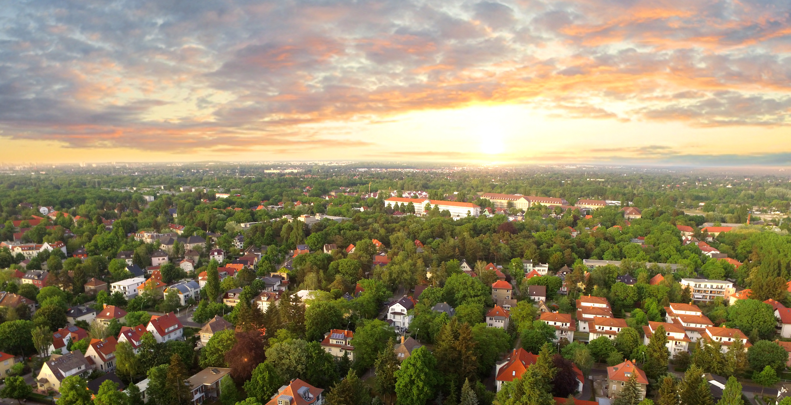
What it Costs You to Wait
Our Market is Changing. Every Percent Counts.
SAMPLE MORTGAGE
INTEREST RATE
PAYMENT
$350,000
$325,000
$300,000
$275,000
$250,000
$225,000
3%
4%
5%
6%
7%
8%
$1,476
$1,552
$1,610
$1,648
$1,663
$1,650
Agent Contact Info / Photo(s) Here.

