Slide 1
YOUR NAME
YOUR PHONE NUMBER | WWW.YOURSITE.COM

Slide 2
Negotiation is a critical skill you'll need to have whether you are buying or selling property. Multiple offers can further complicate what can often already be cumbersome process. Having the right tools and experience is key to getting your best return for investment with the least amount of stress.
In this eGuide, I will walk you through some of the best practices in the industry for negotiating a fair transaction where multiple offers are involved .

Slide 3
In certain markets, such as ones with low listing inventory, sellers are often in the position to weigh competing purchase offers from multiple buyers.
They can then do one of several things:
Accept what they feel is the best offer
Inform all potential buyers that there are multiple offers being considered
Counter one offer, and put other offers on hold until counter-offer Counter an offer and reject other offers
•
•
. UNDER.
CONTRACT

Slide 4
First, let's take a look at some of the facts and strategies that make can affect this type of transaction:
FACT· BOTH parties are seeking the best financial terms for their interests. Sellers want the highest price and buyers want the lowest.
FACT: There are Listing Brokers, who represent the sel ler's best interest, and Buyer Representatives who represent the buyer's interest. All REALTORS® are subject to state real estate regulation and, if they are REALTORS® , to the Code of Ethics of the National Association of REALTO RS® .
FACT· The Code of Ethics obligates REALTORS® to be honest with all parties; to present offers and counter-offers quickly and objectively; and to cooperate with other brokers. Cooperation involves sharing of relevant information.

Slide 5
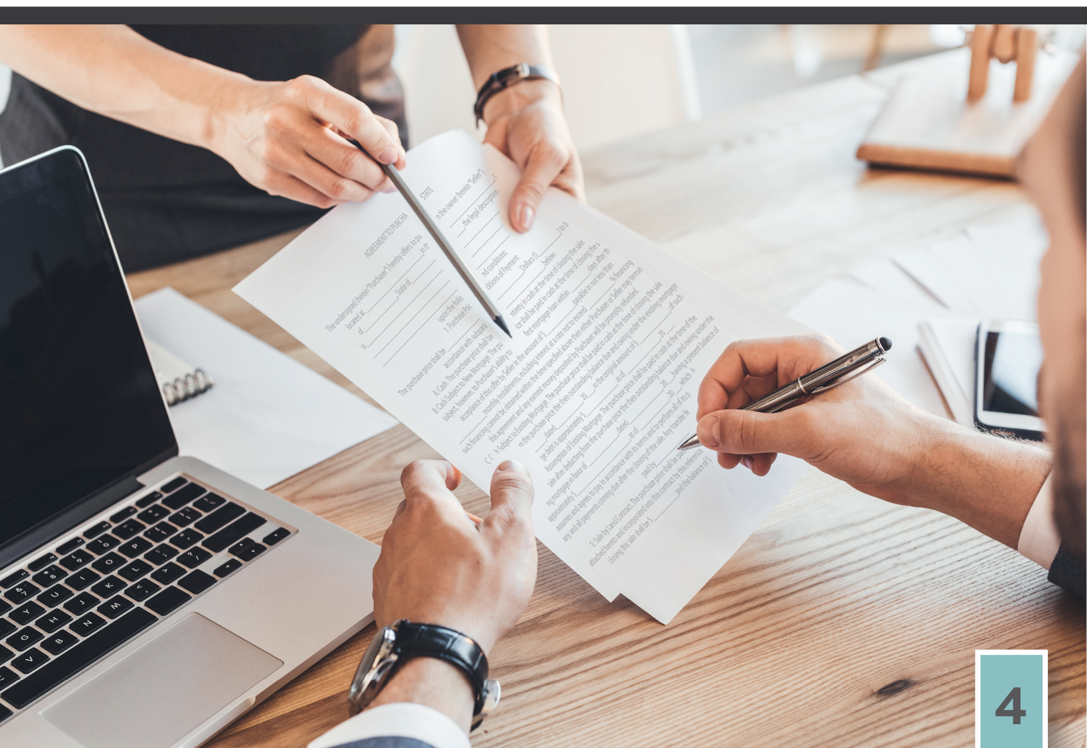
FACT· Ultimately, only one offer will result in the sale of the property. It is imperative that all parties act in good faith, with honesty, and communicate in a timely and truthful way.
FACT: Listing brokers are a professional resource and guide to help protect a seller’s interest in a transaction. However, all decisions in terms of the acceptance or rejection of any offer is ultimately up to the seller.
FACT· Buyer Representatives are a professional resource and guide to help protect the best interests of the buyer. Ultimately, this offer made is up to the buyer.
FACT· Real estate professionals provide guidance based on their experience, market knowledge, and training. However, real estate transactions still come down to a human interaction, so they can make no guarantees for how either a buyer or a seller will react in any given situation.

Slide 6
STRATEGY: Buyers often will present a low initial offer, hoping to purchase a property below Iisted price. This can result in a favorable acceptance of the offer, or leave a buyer in a position to be out-bid by another buyer's higher offer.
Your buyer representative can help guide you as to current fair market value.
STRATEGY: Buyers can submit full-price offer up front in the hopes of a quick acceptance. The risk here is in navigating whether
the sellers would have accepted a Iower offer.
STRATEGY: Sellers can some­ times disclose the details of mul­
tiple offers to all prospective buyers, hoping to create a "bidding war" and increase the sales price of their home. However, in some cases, state law can limit the level of disclosure of the existence or terms of third-party offers. Your real estate professional can guide you.

Slide 7
STRATEGY: Sellers may invite all potential buyers to make their “best offer”, meaning produce a higher offer based on the highest price and terms currently being considered. This could result in a higher sales price. It could also result in discouraged buyers pursuing other properties. Your agent can help you weigh the pros and cons of this strategy.
These facts and strategies represent just a glimpse of what goes into a successful real estate transaction. Whether you are a seller or a buyer -- market and economic trends, negotiating experience, knowledge of state laws that govern the sale of property, and adherence to an ethical code all will help to ensure that you get the best results.
YOUR PHONE NUMBER | WWW.YOURSITE.COM

