Slide 1
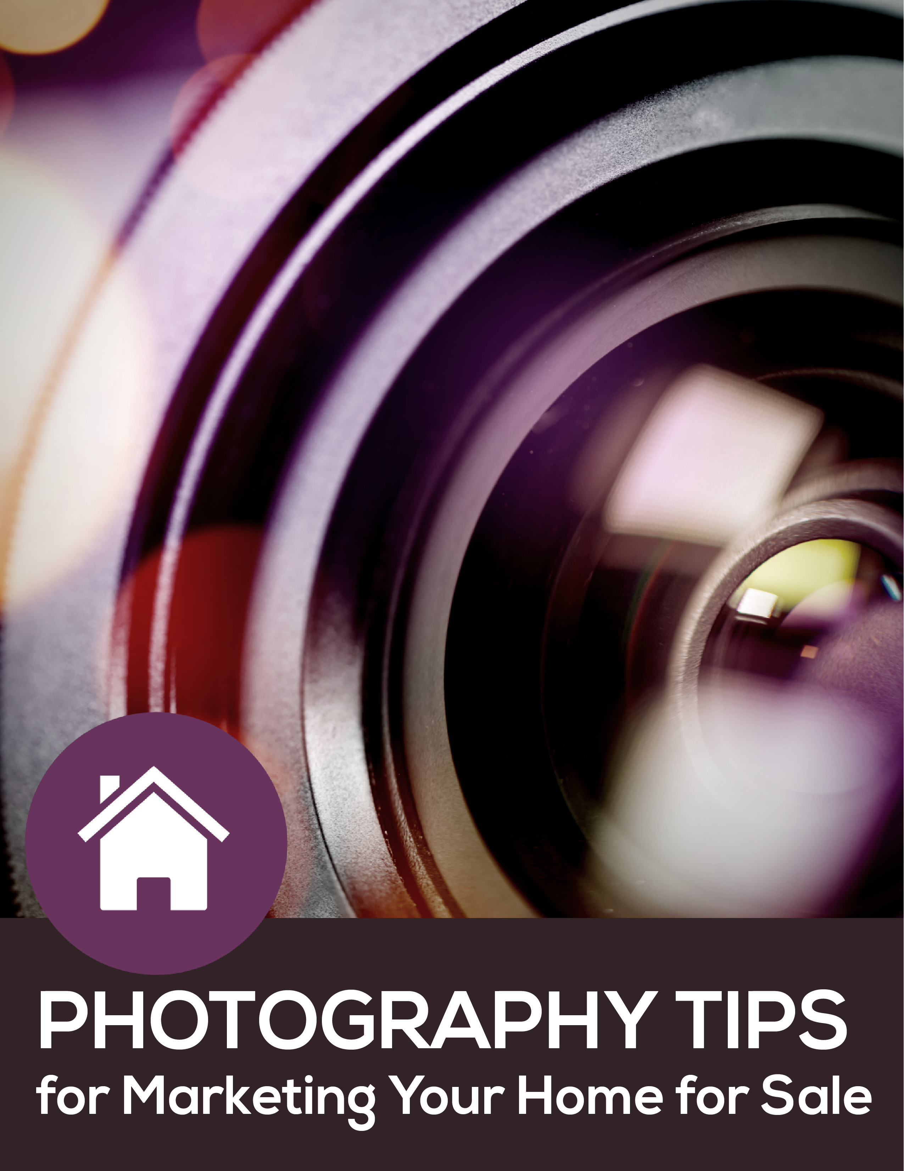

Slide 2
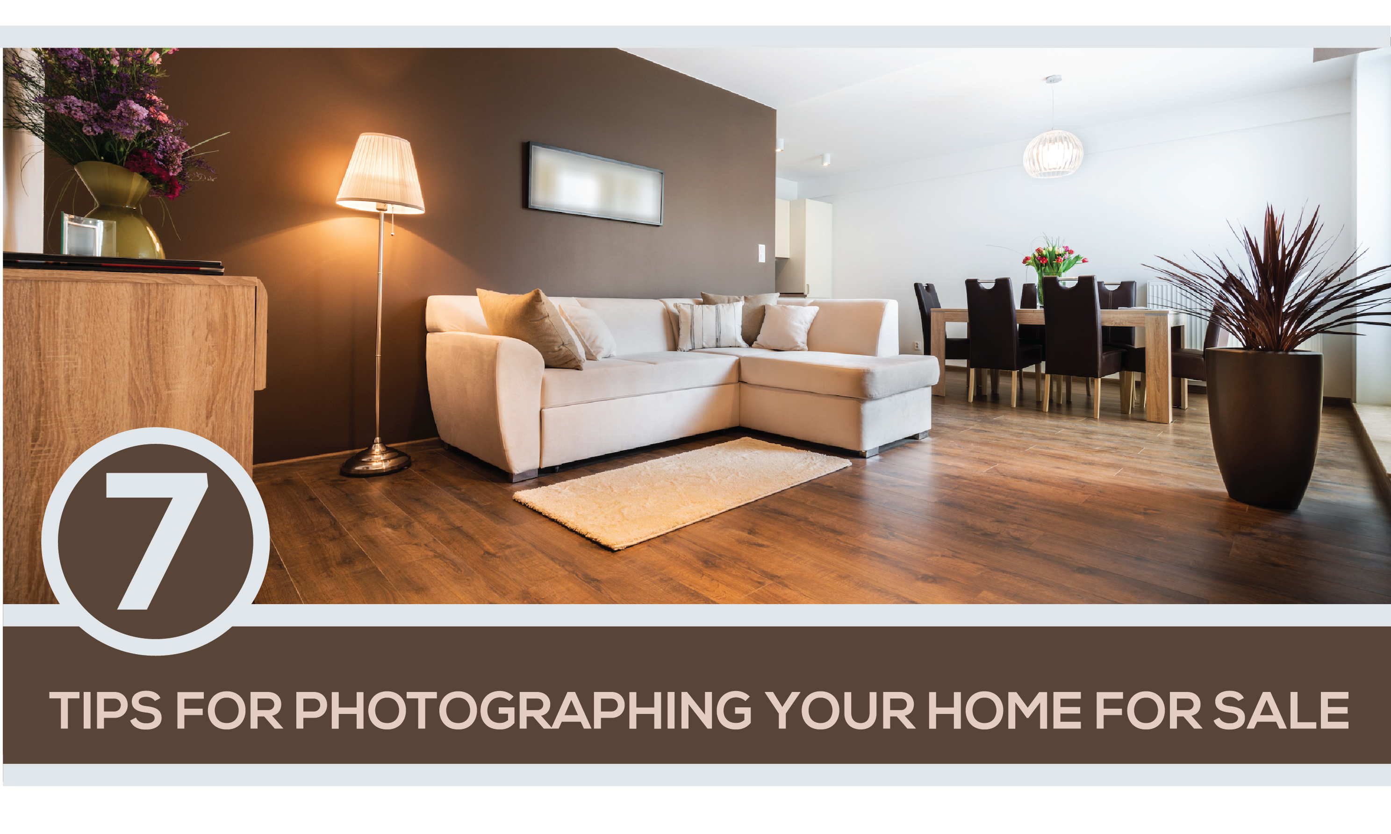
In this case, open houses – or even taking pictures isn’t a viable option. For sellers that must sell, they have an opportunity to become your marketing partner! You can walk them through limited staging and photo taking, and even measuring. They can then send that information to you and you can get started working your MLS magic remotely!
Tour your own house like a buyer. Imagine your home through their eyes and what features might best be conveyed.
Choose what time of day to photograph. A bright blue-sky day is perfect for exterior shots. Schedule your shoot for when the sun is shining on the front of the home.
Pro tip: If you're shooting with a smartphone (although we really, really recommend using a high-quality digital camera) use the high dynamic range (HDR) setting to capture greater detail without having to use additional lights.
Watch for curb appeal before you get behind the lens. Hide trash cans, clear debris, clean up child toys and pet clutter. Remove cars and bikes from driveway so they aren’t in the photos.

Slide 3
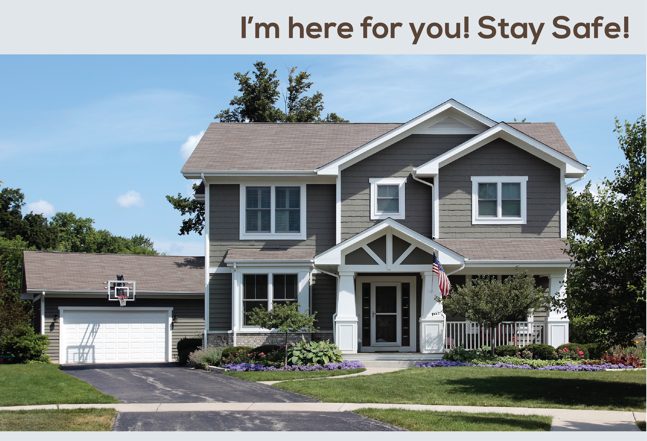
Declutter the interior. Before taking shots inside, do your best to minimalize the décor in each room that might distract from a blank canvas. Clear countertops in the bath and kitchen areas – and make sure the toilet seats are down when you start to take pictures!
LIGHTS, camera, action. Wash your windows and leave curtains and blinds open. Turn on every light you can but turn off ceiling fans (which can distract).
Hold camera chest high and shoot straight while trying to make the room look as expansive as possible.
Agent Contact Info / Photo(s) Here.

