Slide 1
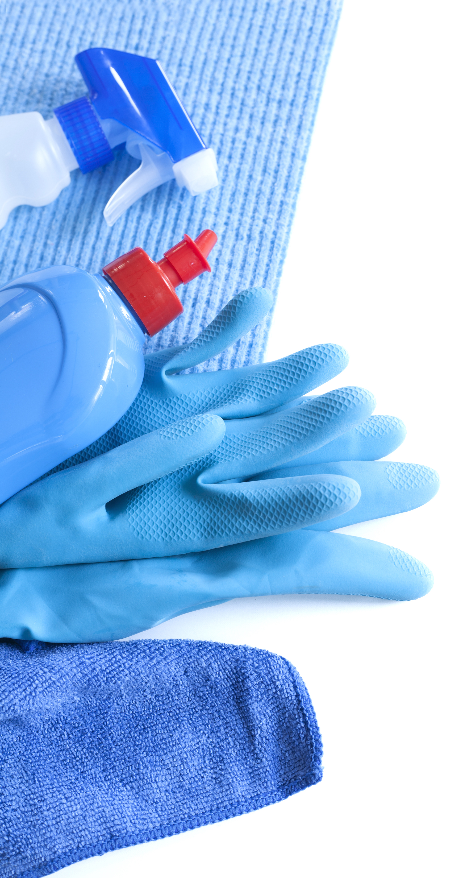
S
A
F
E
- Sanitize
We will make sure your home is completely sanitized after showing.
- Airways
Everyone coming into your home will have their “airways’ covered by wearing a mask. If a buyer doesn’t have one already, one will be provided.
- Footwear
Everyone entering the home will either remove their footwear or wear disposable booties.
- Eyes Only
Prior to showings, all doors and cabinets will be opened so buyers will not touch any service. In addition, everyone will wear sterile nitrile gloves which will be provided.

