Slide 1
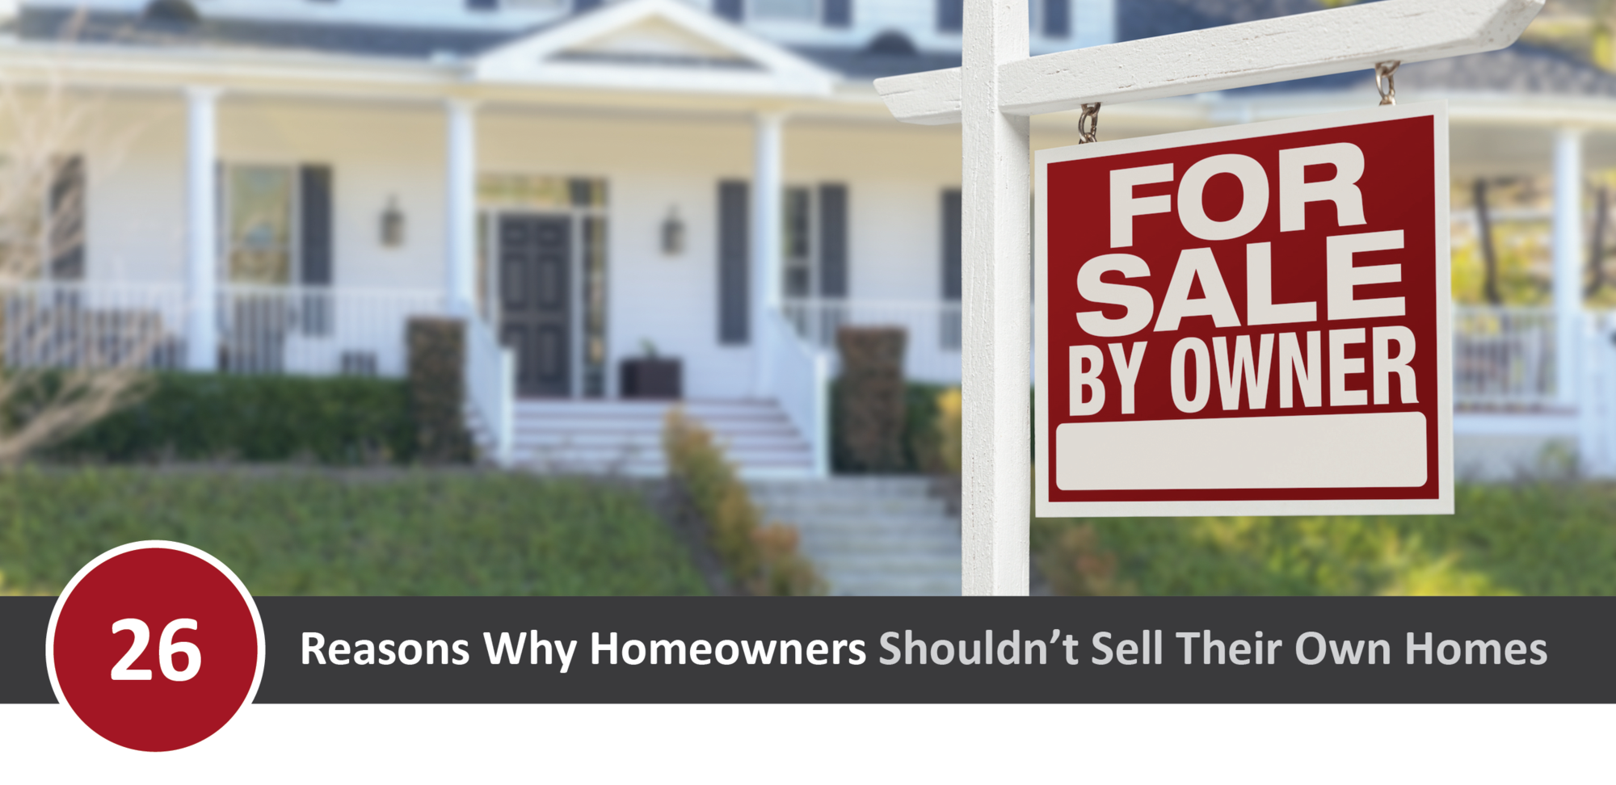
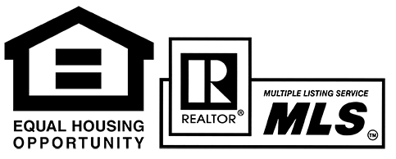
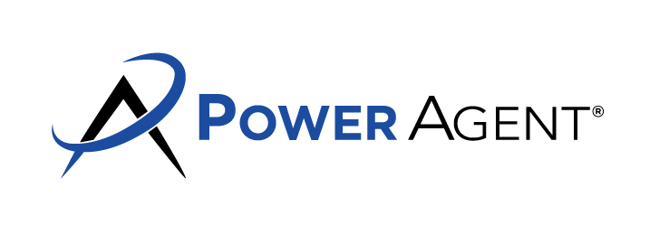
26 REASONS WHY HOME OWNERS SHOULDN’T SELL THEIR OWN HOMES
What you save in commission, you’ll lose in sales price. Statistically, agent-assisted homes sell for more.
You run the risk of underpricing in a competitive market and selling for less.
There’s a danger of overpricing, which will cost time, exposure, and potential a sale.
Get mostly lookers versus serious pre-qualified buyers.
Difficulty in negotiating.
Not finding out buyers’ hidden objections.
Inexperience in handling objections once you find out what they are.
Create an urgency situation for yourself (i.e. if a listing agent is hired at the last minute, the house may not sell in time, forcing you to own two homes or giving the house away).
Problems in financing – types of mortgages, where to go, creative financing, etc.
Lack of several different marketing tools – people don’t buy from specific ad.
Little or no advertising or internet exposure.
No follow up system to showings (i.e. broker call backs).
Buyer must sell his own house before he buys – we can work this out.
Marketing expenses.
Lack of home selling experience.
Buyers’ reluctance on inspection details.
Don’t know how to justify the asking and selling price to the buyer and to the bank.
Not being at home and missing “A+- Buyers”.
Allowing complete strangers have access to home.
People drive by and not keeping their appointment.
Buyers may become interested later and not remembering to follow-up.
Buyers take owners’ point-of-view with “grain of salt”.
Processing, settlement, closing problems – broker takes care of.
How long on market.
Handling legal matters safely.
Time. It takes a considerable amount of time to get the most return for your investment. For busy consumers, that’s difficult.
Agent Information Here.

