Slide 3
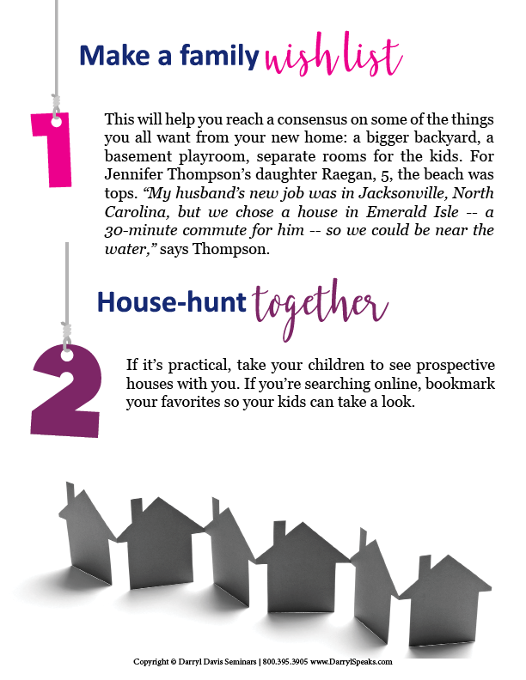

Slide 4
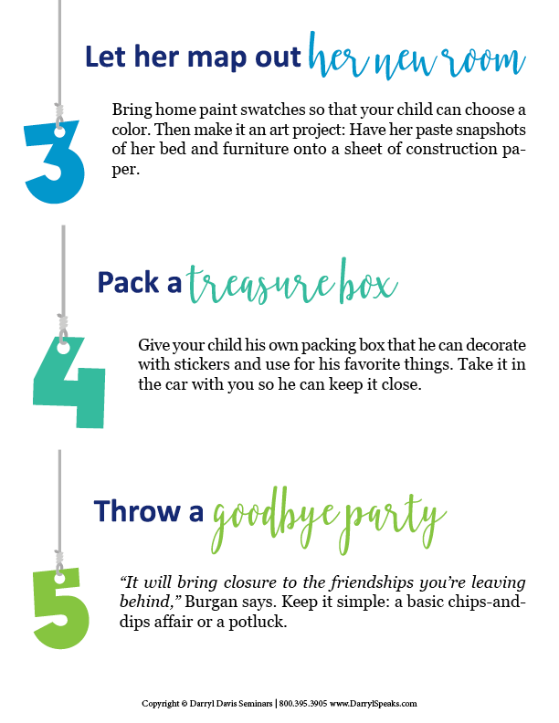

Slide 13
Agent Contact Info / Photo(s) Here.

