Slide 1
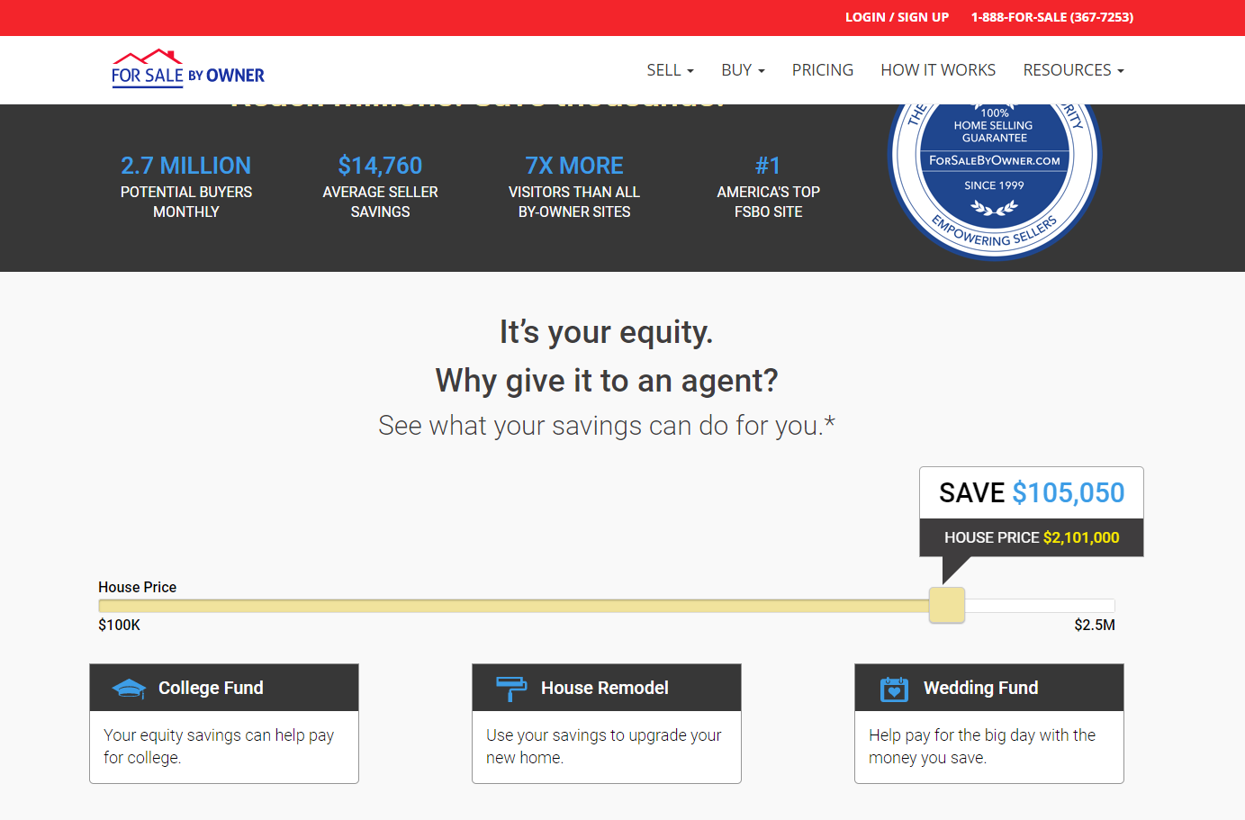
Your site here

Slide 2
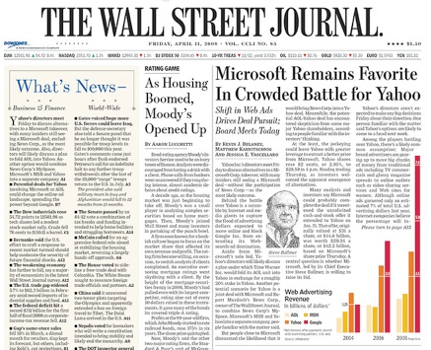
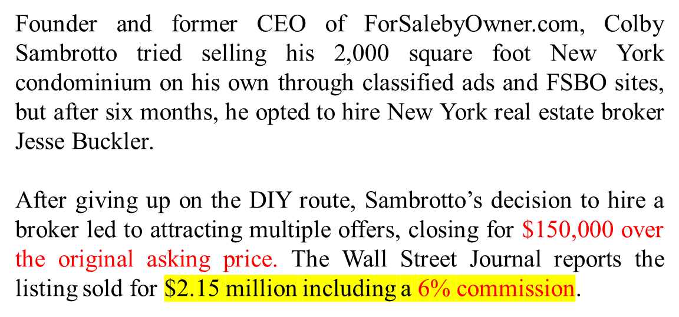
$129,000 Commission
Article appeared August 23 , 2011

Slide 3
$129,000
Commission
Your site here

