Slide 1
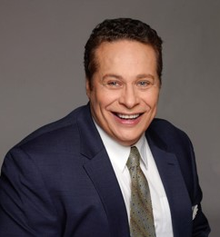
THANK YOU TO OUR VALUED CLIENTS FOR HELPING US SELL (# HERE) HOMES THIS YEAR!
Darryl Davis
REALTOR®
555.555.5555
Darryl@DarrylSpeaks.com
POWER AGENT REALTY
123 Main Street
New York, NY 55555
(REPLACE WITH YOUR
PHOTO AND INFO)
Replace Darryl’s info with your own, then remove this message.

