Slide 1
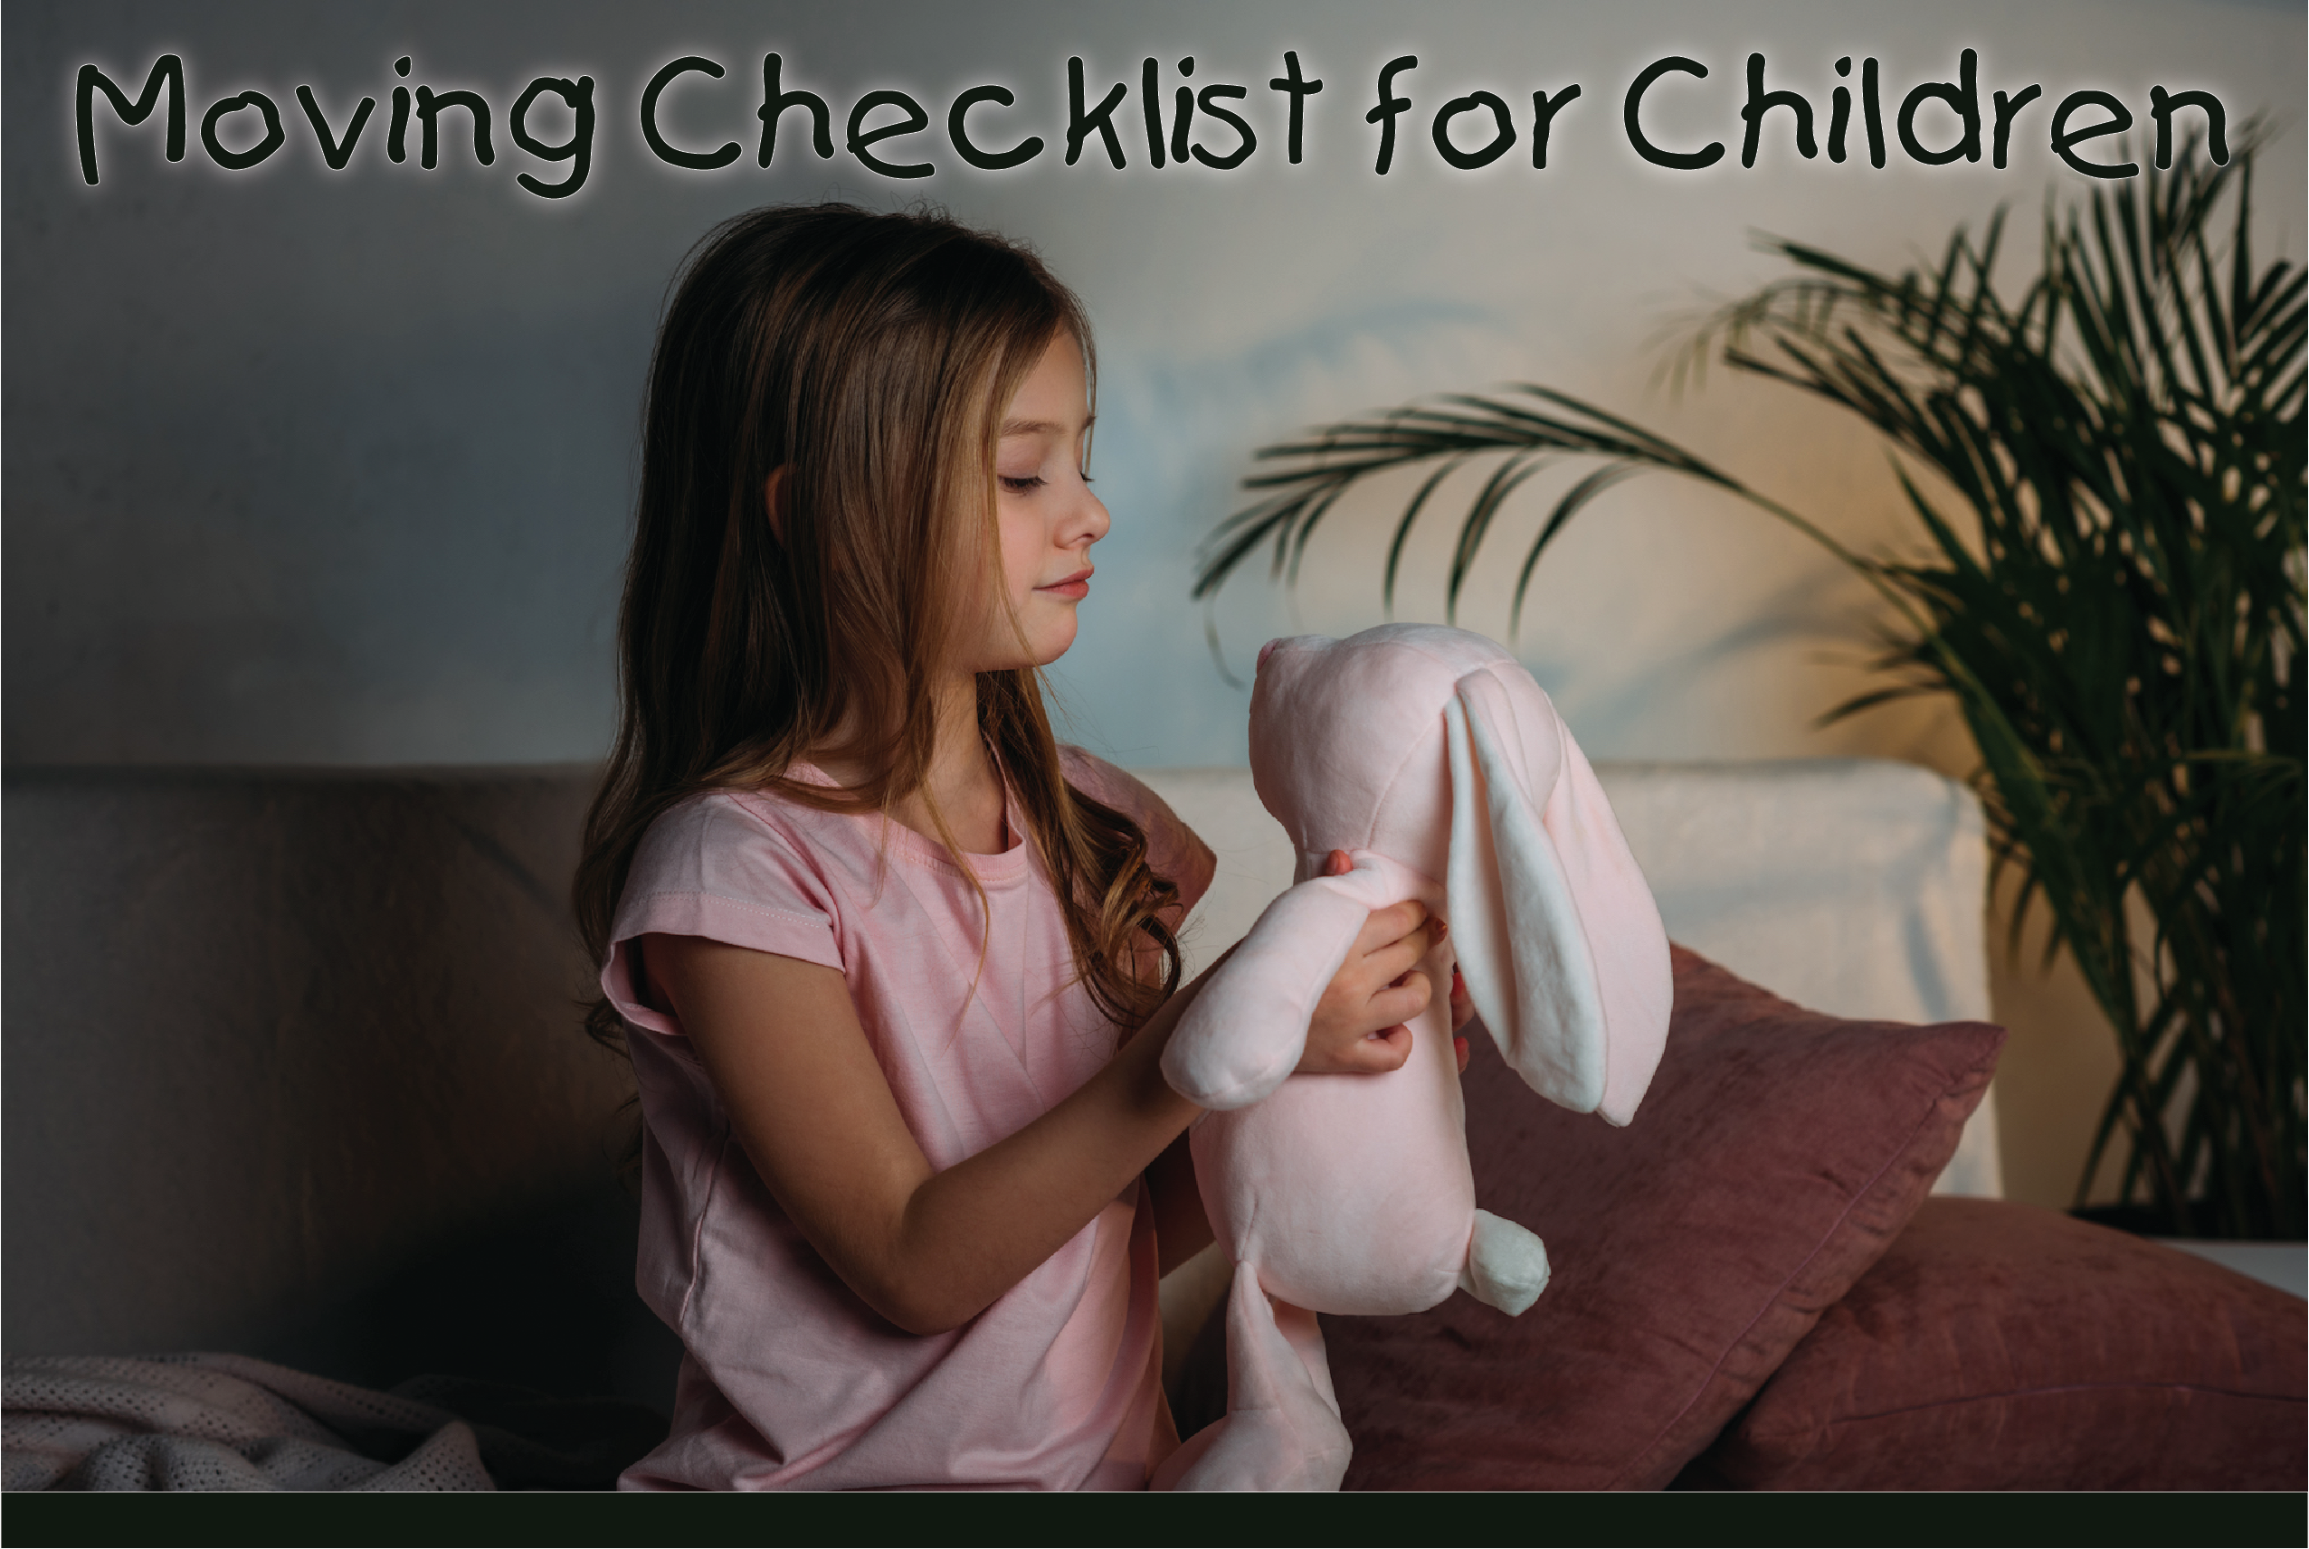
As you travel on the plane or in the car to your new home, bring your favorite stuffed animal to keep you company.
Remember a nightlight or flashlight for the hotel room.
Make sure that you have your favorite bedtime stories.
Bring a small bag of toys, games, coloring books, and crayons, maybe even a puzzle, to keep you busy while Mom and/or Dad helps the packers unload the van at your new house.
When the movers pack your belongings, have them label your boxes with your name so you'll know where your special things are.
Have Mom or Dad take some pictures of your best friends, and take these photos with you to your new home. This will help you from being lonely until you make new friends in your new neighborhood.
Give your pets some hugs, and take good care of them during the move. Reassure them that they'll like their new house.
Tell your friends you are moving, and get their addresses and phone numbers so you can write to them or give them a call.
Say goodbye to your teachers, and let them know you learned a lot from them.
Remember, moving can be an adventure! Put on a happy face, and understand that everyone wants you to love your new house and neighborhood.
Agent Contact Info / Photo(s) Here.

