Slide 1
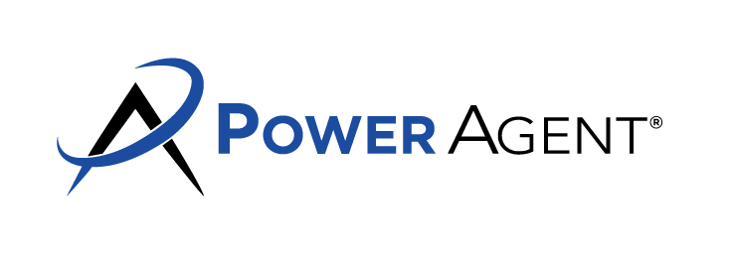
Sell It FAST! Sell It For MORE!
When your home is a part of our SMOOTH-MOVE Program,
you can relax about your home sale!
Here's Why:
You'll get more money. for your home in a shorter time with fewer problems You'll know that your buyer is qualified before you sign the contract
You'll have no worries about hidden property defects that might spoil your sale and/or eliminate your profit!
You'll avoid last minute hassles and sleepless nights that could be brought on by unexpected problems
You'll save money because minor repairs can be completed upfront, avoiding expensive last minute overtime charges
You'll eliminate the risk of losing your buyer to the anxiety inevitable
when an inspector fields problems after the contract is signed.
More Good News:
My SMOOTH-MOVE Program doesn't cost-IT PAYS! So problem-proof your next home sale, Call Sandra Nickel today and look forward to a SMOOTH-MOVE!
The SMOOTH-MOVE Program Includes:
A preliminary professional inspection of your roof. foundation, plumbing and electrical systems
Servicing and inspection of your heating and cooling system
Cleaning and inspection of your chimney
A preliminary professional inspection for termites and other wood destroying insects
A detailed checklist you can use to check out your appliances, doorbell, and many other minor systems
Any problems revealed by these inspections can be solved before they hurt your sale with an incurable case of Buyer's Remorse. The total $350 you'll invest in protecting your home sale is money you'd probably spend anyway after the contract is signed. Call or text me today to learn about my SMOOTH-MOVE Program!
Agent Contact Info Here.

