Slide 1
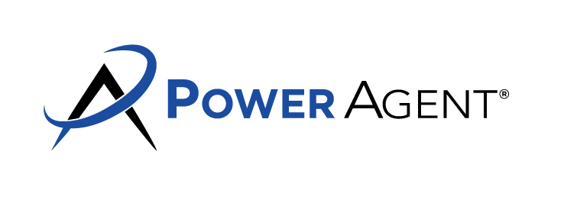
Are you thinking about selling your home? Pricing your home right is the key to getting top dollar on your sale. Overpricing your home is tempting, but can lead to a shopworn listing and reduced sales proceeds.
Here’s why I recommend you competitively price your home:
It makes your home visible to the right buyers. Buyers and their agents search for homes by price range. By pricing your home competitively, you make your home visible to the right buyers.
You’ll catch the peak period of buyer activity. Homes attract the most buyers when they first hit the market. After a couple of weeks, showing activity is reduced to the new home buyers just entering the market. A common misconception by home sellers is that they can start high, and come down later. However, this strategy causes them to miss the best chance for the highest sales price.
You’ll sidestep the staleness. A home that doesn’t sell right away has something wrong with it. The offers made on homes after extensive days on the market are typically much lower than offers received in the first few days. Buyers assume that sellers become more desperate to sell the longer a home sits on the market, causing buyers to become more aggressive in their negotiating.
It eliminates the never-ending hassles of selling. Longer marketing time means more showing appointments and additional efforts to get your home sold. You will also have to maintain it in “showing condition” for a longer period of time.
Don’t help the competition. Comparable homes for sale at lower prices will seem more attractive to potential buyers.
A smooth loan process. Even if a buyer agrees to pay an above market price, the appraisal required by the buyer’s lender may come in short, leading to a canceled sale.
For more information on how to beat out competing sellers and maximize your profit, call me!
I’ll market your property to get you top dollar!
Agent Contact Info Here.

