Slide 1
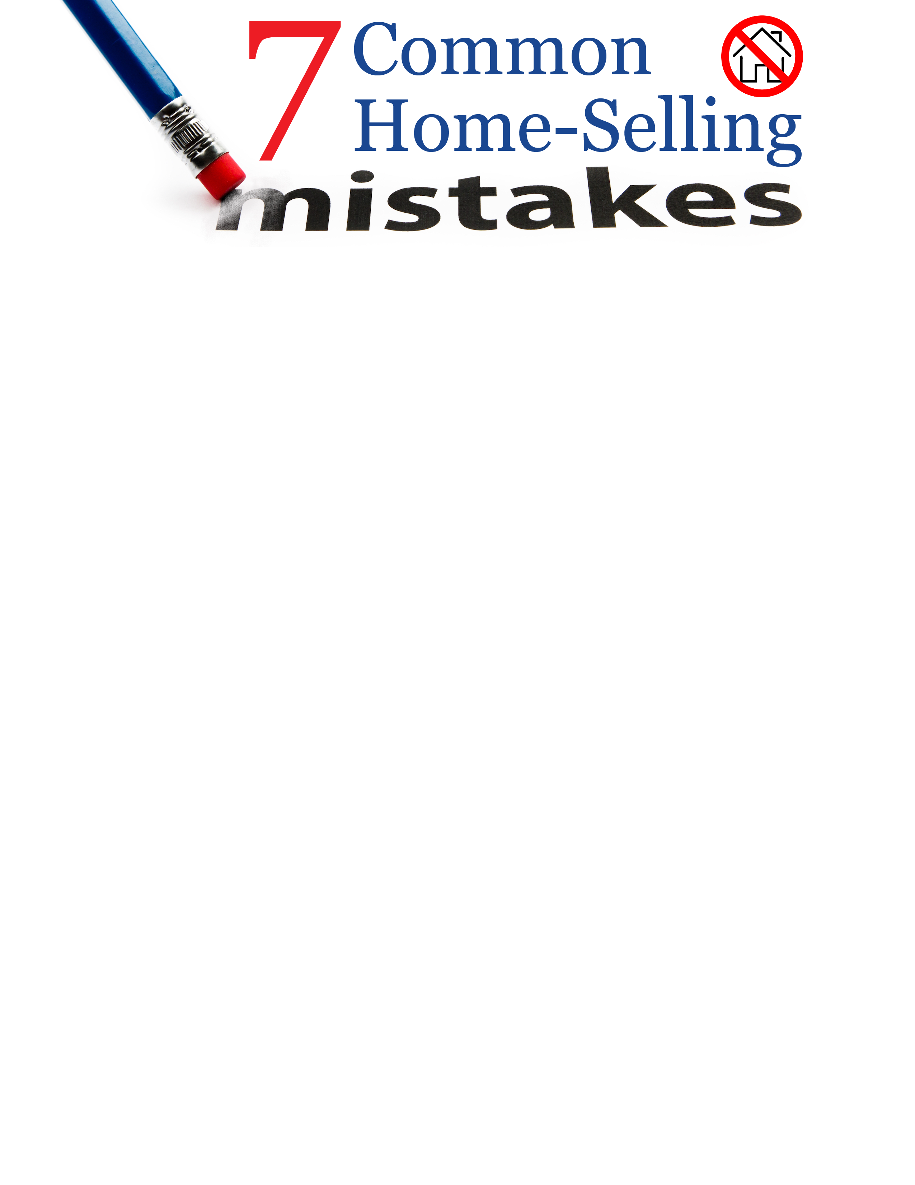



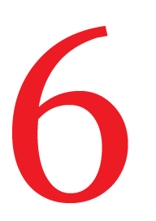
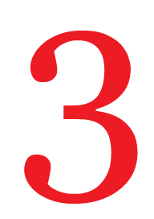

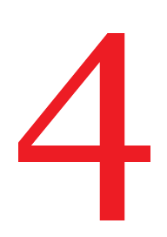



Pricing the Home without Doing Your Homework. Checking listing estimates or the price of homes in your area is not the only way to price a home. Home prices can vary based on market inventory, time of year, recent sales and more. To conclude on a reasonable price, request a comparitive market analysis.
Pricing Too High. Based on statistical data, overpriced homes bring in fewer showings. Correctly priced homes tend to sell closer to asking price than homes that are listed too high.
Pay Attention to Numbers. Choosing a listing price that has a lot of numbers in it (ex: 250,499) may cost you some potential traffic and customers. Websites that buyers use to find homes usually contain specific ranges such as $200,000-$250,000.
Having Time to Sell. Even if you are not in a rush to sell your home, pricing it high will necessarily end in the biggest bang for your buck. Interest in homes is greatest during the first few weeks of listing. The longer the home is on the market, the less likely the home is to have showings and the greater the chance of having to lower your price to sell.
Emotional Management. Home sales are business transcations. Yes, your home holds great significance and value to you. But a low offer does not mean that your home is worth any less. Do not get offended by low offers. Instead, up your negotiation.
Do the Work. Even if your home is a “diamond,” you still need to do your part in making sure it is clean, clutter-free and shows well. Stage your home, clean the yard, and do any necessary maintenance. If you want your home to sell quickly at a good price, stay on top of how it looks to buyers.
Going Solo. The National Association of REALTORS® states that homes for-sale-by-owner tend to stay on the market longer and sell for $39,000 less than homes sold with the help of a real estate professional.
Agent Contact Info Here.

