Slide 3
Understanding the Housing Market
Real Estate Market Cycles
Is Now a Good Time to Sell?
Putting Your Home on the Market
Should You Hire a Real Estate Professional?
Who is Involved in the Sale of Your Home?
How to Determine the Correct Asking Price
The Best Pricing Strategy for Selling Your Home
Preparing Your Home for Sale
Looking at Your Home Through a Buyer’s Eyes
Common Home Improvements to Consider
Attracting Buyers
Technology for Selling Virtually
04
In-Person Showings of Your Home
Closing the Sale
Accepting the Offer
Home Inspection & Appraisal
Closing Costs
The Final Transactions
Moving
Arranging for Another Move
Moving Checklist
Tips for Helping Children with a Move
Building an Ongoing Relationship with Clients
A Resource You Can Trust and a Commitment You Can Count On
27
30
06
31
07
32
08
32
09
33
34
14
35
16
36
40
19
41
20
21
42
23
25
26
web address here
email address here

Slide 4
web address here
email address here

Slide 5
web address here
email address here

Slide 6
web address here
email address here

Slide 7
web address here
email address here

Slide 8
web address here
email address here

Slide 9
web address here
email address here

Slide 10
web address here
email address here

Slide 11
web address here
email address here

Slide 12
web address here
email address here

Slide 13
web address here
email address here

Slide 14
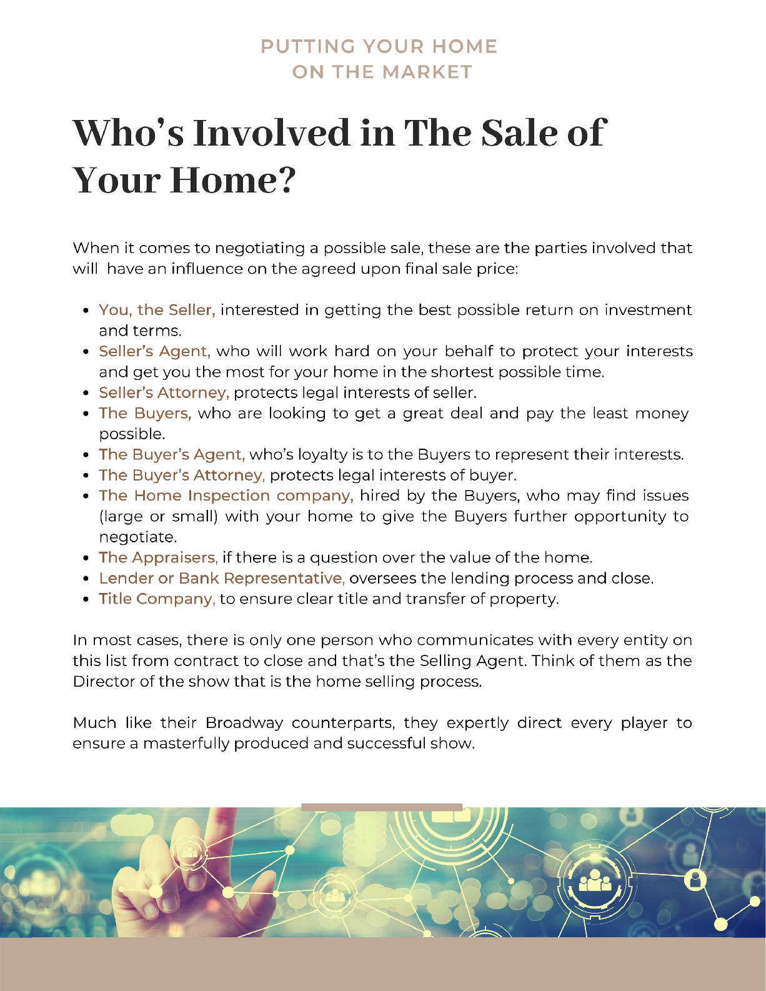
web address here
email address here

Slide 15
web address here
email address here

Slide 16
web address here
email address here

Slide 17
web address here
email address here

Slide 18
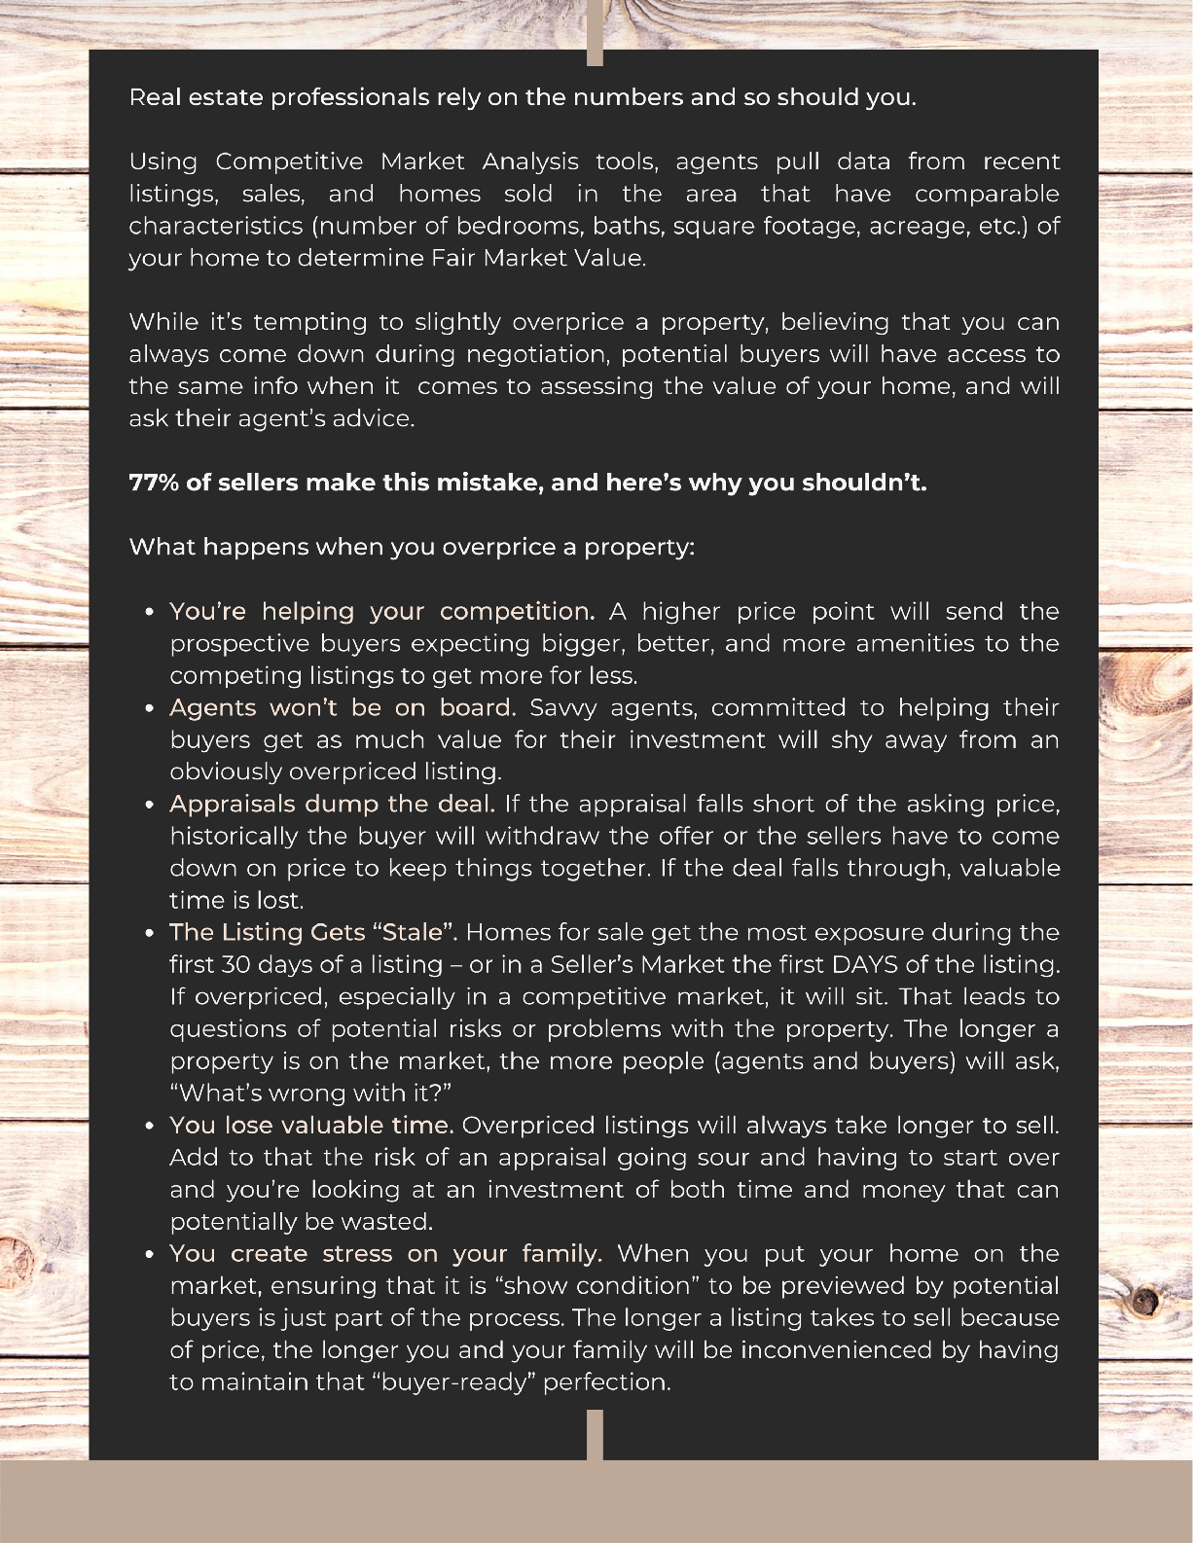
web address here
email address here

Slide 19
web address here
email address here

Slide 20
web address here
email address here

Slide 21
web address here
email address here

Slide 22
web address here
email address here

Slide 23
web address here
email address here

Slide 24
web address here
email address here

Slide 25
web address here
email address here

Slide 26
web address here
email address here

Slide 27
web address here
email address here

Slide 28
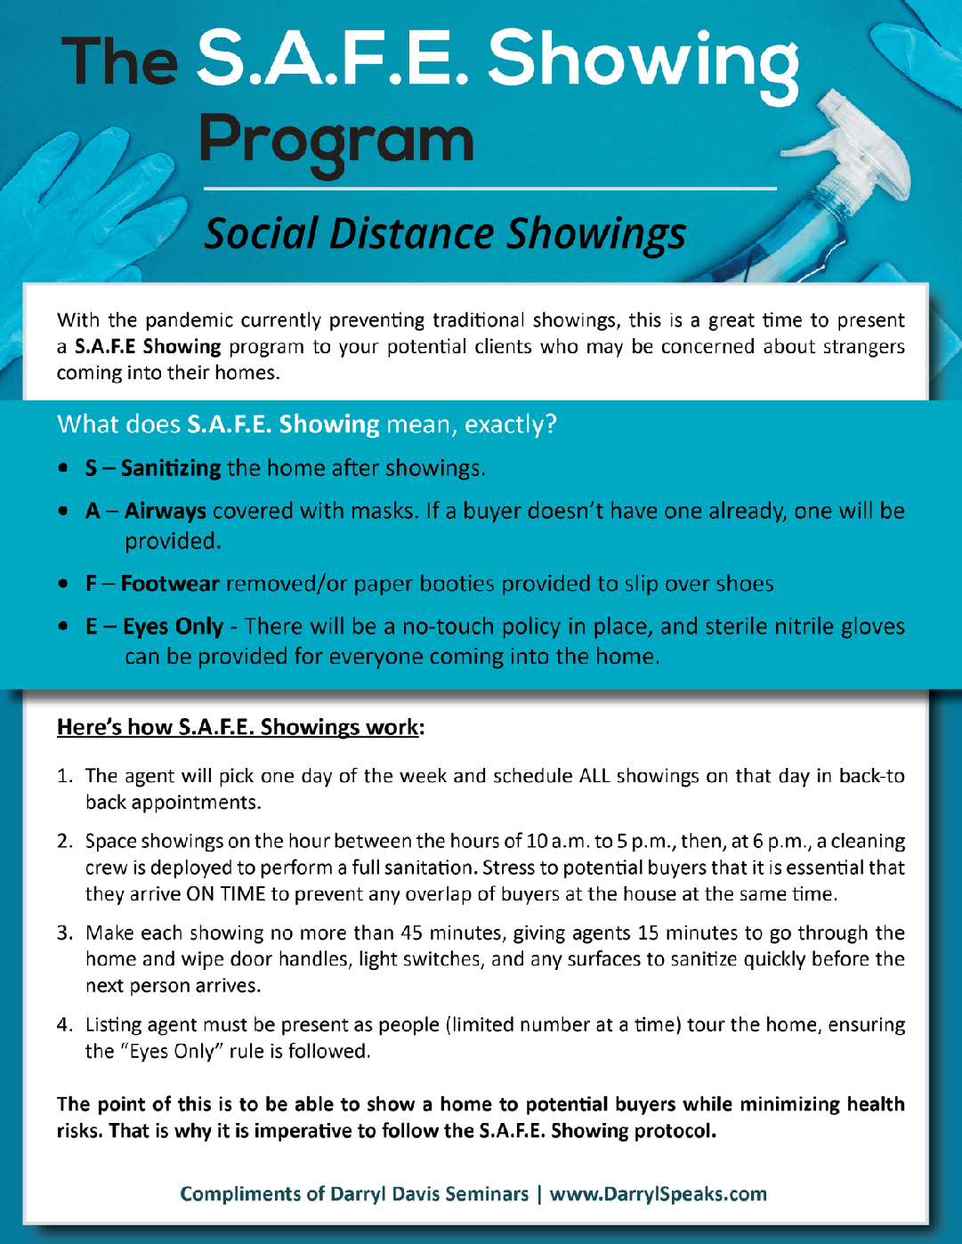
web address here
email address here

Slide 29
web address here
email address here

Slide 30
web address here
email address here

Slide 31
web address here
email address here

Slide 32
web address here
email address here

Slide 33
web address here
email address here

Slide 34
web address here
email address here

Slide 35
web address here
email address here

Slide 36
web address here
email address here

Slide 37
web address here
email address here

Slide 38
web address here
email address here

Slide 39
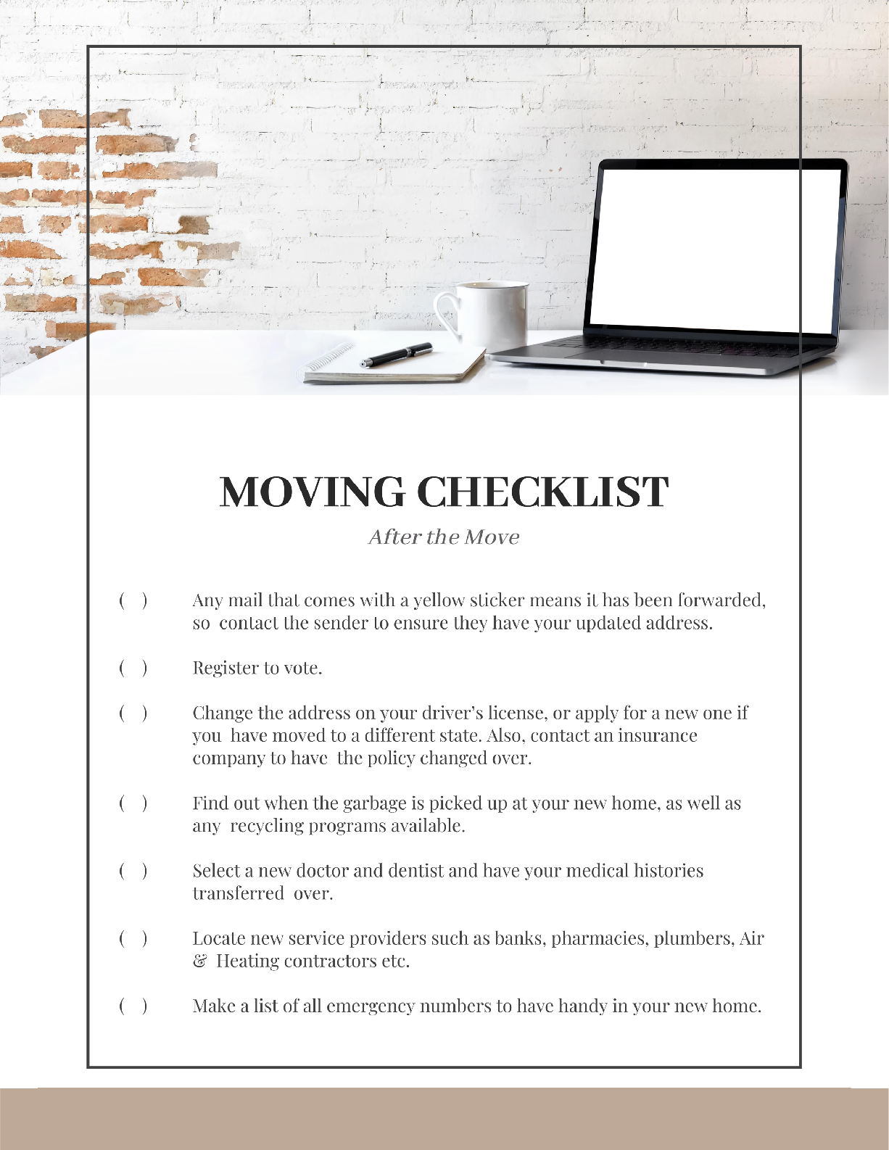
web address here
email address here

Slide 40
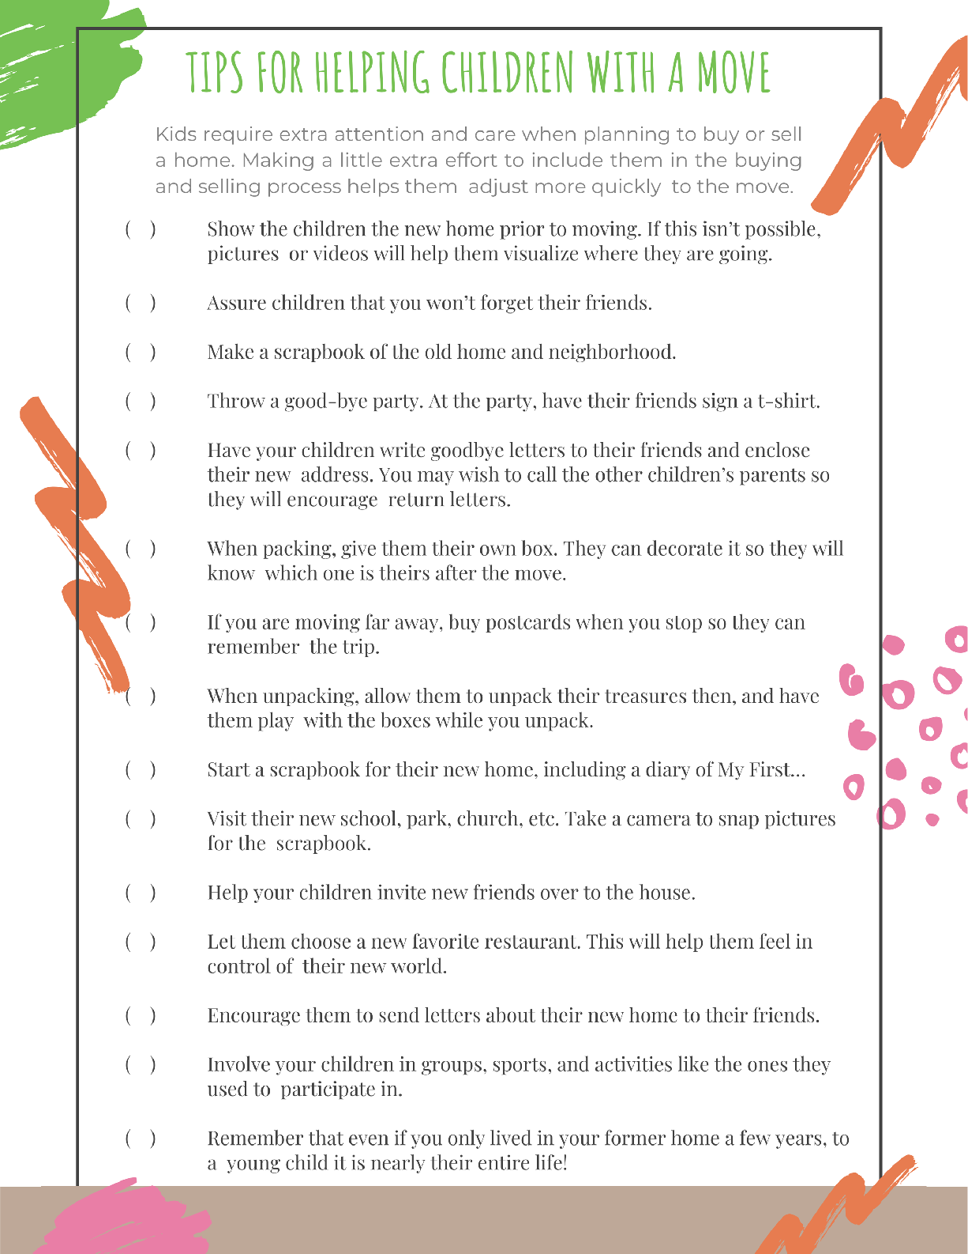
web address here
email address here

Slide 41
web address here
email address here

Slide 42
Your signature here
web address here
email address here

Slide 43
Name Here
Title Here
Office Name
Office Address
Phone Number
Email Address
Web Address
Find me on Social:
#handle
#handle
#handle
#handle
#handle

