Slide 1
Seasonal Photos
Limit
Decor
Consider taking some photos of the exterior of the home during the year, when landscaping is in full bloom for Buyers to see.
Go light on Christmas decorations to keep it tasteful and generic enough that buyers may enjoy.
Heat it Up
Clear the Walkways
Keep the heat on so that Buyers have a warm and cozy home to walk into when it is cold outside.
Make sure to shovel walkways and driveway so it is safe for guests and looks good.
Light the Way
During the winter, it gets dark earlier. Buyers may be coming later on in the evening for showings so use brighter bulbs throughout the house or add more lighting.

Slide 2
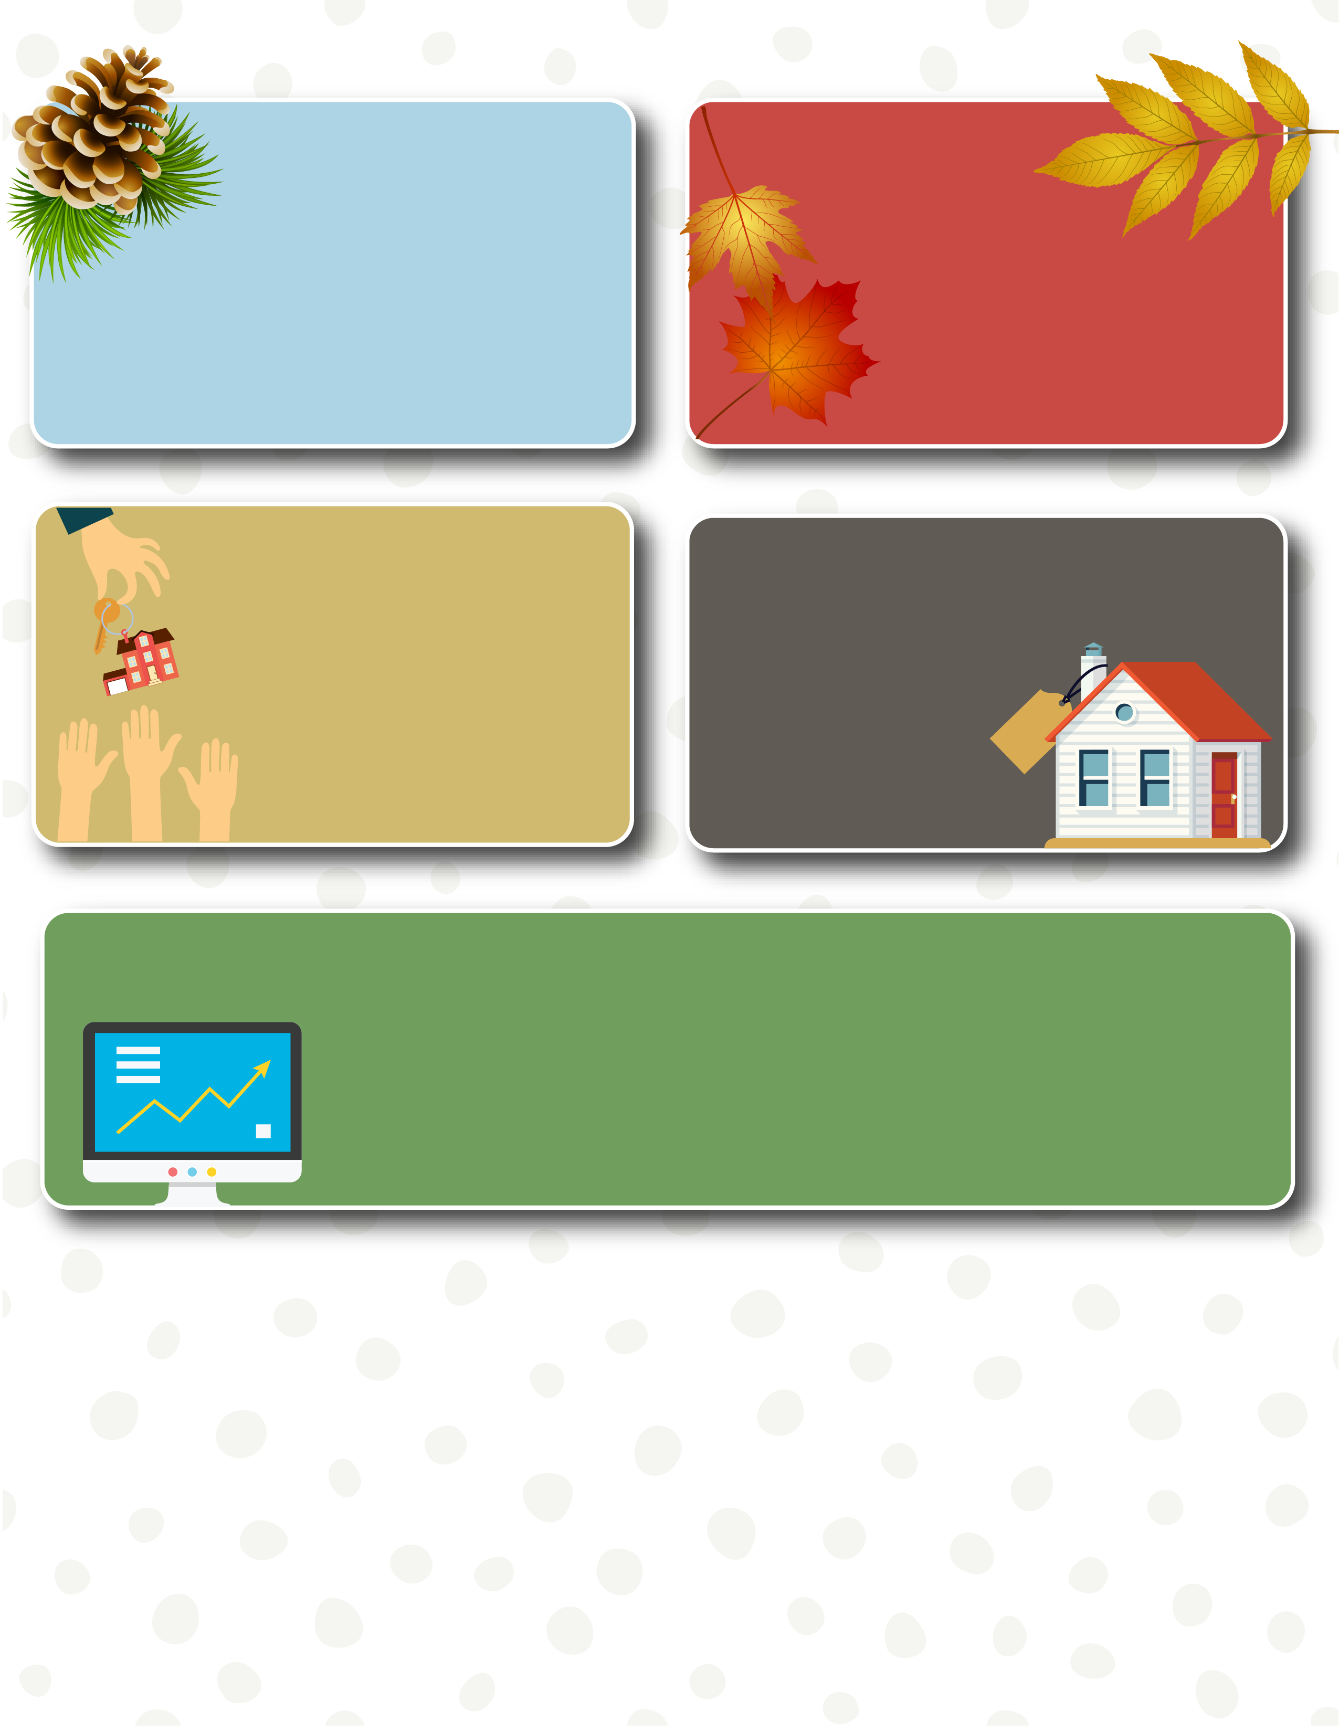
Scents Abound
Clean Up
Add some cinnamon scented pine cones, fresh cut pine or balsam, or the smell of gingerbread. Yummm.
Rake leaves around the property or mulch them with the lawnmower.
Serious Buyers
Less Competition
Many buyers will wait until spring or summer to find a home. The buyers out looking during the winter tend to be more serious.
Statistics show there are fewer listings in the winter, which means there’s less competition out there for you.
Price it Right
Be careful not to overprice your home during the winter months. Pricing too high can cause you to run the risk of your home sitting on the market for months and possibly losing money from price reductions.
According to USNews.com, as housing markets continue to struggle for enough inventory to meet buyer demand and prices continue to rise, serious homebuyers are widening their scope and choosing to shop throughout the year, not just during the warmer months.
For help buying or selling, I’m only a phone call away!
Agent Contact Info / Photo(s) Here.

