Slide 14
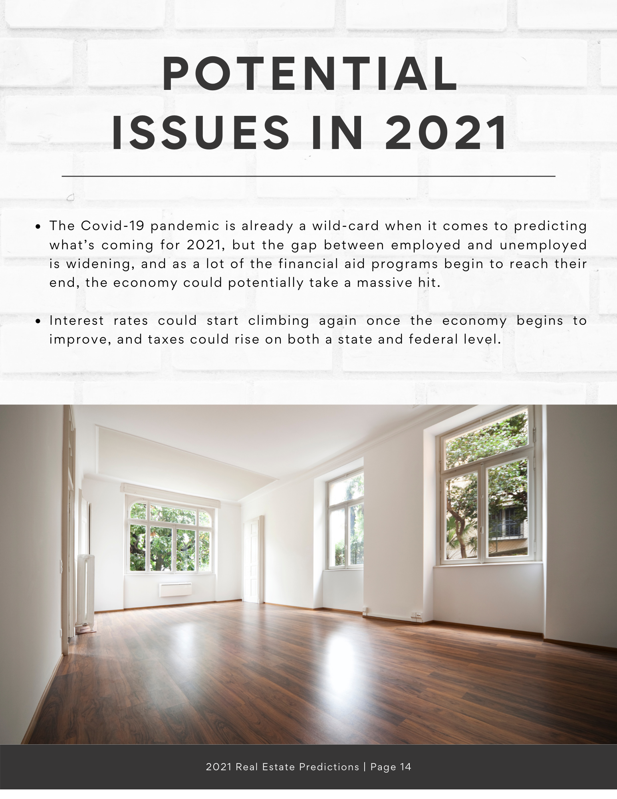

Slide 15
Name Here
Title Here
Office Name
Office Address
Phone Number
Email Address
Web Address
#handle
#handle
#handle
#handle
#handle

