Slide 3
Understanding the Housing Market
Real Estate Market Cycles
Is Now a Good Time to Sell?
Putting Your Home on the Market
Should You Hire a Real Estate Professional?
Who is Involved in the Sale of Your Home?
How to Determine the Correct Asking Price
The Best Pricing Strategy for Selling Your Home
Preparing Your Home for Sale
Looking at Your Home Through a Buyer’s Eyes
Common Home Improvements to Consider
Attracting Buyers
Technology for Selling Virtually
04
In-Person Showings of Your Home
Closing the Sale
Accepting the Offer
Home Inspection & Appraisal
Closing Costs
The Final Transactions
Moving
Arranging for Another Move
Moving Checklist
Tips for Helping Children with a Move
Building an Ongoing Relationship with Clients
A Resource You Can Trust and a Commitment You Can Count On
27
30
06
31
07
32
08
32
09
33
34
14
35
16
36
40
19
41
20
21
42
23
25
26
Agent Name here ⋅ (123) 456-7890

Slide 4
Agent Name here ⋅ (123) 456-7890

Slide 5
Agent Name here ⋅ (123) 456-7890

Slide 6
Agent Name here ⋅ (123) 456-7890

Slide 7
Agent Name here ⋅ (123) 456-7890

Slide 8
Agent Name here ⋅ (123) 456-7890

Slide 9
Agent Name here ⋅ (123) 456-7890

Slide 10
Agent Name here ⋅ (123) 456-7890

Slide 11
Agent Name here ⋅ (123) 456-7890

Slide 12
Agent Name here ⋅ (123) 456-7890

Slide 13
web address here
Agent Name here ⋅ (123) 456-7890
email address here

Slide 14
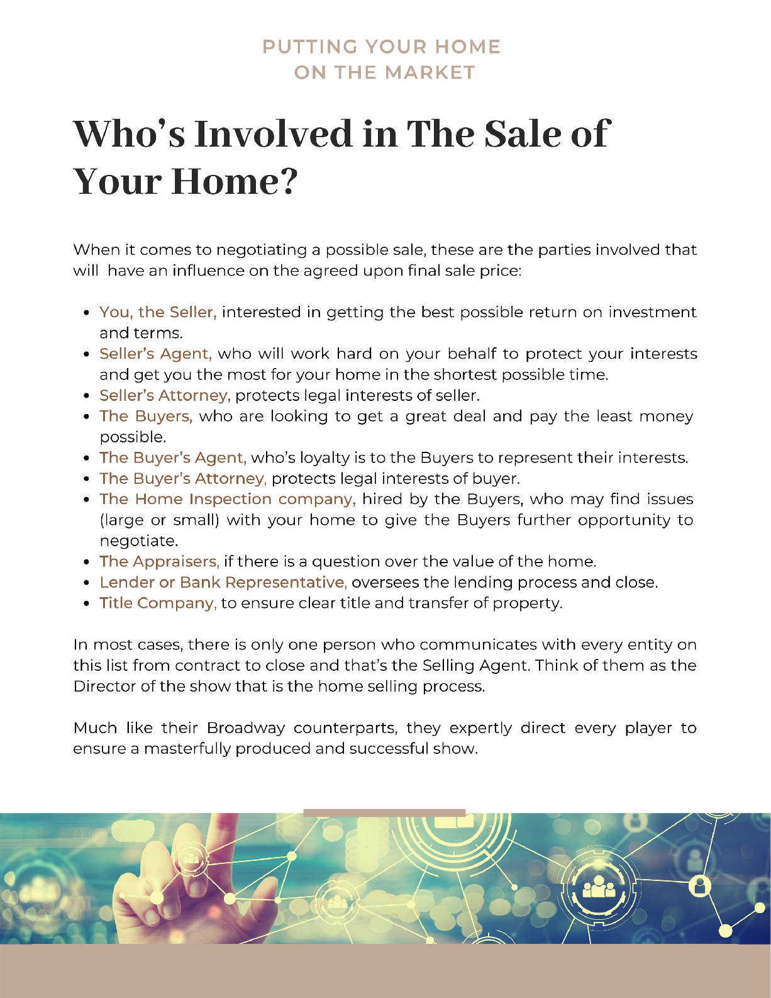
Agent Name here ⋅ (123) 456-7890

Slide 15
Agent Name here ⋅ (123) 456-7890

Slide 16
Agent Name here ⋅ (123) 456-7890

Slide 17
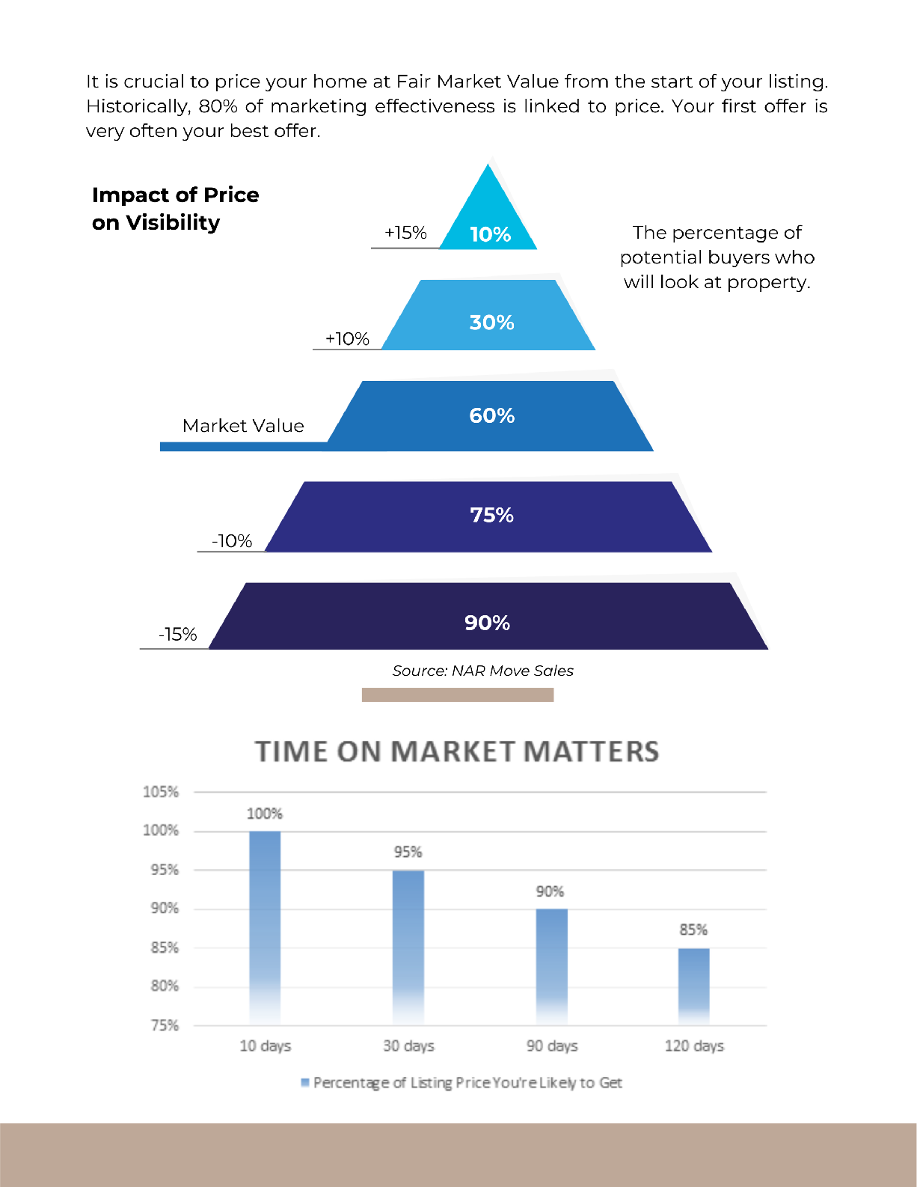
Agent Name here ⋅ (123) 456-7890

Slide 18
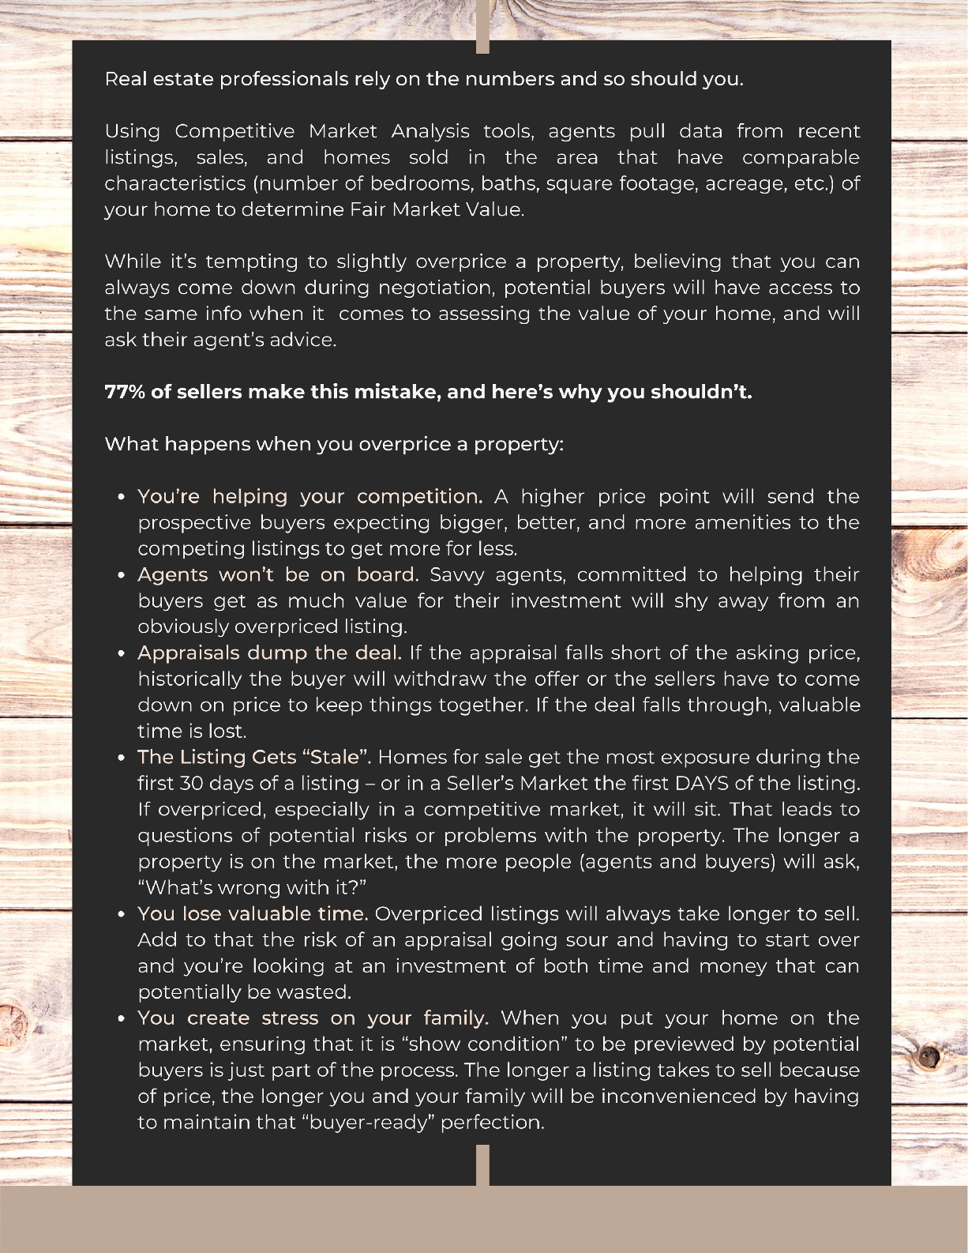
Agent Name here ⋅ (123) 456-7890

Slide 19
Agent Name here ⋅ (123) 456-7890

Slide 20
Agent Name here ⋅ (123) 456-7890

Slide 21
Agent Name here ⋅ (123) 456-7890

Slide 22
Agent Name here ⋅ (123) 456-7890

Slide 23
Agent Name here ⋅ (123) 456-7890

Slide 24
Agent Name here ⋅ (123) 456-7890

Slide 25
Agent Name here ⋅ (123) 456-7890

Slide 26
Agent Name here ⋅ (123) 456-7890

Slide 27
Agent Name here ⋅ (123) 456-7890

Slide 28
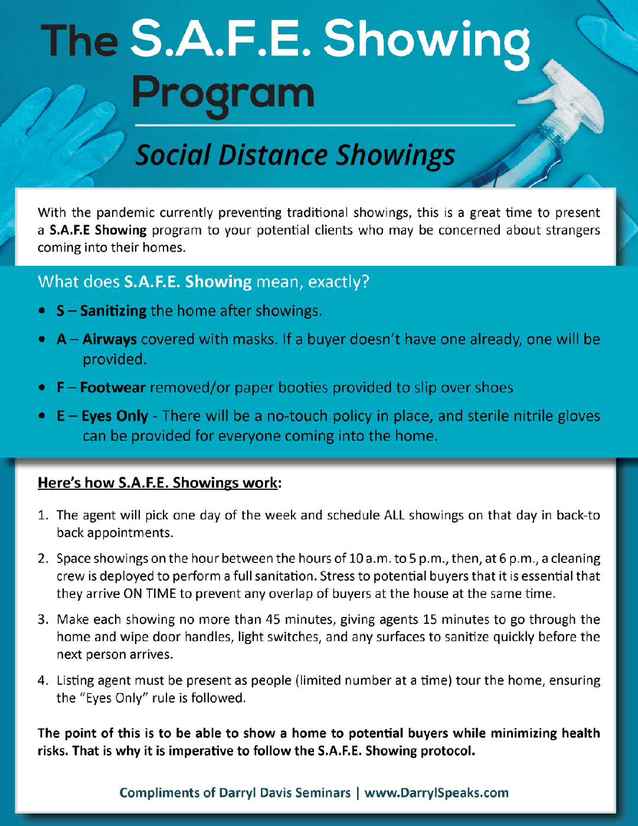
Agent Name here ⋅ (123) 456-7890

Slide 29
Agent Name here ⋅ (123) 456-7890

Slide 30
Agent Name here ⋅ (123) 456-7890

Slide 31
Agent Name here ⋅ (123) 456-7890

Slide 32
Agent Name here ⋅ (123) 456-7890

Slide 33
Agent Name here ⋅ (123) 456-7890

Slide 34
Agent Name here ⋅ (123) 456-7890

Slide 35
Agent Name here ⋅ (123) 456-7890

Slide 36
Agent Name here ⋅ (123) 456-7890

Slide 37
Agent Name here ⋅ (123) 456-7890

Slide 38
Agent Name here ⋅ (123) 456-7890

Slide 39
Agent Name here ⋅ (123) 456-7890

Slide 40
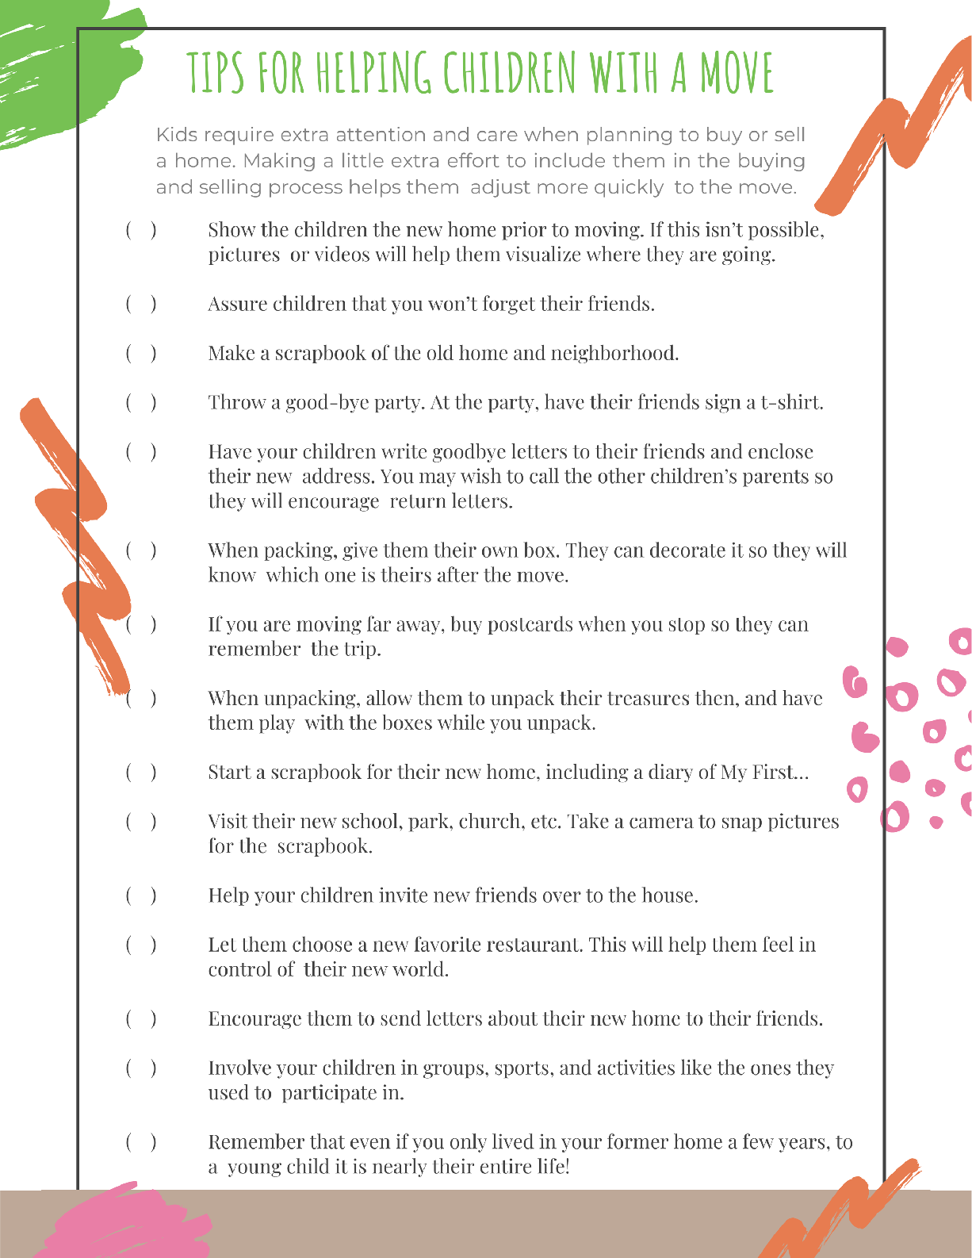
Agent Name here ⋅ (123) 456-7890

Slide 41
Agent Name here ⋅ (123) 456-7890

Slide 42
Your signature here
Agent Name here ⋅ (123) 456-7890

Slide 43
Name Here
Title Here
Office Name
Office Address
Phone Number
Email Address
Web Address
Find me on Social:
#handle
#handle
#handle
#handle
#handle

