Slide 1


Slide 2

Buying a home is a big decision!
Perhaps even more so today, as the housing market and economy are adjusting to the ever-changing circumstances around us. I want you to know that I’m here to help every step of the way.

Slide 3

Understanding the Housing Market
Real Estate Market Cycles
Is Now a Good Time to Buy?
Pre-Purchase Preparation
Are You Ready to Buy?
Get Pre-Approved for a Mortgage
What You Need to Know About Your Credit Score
Hiring a Real Estate Professional
Do I need a Buyer’s Agent?
Who’s Involved in the Purchase
of Your Home?
Let the House-Hunting Begin
Identifying your “Must-Have’s”
and “Nice-to-Have’s”
10 Things to Consider When Choosing Your New Home
Look at Homes!
04
Things to Think About When Considering a Home
Virtual Home Viewing
Explore the Neighborhoods
What If I Want to Purchase a Home Through a Builder?
Make an Offer on The Home of Your Choice
Negotiate the Details with the Seller or Seller’s Agent
Purchasing and Closing the Deal
Have your Home Inspection and Appraisal Done
Secure your Financing
Understand the Closing Costs
The Official Closing
Celebrate and Move In!
Moving Checklist
Tips for Helping Children with a Move
My Commitment to You, the Buyer
22
22
05
23
06
24
07
25
08
09
25
09
26
10
27
13
16
29
29
18
30
19
30
31
20
35
21
37
Agent Name here ⋅ (123) 456-7890

Slide 4

Finding a new home can be an exciting experience, even if the process seems daunting! This guide is for anyone considering the purchase of a new home, particularly those who are first-time homebuyers. If you’re like most people looking to purchase right now, you probably have lots of questions - and I understand! I’ve put together this Buyer’s Guide so you know what to expect, and even more importantly, what to consider while moving forward through the process of buying a home.
This resource guide will explain all the little things that should be considered and completed - from the moment buying a house first enters your mind – right through moving day. I also want to point out the benefits of working with industry professionals to ensure that you (and your future home) are in the best possible hands.
Agent Name here ⋅ (123) 456-7890
04

Slide 5
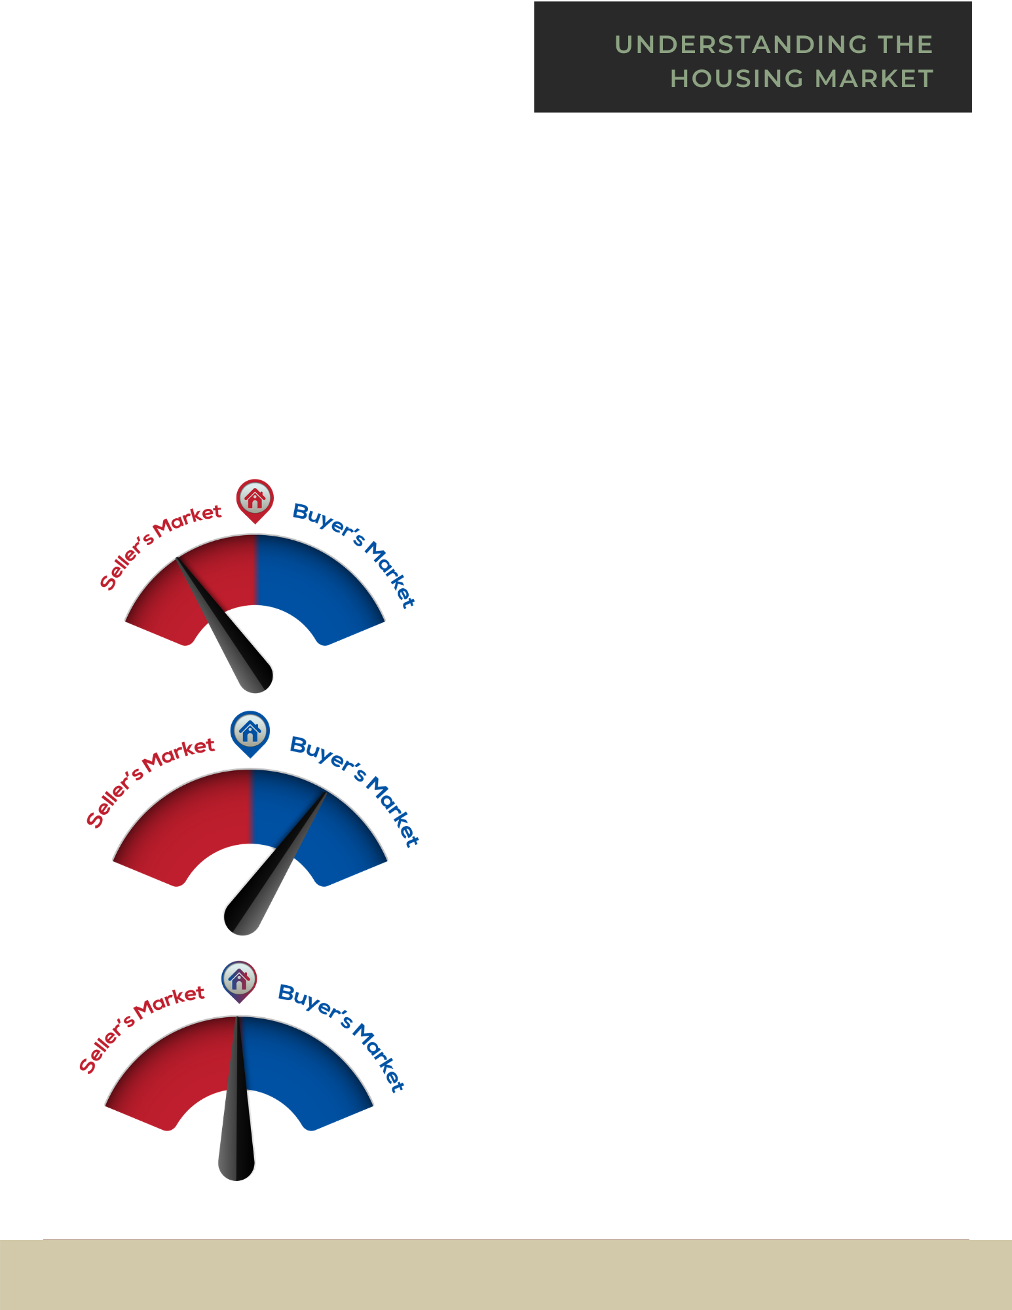
Real Estate Market Cycles
The real estate market is like many things in life and business — constantly changing! That’s not a bad thing! What’s important is to have a resource that you can trust to make sure that you’ve got a solid understanding of what market trends mean for you, and your buying and selling power.
There are three types of real estate markets:
A Seller’s Market
This happens when there are fewer houses on the market and the buyers are the ones competing for the properties. This is often when you see multiple-offer situations, and purchase price sometimes higher, even much higher than the list price. This market favors the sellers.
A Buyer’s Market
This happens when there is a flood of properties on the market and home sellers are the ones competing to attract the attention (and land the contract) from a much smaller pool of buyers. In this market, you’ll see lower price points and terms that favor the buyers.
A Balanced Market
This happens when there is a more even balance between properties for sale and buyers coming into the market. This market is the fairer and more equitable of the three, but is much less common than it’s two counterparts.
Agent Name here ⋅ (123) 456-7890
05

Slide 6

Is Now a Good Time to Buy?
To determine if this is the right time to buy, speak to your real estate professional to find out which real estate market cycle your particular area is leaning towards.
They can provide you with local market statistics, trends, and a current home price evaluation. It’s important to note here that “national” trends don’t always mean we’re seeing the same conditions locally. Every market is different, and ours is no exception to that rule!
A question even bigger than market cycles is: “What is YOUR motivation to buy?” While some conditions may certainly favor buying, I often coach clients to clearly identify what making a move will look and feel like for themselves and their families, as well as keeping an eye on the trends for purchasing.
A good real estate professional will be able to help you fully lay out all of the information so that you have what you need to make the best possible decision for you and your family, both emotionally and financially.
Agent Name here ⋅ (123) 456-7890
06

Slide 7
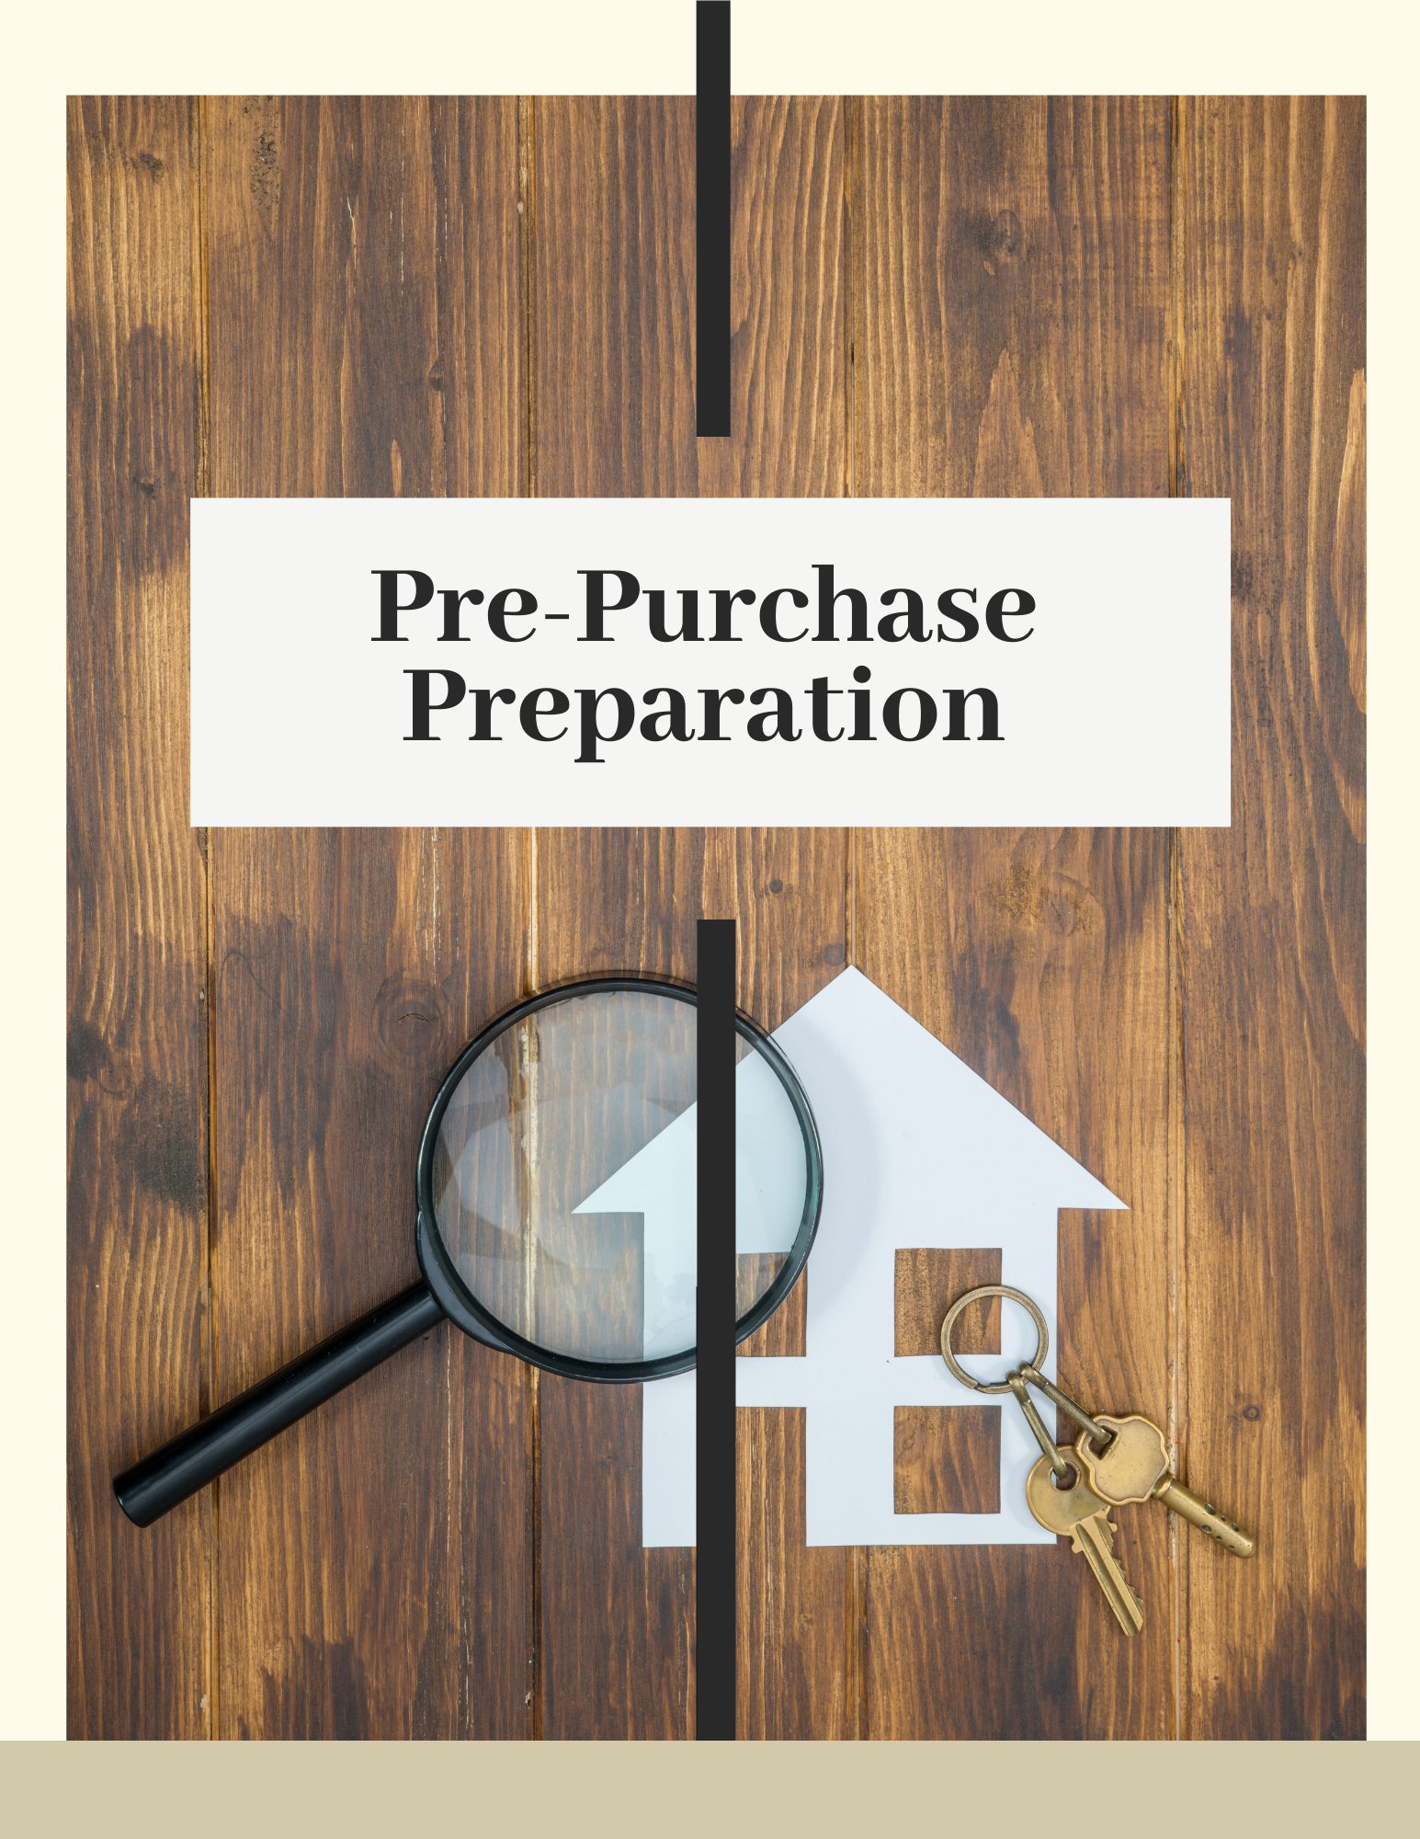
Agent Name here ⋅ (123) 456-7890
07

Slide 8

Are You Ready to Buy?
House-hunting doesn’t start when you begin touring houses. There is a lot of preparation that should be done before you even pick up the phone to call an agent. Not only should you think about what you have to do, there are also things you should avoid doing in preparation for your purchase. These can complicate the mortgage approval process and/or affect your credit rating:
  Don’t make any large purchases that might affect your credit score or debt-to-income ratio.
  Don’t buy new things for your future home - wait until after you close the sale.
  Don’t apply, co-sign, or add any new credit.
  Don’t close or consolidate any accounts/credit lines without advice from your lender.
  Don’t quit or change jobs.
  Don’t change banks.
Agent Name here ⋅ (123) 456-7890
08

Slide 9

Get Pre-Approved for a Mortgage
Finding a lender before you start house-hunting is always a good idea for a few reasons. You will know up front what mortgage amount you are approved for which lets you know how much you can spend on your home, and pre-approval makes the financing part of the process after making an offer flow more smoothly. Many sellers will not even consider offers from a buyer who is not already pre-approved. It also never hurts to get a second opinion from another lender, who may have some suggestions on incentives or rates that your first lender doesn’t have.
Your lender will help you decide how large of a loan you actually want to take out, and will guide you through how your property taxes, homeowner’s insurance and closing costs will be factored into your final numbers.
What You Need to Know About Your Credit Score
While FHA loans technically require a minimum credit score limit of 580, higher scores in the 700+ range will get you better interest rates. Your FICO score will be one of the main determining factors for the type of loan you qualify for, and any increase in the interest rate can affect your overall monthly payment, and also what you end up paying over the life of the loan term.
There is a large disparity in how loans are approved between all the different lenders, so you may need to phone around to see what sorts of loans might be available to you.
Agent Name here ⋅ (123) 456-7890
09

Slide 10
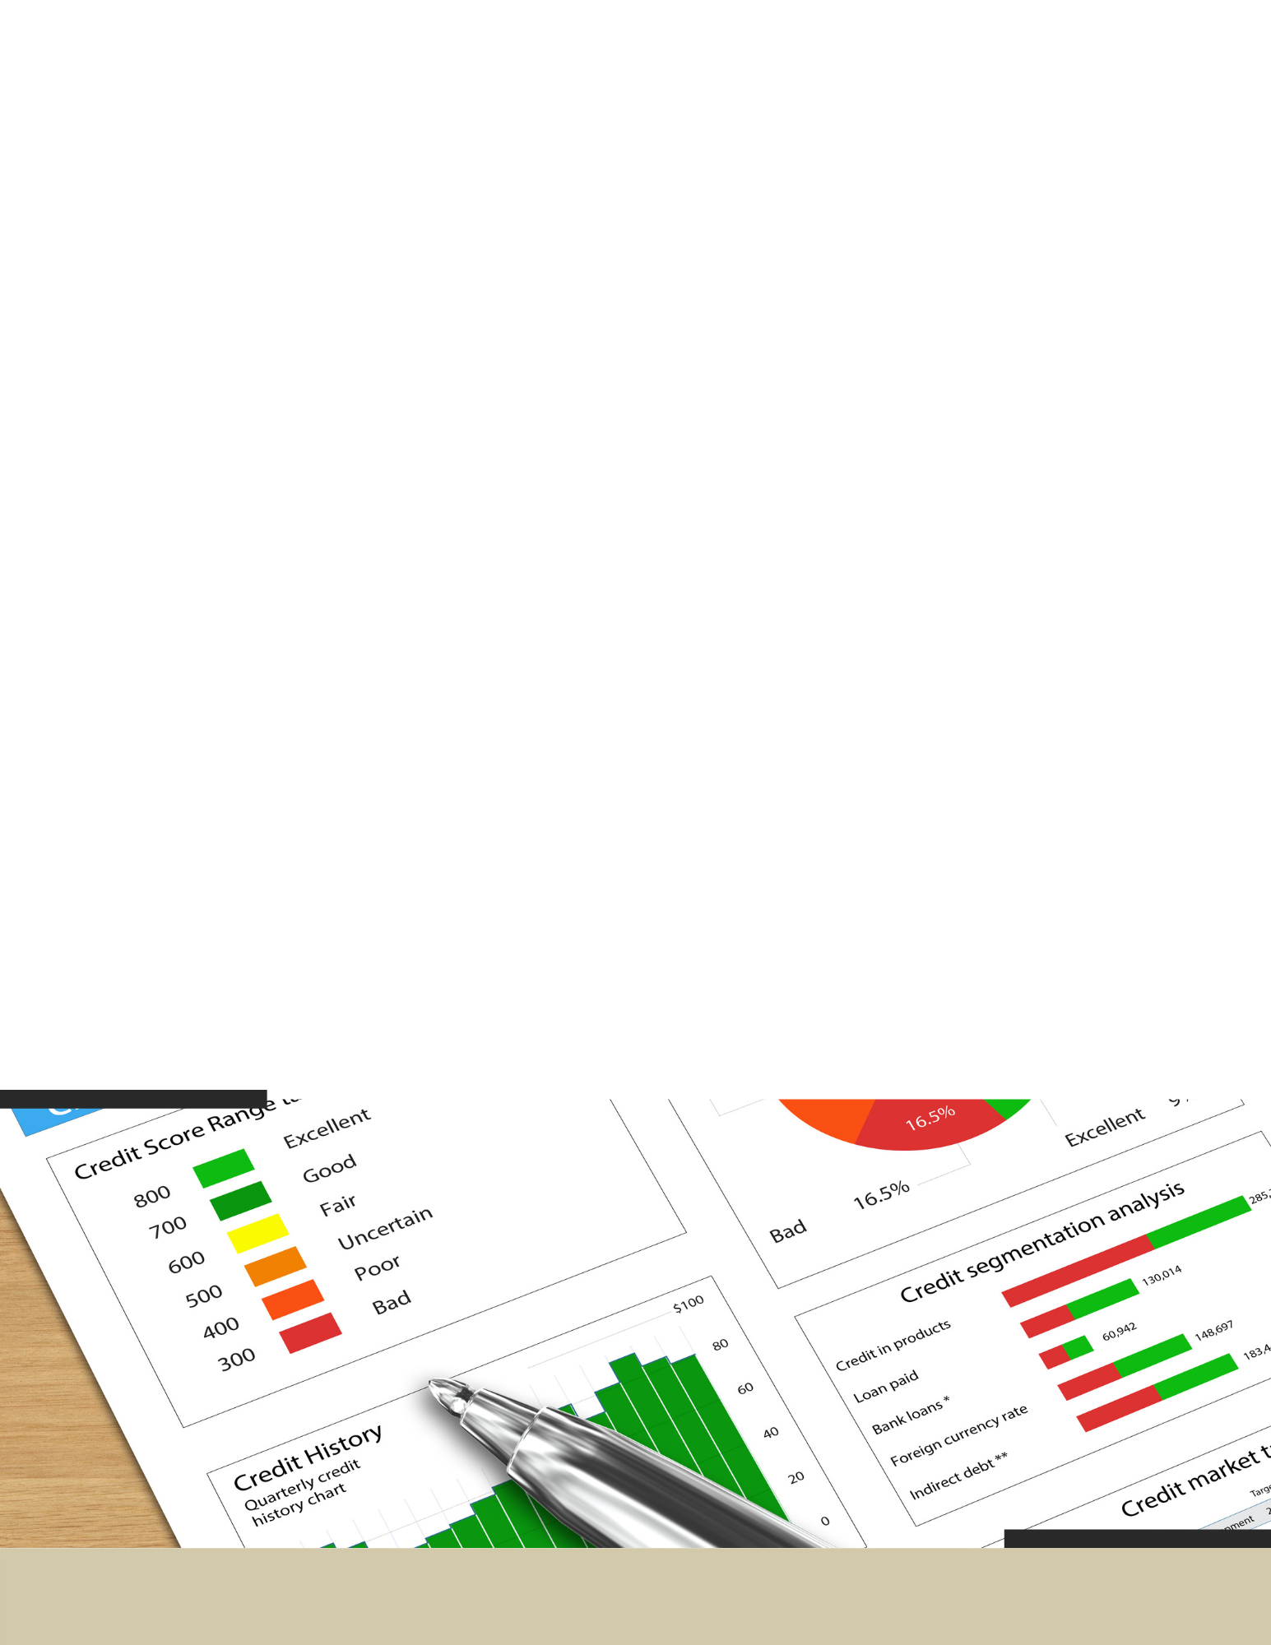
Things That Can Hurt Your Credit Score
  What is your payment history like? Were you prompt with your payments? Late or missed payments will negatively affect your credit rating.
  If you owe more than 33% of your total credit line, that will dramatically lower your credit score. So, a great strategy is to pay down your credit cards below that 33% threshold.
Hiring a Real Estate Professional
A licensed real estate professional will provide much more than the service of helping you find your ideal home. Real estate agents are expert negotiators with other agents, seasoned financial advisors with clients, and superb navigators in the geographic areas they service. A professional real estate agent is your best resource when buying your home.
If that isn’t enough, listen to the 93% of homeowners polled, who agreed that YES, you should absolutely work with a real estate professional through this process!
Agent Name here ⋅ (123) 456-7890
10

Slide 11

They Protect Your Best Interests
Just as you’d turn to a trusted surgeon for a medical procedure or an attorney to help with a legal woe or contract, hiring a professional real estate agent helps to ensure that all your family’s interests are well served. From navigating complicated processes to negotiating on your behalf, it’s important to have an advocate on your side.
They’ve Done the Homework
In the United States, it takes between 60-180 hours of course work before you can even sit for the real estate exam. During that time, we learn principles which include property valuation, escrow procedures, financing, and taxes. We learn state and federal law which includes writing binding contracts and leases, titles, liens and encumbrances, unlawful discrimination. We then learn safe and fair practices for working with sellers and buyers that include communication skills, marketing, pricing, and a wide spectrum of necessary technology and tools needed to list and sell real estate in today’s world.
Standards Matter
There is a difference between just being a licensed agent and being a REALTOR®. A Realtor® is a real estate agent who is an active member of the National Association of Realtors®, which was founded in 1908, and is one of the largest trade associations in the United States. To join this organization, agents must not only have a valid license, but impeccable conduct records and adhere to an extensive Code of Ethics and Standards of Practice.
Agent Name here ⋅ (123) 456-7890
11

Slide 12

For buyers like you, that means hiring a REALTOR® allows you more peace of mind knowing that your representative has been thoroughly vetted and has sworn an oath to those professional ethics and standards.
"Legal Ease"
As you might imagine, managing contracts, addendums, contingencies, and caveats in a world that has become more litigious than ever is not for the faint of heart. Just as a CPA might help you successfully wade through ever-changing tax codes to confidently file a tax return, a real estate professional helps home sellers expertly and legally navigate price, terms, conditions, and contracts with a lot more peace of mind.
web address here
Agent Name here ⋅ (123) 456-7890
email address here
12

Slide 13

Do I need a Buyer’s Agent?
A buyer’s agent is a licensed, professional real estate agent working on behalf of a home buyer. They officially represent the buyer in all aspects of their home purchase. Buyer’s agents are legally bound to help buyers, whereas a listing agent—the real estate agent representing the home listing—will always be bound to their contractual relationship with the seller and will be working in their best interests.
The advantage to signing a Buyer’s Agency Agreement is that you will have a professional agent working to find and secure the ideal home for you. It is much easier to find a home that meets your needs, negotiate a contract, and close the transaction with an experienced agent by your side. You won’t need to spend endless evenings and weekends running around looking for homes or trying to search computer networks by yourself. When you tour homes with your professional Buyer’s Agent, you will already know that the homes meet your criteria and are within your price range.
I would be happy to further explain the process of how the Buyer Agency Agreement works and answer any questions you may have!
web address here
Agent Name here ⋅ (123) 456-7890
email address here
13

Slide 14

Enlisting the services of a professional Buyer’s Agent is similar to using an accountant to help you with your taxes, a doctor to help you with your health care, or a mechanic to help you with your car. If you had the time to devote to learning everything about accounting, medicine, and automotive mechanics, you could perform these services yourself. But who has the time? This is why you allow other professionals to help you in their specific areas of expertise.
I will take care of the hassles of everyday real estate transactions for you. I let you concentrate on your full-time job, while I do my job. I will guide you through the home-buying process and exclusively represent your interests as I help you find a home, present your contract offer, negotiate, and close on your home!
web address here
Agent Name here ⋅ (123) 456-7890
email address here
14

Slide 15

As your Buyer’s Agent, I will…
Promote and protect your interests.
Sign an agency agreement saying I will represent you, the buyer.
Ask you to be loyal and not work with other REALTORS.
Locate and show available properties from any company, pointing out strengths and weaknesses to you while honoring your price limits.
Provide important information about neighborhoods, floor plans, and resale characteristics.
Counsel you about property values.
Keep your bargaining and financial position confidential.
Advise you on offers you may want to make on a property.
Assist you in arranging property inspections.
Submit offers to purchase promptly.
Respond honestly and accurately to questions.
Consult with you regarding counter-offers.
Negotiate only on your behalf.
Follow-up on necessary corrections and/or repairs.
Supply information for any services requested.
Provide guidance and support throughout the closing process.
Stay in touch with you regarding future market conditions that may affect your home value.
Appreciate any recommendations to family and friends!
Agent Name here ⋅ (123) 456-7890
15

Slide 16

Who’s Involved in the Purchase
of Your Home?
When it comes to negotiating the purchase of a home, these are the parties involved that will have an influence on the agreed upon prices and conditions:
You, the Buyer – are looking to find a home that fits your needs and make a sound investment
The Buyer’s Agent – the real estate agent charged with negotiating on your behalf and looking out for your best interests
The Buyer’s Attorney – protects your legal interests
The Seller – looking to sell their home and get the highest price and best return on their investment.
The Seller’s Agent – the real estate agent who will protect the interests and negotiate the price and terms on behalf of the seller
The Seller’s Attorney – protect the legal interests of the seller
The Home Inspection company – enlisted by the buyers to find issues (large or small) with the home to give you further negotiating power and knowledge of what you might be purchasing
The Appraiser –will appraise the home’s value objectively on behalf of the lender
Mortgage lender or Bank – will oversee the lending process, mortgage options, and closing.
Title Company – ensures a clear title and transfer of property.
Agent Name here ⋅ (123) 456-7890
16

Slide 17



Sellers
Buyers
Appraisers
Engineers
Seller’s Attorney
Buyer’s Attorney
Title Company
Home Inspector
Bank Representative
Your Real Estate
Professional
Agent Name here ⋅ (123) 456-7890
17

Slide 18

This is the exciting part! You have been preparing yourself, your goals, your hopes and dreams, and now it’s time to get shopping!
Agent Name here ⋅ (123) 456-7890
18

Slide 19


Identifying your “Must-Have’s”
and “Nice-to-Have’s”
We can’t help but daydream about living in a new home, thinking about how we would decorate and creating our own special spaces, but even amidst the dreaming, it’s important that we make TWO lists when considering a home for purchase.
  The first, and most important list, is the “Must-Have” list. This is your list of non-negotiable things that your home needs to have. Do you work from home and need a space suitable for your business? Do you have mobility limitations and need a one-floor home or one with few stairs? Do you plan to add to your family in the near future and need multiple bedrooms? Is cooking gourmet meals your passion and you just have to have a large kitchen?
  The second list is for all those features that you would like, but you could do without if you found a great home that boasted all your Must-Have’s. An in-ground pool, perhaps? Large picture windows with an open view of a large backyard? Brand new appliances? This is the daydream list, filled with those things that you really want, but are negotiable.
Agent Name here ⋅ (123) 456-7890
19

Slide 20

10 Things to Consider When Choosing Your New Home
Price. Once you have your budget set, look for homes that fit your range. Keep in mind that you’ll need to leave room for closing costs, possible renovations or upgrades, moving costs, etc.
Bedrooms. The size and layout of your new home and its number of bedrooms is a major consideration. You should not only think of your current needs, but what you may need in the future.
Bathrooms. The same as your bedroom count and size, you should figure out how many bathrooms best fit your household needs as well as the features in them, and if they will require renovation.
Kitchen. Considered by many to be the “heart of the house,” your kitchen needs/wants can take up some of your post-closing budget if you will have to upgrade or renovate, so keep that in mind during your search.
Dining Room. This can be a separate formal room, or a combo style with your kitchen area. Keep in mind your own personal household dining requirements when looking at different styles.
Location. Even when you are sure of the city and/or certain part of town you’d love to live in, even particular streets within those areas can be different. Also consider the distance to major thoroughfares and work commutes.
Style. There are condos, colonials, duplexes, ranches and many other styles of home. You’ll have to find the one that you prefer and fits your household’s needs.
Outdoor Spaces. From curb appeal and front porches to backyard gardens and lawn maintenance needs, there are many considerations to take in when you’re looking at the exterior property details of your new home.
Storage and Parking. These are two important space needs that can affect the convenience of your home - and its comfort and “live-ability”. Pay attention to these areas and if they fit your lifestyle and household needs.
Energy Efficiency. The condition of windows and HVAC systems can make a significant impact on monthly energy costs, so this might be something you keep in mind when considering your home.
Agent Name here ⋅ (123) 456-7890
20

Slide 21

Look at Homes!
Now that you've worked out your “must-have" and “nice-to-have" list, you will finally go look at homes. Your real estate agent will have information about the local housing market and will know what to look for when you view the homes, whether in person or virtually.
The timeframe of your purchase can also be a key part of the buying process. If you need to move quickly, finding a home that will be available immediately is vital, and may limit the homes you tour. However, if you have a longer timeframe to work with, you can be patient and look for a home that will be perfect for you.
Agent Name here ⋅ (123) 456-7890
21

Slide 22

Things to Think About When Considering a Home
Every house has its pros and cons, but there are several things to think about when considering each as a possible home:
What is the overall condition of the home? Are there any safety concerns? If you have small children, can you fit safety gates at the stairs? Are the locks on doors and windows in good condition?
How is the home’s functionality? A certain home might be perfect at this point in your life, but what about 5 years from now? Are you planning to have a family? Will you be empty nesters? Do you think about renting out a room, or possibly working from home? Is there lots of storage space?
What is the home’s location like? Is there a park close by? How far away is the grocery store? Restaurants? Are you close to your workplace? Are you near a main road to hear traffic and sirens going by?
Virtual Home Viewing
Many real estate agents can use Facetime or Zoom to show homes now, or use pre-recorded videos, 3D walkthroughs, or interactive floorplans to show each home. Realtor®.com now has integrated a livestream mode to accommodate virtual open houses and make them available to all.
Agent Name here ⋅ (123) 456-7890
22

Slide 23

Explore the Neighborhoods
  Drive or walk through areas at different times of the day, during the week and on weekends.
  Travel to and from places that you would typically frequent. Look for access to major thoroughfares, highways, and shopping.
  Check with local civic, police, fire, and school officials to find information about the area.
  Look at traffic access patterns around the area during different times of the day and drive from the area to work.
  Is the neighborhood near parks, places of worship, recreation centers, shopping, theaters, restaurants, public transportation, schools, etc.?
Agent Name here ⋅ (123) 456-7890
23

Slide 24

What If I Want to Purchase a Home Through a Builder?
The advantages of having an agent help you purchase a new home are the same as those for purchasing a resale home…
  Knowledge of the market
  Help in finding the perfect home quickly
  Expertise in contract writing/negotiation
  Closing assistance
The builder often has a professional representative watching out for his/her interests, and you need the same expert representation.
Buying a brand-new build can be a little more intricate and time-consuming than buying a resale, but your real estate professional can walk you through this process. It’s important that your interests be protected when you are entering into a contract for a semi-custom or a build-to-suit home. The contract details must be exact in order to protect you and to ensure you get exactly the home you want!
NOTE – the Builder often requires that your Agent accompany you on your first visit to the Builder’s sales office in order for your representative to participate in the process.
Agent Name here ⋅ (123) 456-7890
24

Slide 25

Make an Offer on The Home of Your Choice
After you have likely looked at a lot of houses and picked the house of your dreams, you’ll be ready to take the next step to make an offer!
Your real estate agent will help you write up the offer, including the sales price and clauses, then will act as your advocate and present your offer, representing your interests to the other party.
Negotiate the Details with the Seller or Seller’s Agent
Once the seller views your offer, they will very likely prepare a counteroffer. With the help of your expert negotiator real estate agent, the parties will go back and forth until both sides accept the offer. During this process, your real estate agent will offer insights and suggestions on how to proceed. Once all parties have agreed to the price, terms and conditions, you will enter in to contract!
Agent Name here ⋅ (123) 456-7890
25

Slide 26

Your offer was finally accepted by the seller, and you now move into the final phase of the home buying process! This is probably considered the stressful part by homebuyers everywhere. By the time the deal is done, you will have signed what feels like a thousand documents.
Agent Name here ⋅ (123) 456-7890
26

Slide 27

Have your Home Inspection and Appraisal Done
Typically, there will be a thorough home inspection and an appraisal done for the home you are looking to purchase, especially if you are financing.
Appraisals are scheduled by your lender. These can be a simple exterior drive-by, using pictures or video walk-throughs for their assessments, or in other cases a more thorough physical appraisal is done.
If you are purchasing a resale property, we highly recommend that you have a professional home inspector conduct a thorough inspection. The inspection will include, but may not be limited to the following:
  Appliances
  Plumbing
  Electrical
  Air conditioning and heating
  Ventilation
  Roof and Attic
  Foundation
  General Structure
Agent Name here ⋅ (123) 456-7890
27

Slide 28

The inspection is not designed to criticize every minor problem or defect in the home. It is intended to report on major damage or serious problems that require repair. Should serious problems be indicated, the inspector will recommend that a structural engineer or some other professional inspect it, as well.
A home cannot “pass or fail” an inspection, and your inspector should not tell you whether he/she thinks the home is worth the money you are offering. The inspector’s job is to make you aware of repairs that are recommended or necessary so that you can continue to make an informed decision.
The seller may be willing to negotiate completion of repairs or a credit for completion of repairs, or you may decide that the home will take too much work and money. A professional inspection will help you make a clear-headed decision. In addition to the overall inspection, you may wish to have separate tests conducted for termites or the presence of radon gas.
In choosing a home inspector, consider one that has been certified as a qualified and experienced member by a trade association. Your real estate agent can recommend several professional home inspectors for you to consider, and they will attend the inspection.
I recommend being present at the inspection and hiring an inspector that is familiar with the type of property you are intending to purchase and its immediate surroundings. You will be able to clearly understand the inspection report and know exactly which areas need attention. Plus, you can get answers to many questions, tips for maintenance, and a lot of general information that will help you once you move into your new home. Most importantly, you will see the home through the eyes of another objective third party.
Agent Name here ⋅ (123) 456-7890
28

Slide 29

Secure your Financing
Since you’ve already seen your lender to get pre-approved, it’s now a matter of securing the funds for the sales amount agreed upon. You will finalize the details like the down payment, the interest rate, and the payment schedule, and sign the papers.
Understand the Closing Costs
One thing that every homebuyer needs to be aware of, especially first-time buyers, are the closing costs. Typically, this works out to about 3 -4 % of the cost of the home you are purchasing. For example, a $400,000 home would have approximately $12,000 to $16,000 in closing costs.
These are the things that need to be paid by the buyer:
Home inspection
Property appraisal
Property survey
Deposit (down payment)
Title insurance
Property insurance
Land transfer tax
State recording fees
Property taxes, Utilities, and condo fees
Mortgage default insurance
Escrow fees
Legal fees and disbursements
New home warranties
Moving costs
If you hire an agent to represent you and your best interest, that is often referred to as a buyers agent. In this scenario, you would be responsible for your Agent getting paid their fee. This doesn’t necessarily mean that you would cut a check directly to your agent, although that’s an option, but usually it can be worked and negotiated when presenting the offer to the seller. Because this is something that is based on license law and state guidelines, ask your agent to explain how they plan on getting paid their fee.
Agent Name here ⋅ (123) 456-7890
29

Slide 30

The Official Closing
This meeting will typically be at the lender’s (or lender’s attorney’s) office. In some states, a real estate transaction is not officially closed until the documents are recorded at the local records office. Other states simply consider the deal closed when the documents are signed and the money changes hands. A lot of documents need to be signed with several institutions.
Celebrate and Move In!
You’ve done it! You’ve bought your dream home, and all that is left is moving in! On the day you get possession of your new home, you will meet with your real estate agent for a final walk-through of your new home.
After the walk through is completed, you will get the keys, and discuss any final issues with your agent, and then you are free to start moving in!
Congratulations!
Agent Name here ⋅ (123) 456-7890
30

Slide 31
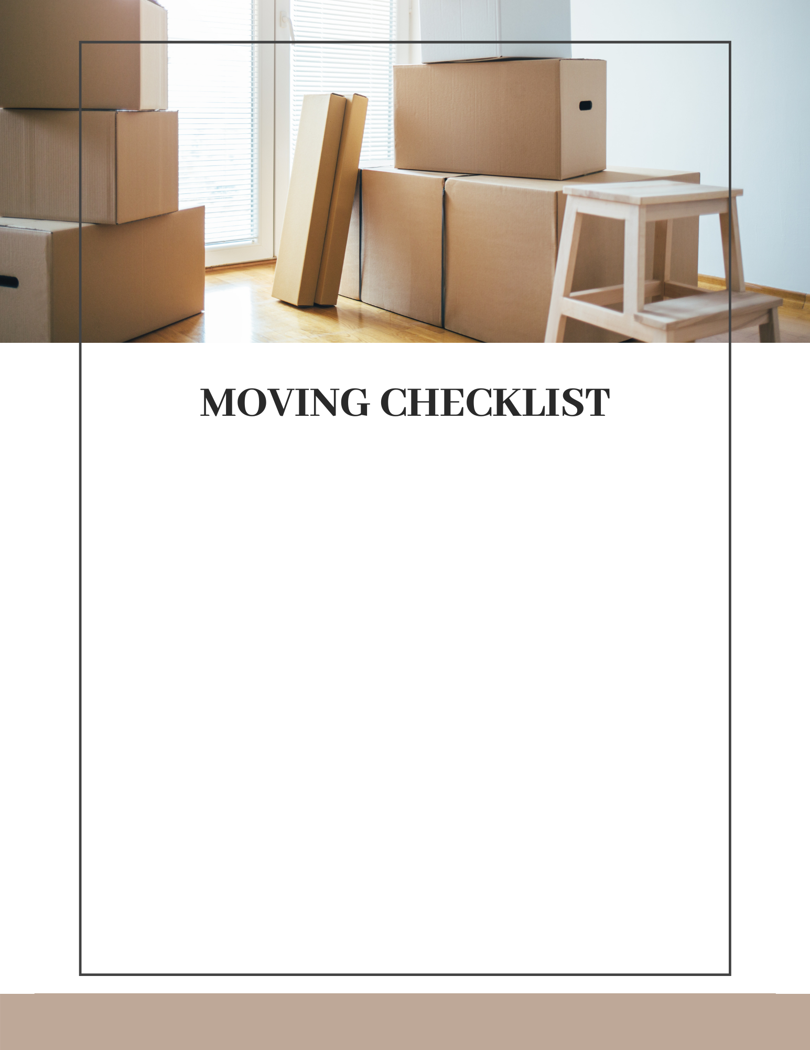
One Month Prior
File “Change of Address” forms with the postal service
Make arrangements to move your personal belongings and furniture, either by phoning a moving company or arranging for a rental truck.
Gather boxes and other moving supplies that you might need.
Plan your travel route to your new home. Be mindful of any bridges or overpasses that might have a clearance restriction.
Create a folder to keep moving expense reciepts, as some of these are tax deductible. Lodging, meals, and fuel are some of the items you can claim on your taxes.
Develop a plan for packing – packing the things you will use most, pack last, then ensuring those items that you will need first when you arrive at your new home will be available.
Notify family, friends, and businesses of your move.
Notify federal and state tax authorities, as well as any other government agencies.
Agent Name here ⋅ (123) 456-7890
31

Slide 32

Two Weeks Prior
Notify services like gas, electric, water, cable TV, phone, and internet of your move.
Arrange for services at your new address
Have your car serviced if your new home is some distance away.
Recruit people to help you on moving day.
Have a detailed plan for keeping pets safe at all times once the movers arrive. This can be a very stressful time for them as well, with strangers in the house, loud noises, a lot of activity, and doors being open for periods of long time.
Arrange for babysitters of any small children
Confirm your moving company or rental truck arrangements.
Notify your bank if you are leaving the city.
Agent Name here ⋅ (123) 456-7890
32

Slide 33
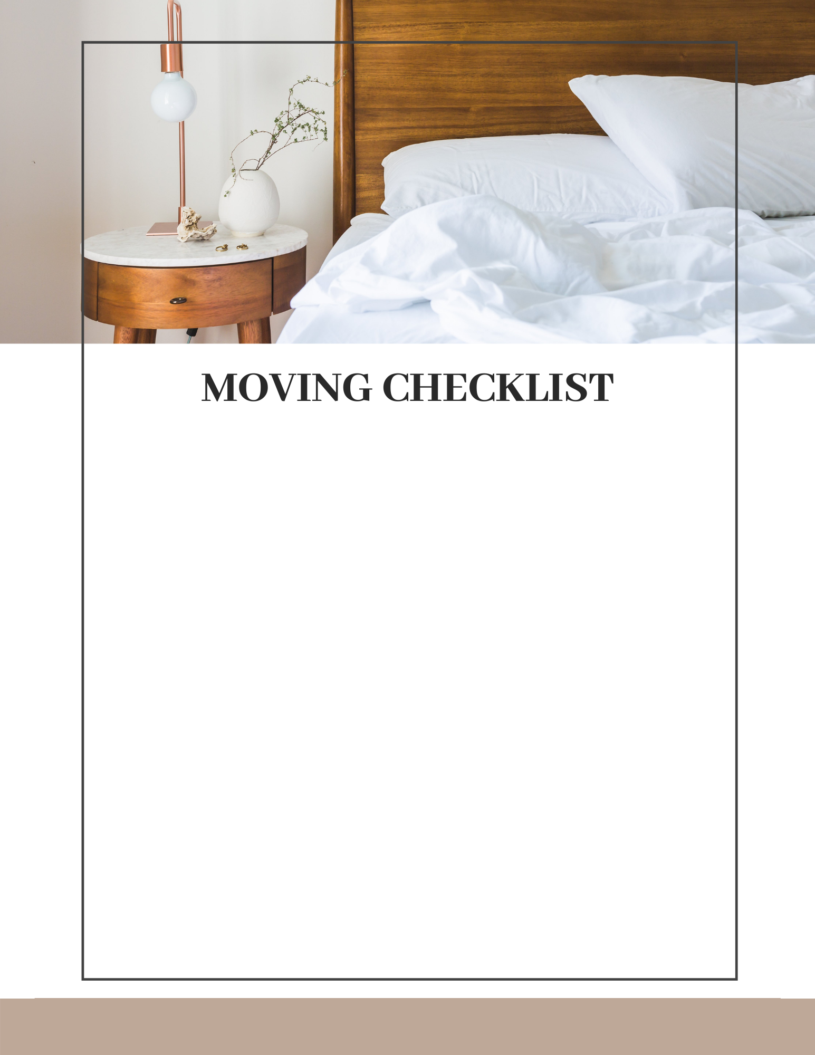
One Day Prior
Keep moving materials separate so they don’t accidentally get packed until you are done.
Put your phone chargers in a safe place to keep handy.
Pick up a rental truck if you are moving yourself.
Fill up your car with gas, and double check your oil and tire pressure.
Get a good sleep!
On Moving Day
Have the proper moving supplies handy, such as undamaged boxes to finish packing, blankets for TV’s, mirrors, and pictures, and tie-down straps to prevent large items from shifting during the drive.
Do a final walk-through to make sure you have everything!
Pack the “Essentials” box. This will be the box you open first at your new home, and will have phone chargers, personal hygiene items, pet food, snacks, bottled water etc. Everything you will need to keep handy as you move into your new place.
Do a walk-through of your new home and take pictures, checking for any damage that wasn’t there when you purchased.
Agent Name here ⋅ (123) 456-7890
33

Slide 34
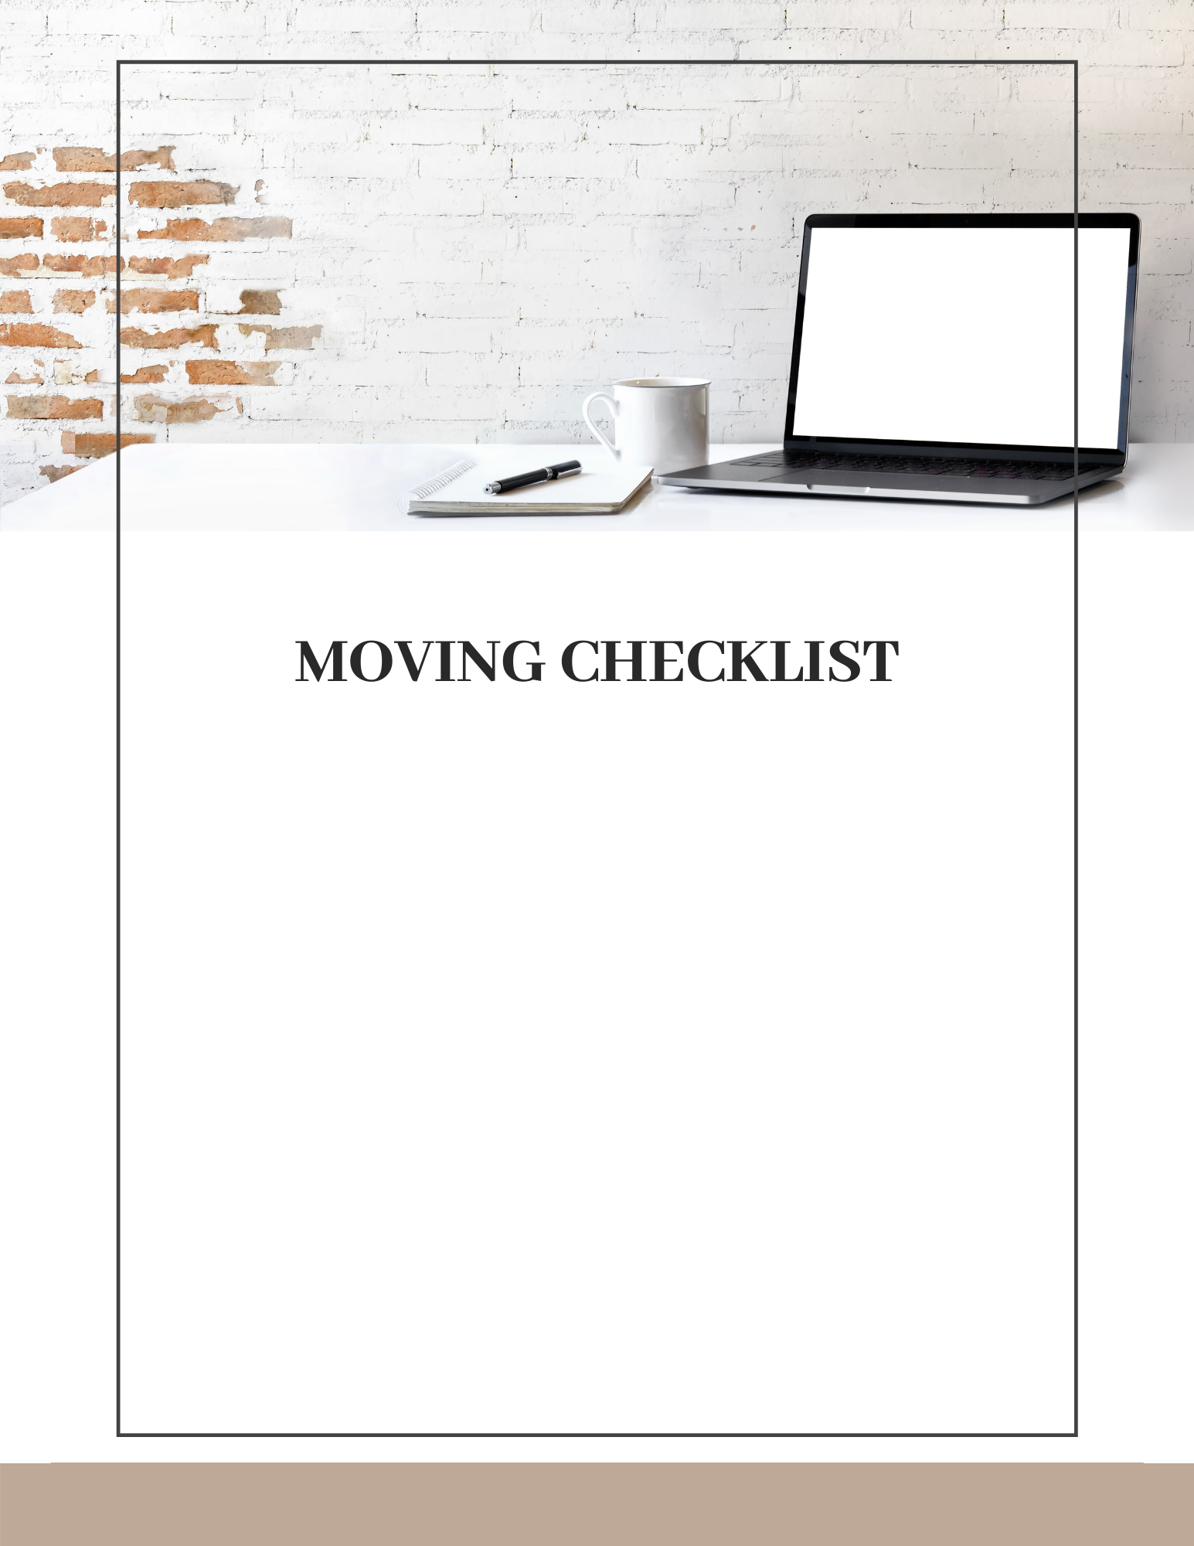
After the Move
Make sure that any mail that arrives with a yellow sticker (this indicates it was forwarded) is contacted and given your new address.
Register to vote in your new area.
Get the address on your driver’s license changed to your current address. If you have moved to a different state, you will need to apply for a new one.
Contact auto insurance to have the policy changed to your new address.
Find out when the garbage is picked up at your new home, and what recycling programs are available.
Select a new doctor, dentist, chiropractor, optometrist, etc. and have your medical files transferred.
Locate new service providers such as banks, pharmacies, plumbers, HVAC contractors etc.
Make a list of the new emergency numbers to have handy in your new home.
Agent Name here ⋅ (123) 456-7890
34

Slide 35
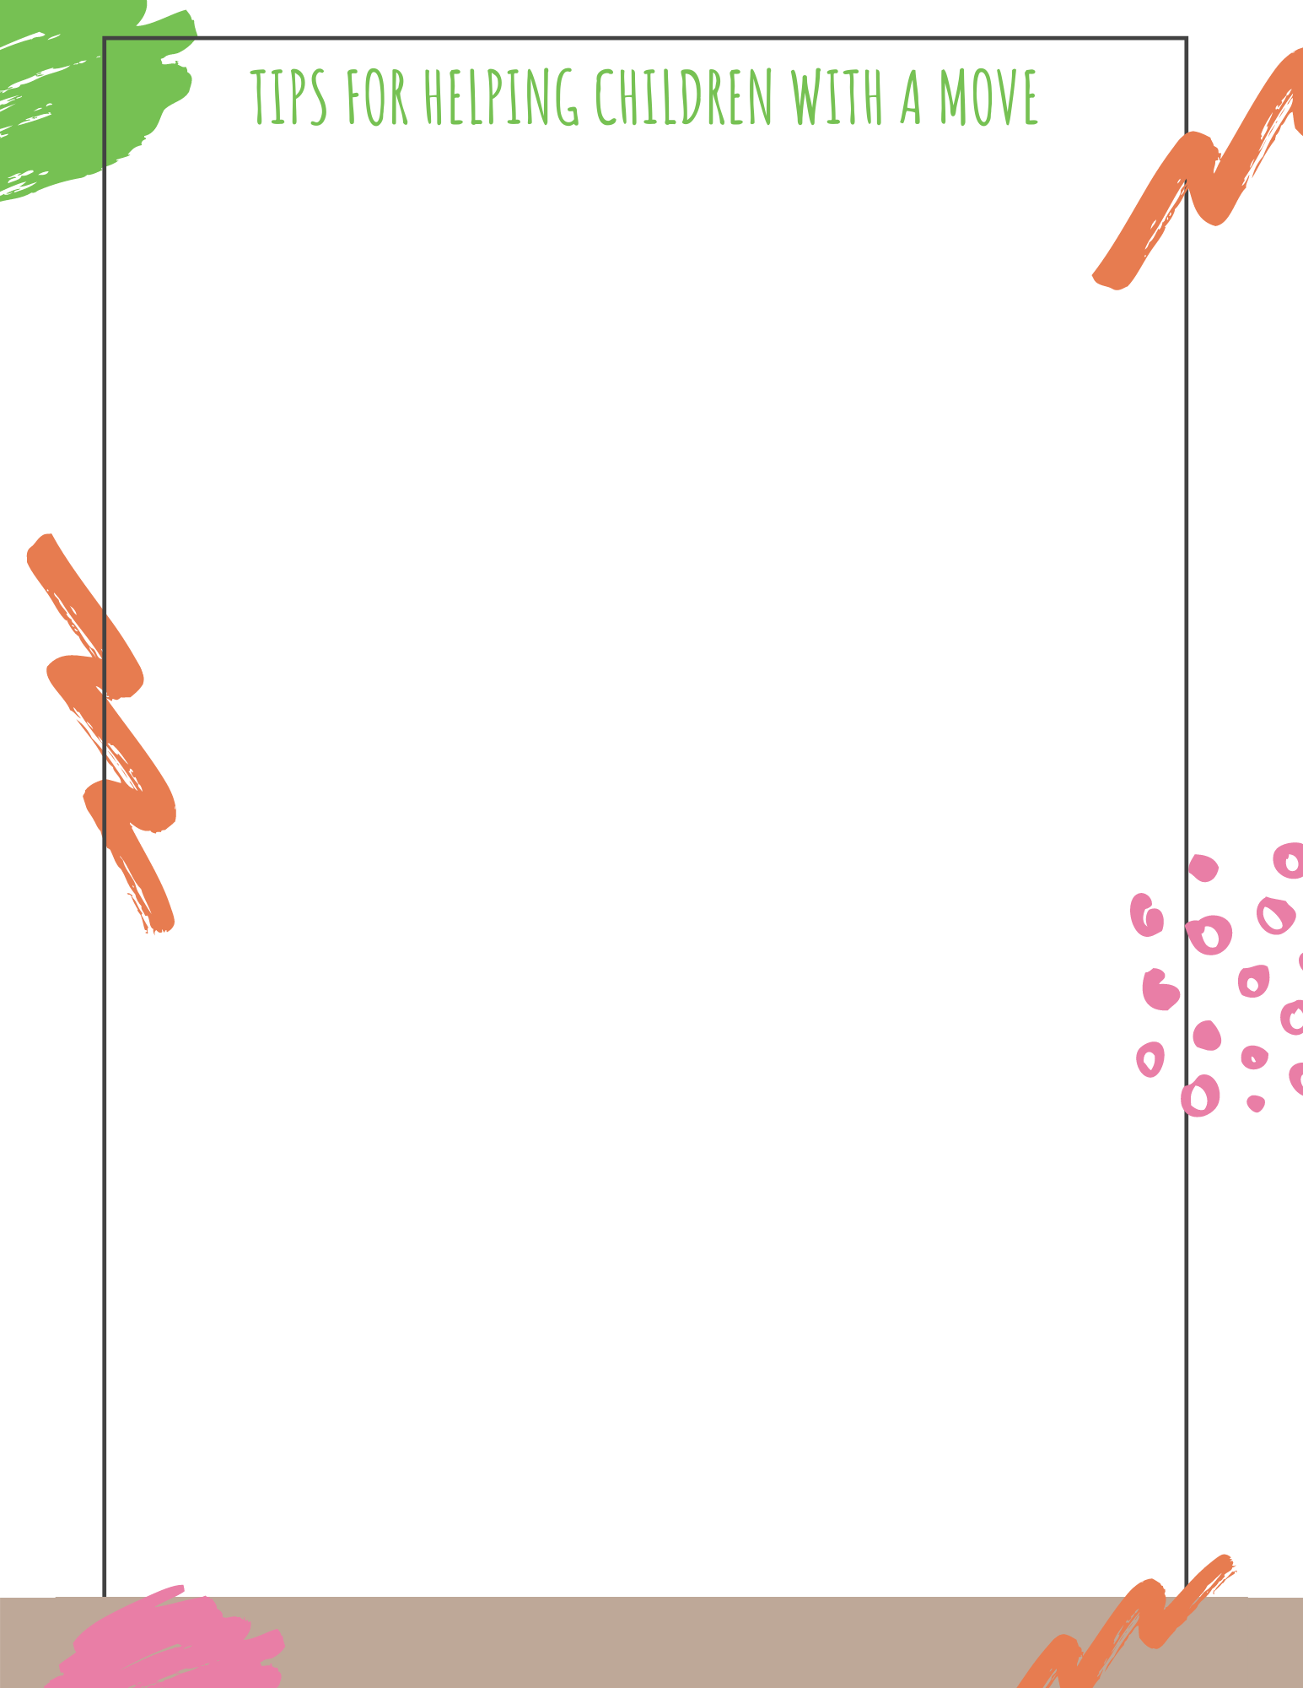
Kids require extra attention and care when planning to buy or sell a home. Making a little extra effort to include them in the buying and selling process helps them adjust more quickly to the move.
Show the children the new home prior to moving. If this isn’t possible, pictures or videos will help them visualize where they are going.
Assure children that you won’t forget their friends.
Make a scrapbook of the old home and neighborhood.
Throw a good-bye party. At the party, have their friends sign a t-shirt.
Have your children write goodbye letters to their friends and enclose their new address. You may wish to call the other children’s parents so they will encourage return letters.
When packing, give them their own box. They can decorate it so they will know which one is theirs after the move.
If you are moving far away, buy postcards when you stop so they can remember the trip.
When unpacking, allow them to unpack their treasures then, and have them play with the boxes while you unpack.
Start a scrapbook for their new home, including a diary of My First…
Visit their new school, park, church, etc. Take a camera to snap pictures for the scrapbook.
Help your children invite new friends over to the house.
Let them choose a new favorite restaurant. This will help them feel in control of their new world.
Encourage them to send letters about their new home to their friends.
Involve your children in groups, sports, and activities like the ones they used to participate in.
Remember that even if you only lived in your former home a few years, to a young child it is nearly their entire life!
Agent Name here ⋅ (123) 456-7890
35

Slide 36

LOAN APPLICATION CHECKLIST
Real estate contract with legal description and deposit receipt.
Check for appraisal and credit report, varies with lender.
Name and complete address of last two years of residence.
Name and complete address of last two years landlord or mortgage company.
Explanation letter regarding any employment gaps over the last two years.
Name and address of last two years employers with dates.
Explanation letter of any credit deficiencies.
Social Security Numbers of all borrowers.
Current gross monthly income figures.
Copy of paystubs covering a 30-day period and last two years W2s and or 1099s.
If income is derived from other sources, two years tax returns, both business and personal with all schedules, signed.
If self-employed, current profit and loss on income and expenses.
If divorced, copy of complete recorded decree and settlement.
Name, address, and account numbers of all places where assets are held (checking, savings, CD’s, IRA’s, etc.) 3 month’s of most current statements.
List of stocks, securities with market value – certified copies.
Estimate of cash value of life insurance.
Schedule of real estate owned, with value, lien, rental income, payments.
Year, make, and model of vehicles.
Estimate value of furniture and personal property.
Name, address, numbers, balance and payments of installment loans
If child support is being paid, proof of payments.
If relocating, information regarding buy-out of house, payment of closing costs, etc. from company.
If selling current house, copy of listing agreement or contract.
Homeowner’s Insurance documentation.
Additional Requirements for FHA/VA Loan Applications
Copy of Driver’s License and Social Security Cards
Name and address of nearest living relative.
Copy of DD214 and/or original Certificate of Eligibility (VA only).
Child care expenses must be provided.
Agent Name here ⋅ (123) 456-7890
36

Slide 37

While the closing on your new home may mark the end of the purchase process, I hope it will mark the beginning of an ongoing relationship. I make a concerted effort to keep in touch with my clients and to continue to be a resource for their real estate and neighborhood needs.
As a client, you can look forward to receiving periodic updates on neighborhood events and quarterly real estate market analysis reports. And, of course, if you need referrals for plumbers, electricians, and other service professionals, I am always happy to provide you with a list of trusted vendors. I am committed to being a trusted resource you can count on to help you expertly navigate any real estate question or need.
My goal is your goal, and I want to help you move up to your Next Level in life, whatever that might be.
Maintaining relationships is part of my commitment to provide a level of real estate service well above and beyond expectations. My clients share their positive experience with friends and associates who then seek me out. This has allowed me to build a successful real estate practice based on referrals.
As a result, I can devote more of my time to helping clients and less looking for new ones. If you are happy with my service, I hope you will spread the word and send people my way so I can help them the same way I helped you. That’s a win-win all around!
Thank you for the privilege!
Agent Name here ⋅ (123) 456-7890
37

Slide 38










Find me on Social:
#handle
#handle
#handle
Name Here
Title Here
#handle
Office Name
Office Address
#handle
Phone Number
Email Address
Web Address

