Slide 1
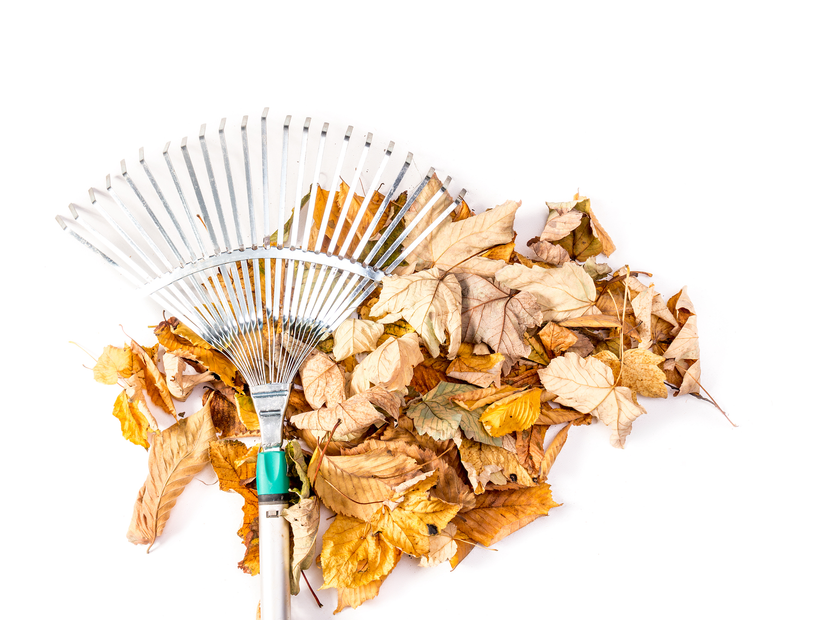
Tips For Getting Your Yard and Home Winter-Ready
Winter has a nasty way of surprising us when we least expect it, so now is the time to make sure you have your yard and home ready. We have some tips to help, so when winter blows in on a whim, you don’t have to stress!
Prune Your Plants – Late fall is the best time to prune those shrubs and clear out the deadfall that has accumulated so far.
Set up your drainage – Make sure the ground slopes away from your home.
Check your roof – Check for missing or damaged shingles, rusted flashing, and damage on the vent stack’s rubber collar.
Clean out the gutters – Remove the gunk that has built up in your gutters over the summer and fall. Also check for leaks or sagging gutters and aim drain spouts away from the house.
Seal air leaks – Take a tour around your home’s exterior with a tube of caulk and fill in any gaps between the trim and siding, around door and window frames, and where pipes enter the home.
Drain your sprinkler system – Turn off the main water valve, shut off the automatic controller, open the drain valves to remove the remaining water, and shake excess water from sprinkler heads.
Remove garden hoses from the faucets – Water left in the hose can expand when it freezes, cracking the faucet or the pipes. Also, turn off the shutoff valves for the outdoor faucets.
Clean and park the lawn mower – Either pour fuel stabilizer into the gas tank (it protects the mower from deterioration from the fuel sitting for months) or run your mower dry before putting it in the garage or shed for the winter.
Check your furnace – Call your heating and cooling professional for a yearly furnace check-up. Also, this is a great time to change the filters.
Check your fireplace – Using a flashlight, look up the flue to make sure the damper opens and closes properly, and check for obstructions.
Agent Contact Info / Website Here.

Slide 2
Halloween Jell-o Worm Cups
A fun, kid-friendly holiday treat made with lime jello, gummy worms, candy eyeballs and OREO cookies. They’re the perfect addition to a Halloween party table with the bright colors and creepy vibe.
INGREDIENTS
3 ounces lime gelatin
1 cup boiling water
2 cups ice
10 OREO cookies, (thins)
3.5 ounces Troli Sour Bright Crawlers, (minis)
candy eyes
INSTRUCTIONS
Bring 1 cup water to a boil.
Remove from heat and add in gelatin packet. Whisk for 3 minutes or until gelatin is completely dissolved.
Add 2 cups ice and whisk for 5 minutes. If there are some pieces of ice leftover, just remove them after 5 minutes if not melted completely. The mixture should be setting up at this point.
Pour the mixture into four 5.5-ounce cups.
Place gummy worms into each cup and a few candy eyeballs. Using a toothpick can help push them down so they are floating in the middle of the cups.
Let chill in the refrigerator for 30 minutes.
Crush up OREO cookies and sprinkle over the top of each cup with a few more gummy worms and candy eyes.
Safety First: Prepping Your Home For Trick or Treaters
Halloween is a lot of fun for everyone, but it’s a lot LESS fun when our precious little darlings (or ourselves) get hurt while trick or treating.
Here are some tips to make sure your place is secure.
Make your outdoor lights nice and bright.
Prop open your storm door (or screen door) so it’s out of the way for trick or treaters.
Use LED candles instead of real candles in your jack-o-lanterns
Use motion-sensor lights after the trick or treaters are done to prevent vandalism
Make sure your railings are tight and not wobbly
Use bright colored friction tape on the edges of any steps so trick or treaters can see them.
Create a fun candy-chute to prevent the spread of germs and maintain some social distancing.
Agent Contact Info / Photo / Website Here.

