Slide 1
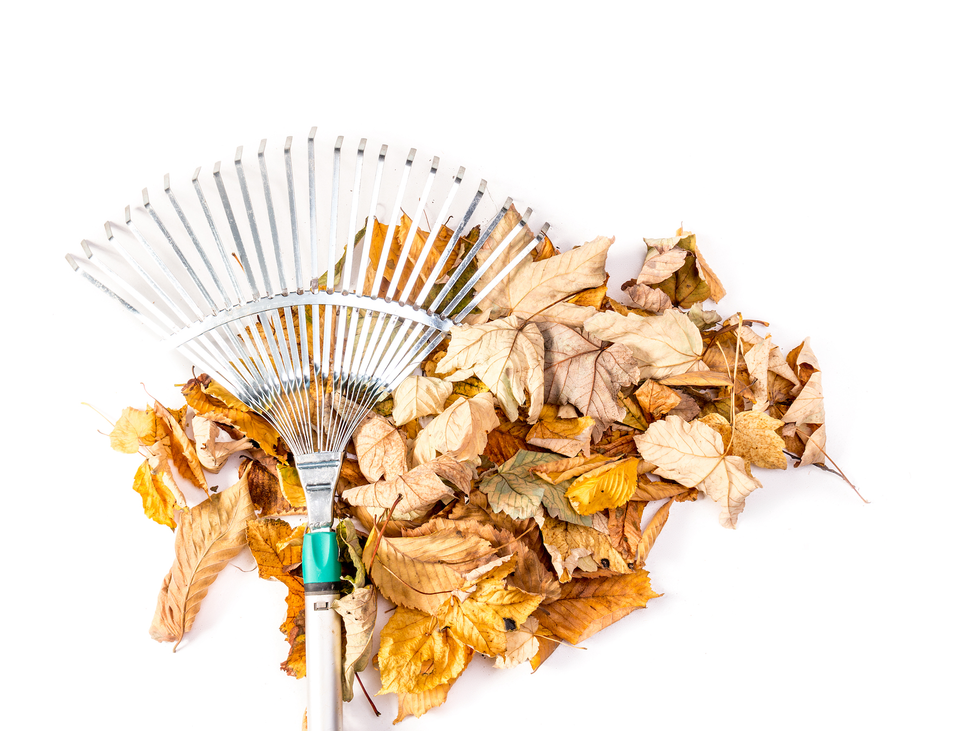
The Thanksgiving Countdown: Tips for Getting Started!
Thanksgiving will be here quickly and waiting until the last minute to start getting ready will have you frazzled and stressed! Get started on the following TODAY so you can be ready by the holidays.
Create your guest list. Once you know who is coming, you can plan seating arrangements. (Psst, make sure you have enough chairs!)
Plan your menu. This includes making your grocery lists and shopping for non-perishable food items early to avoid the panic of empty shelves at the store (as well as a huge bill at checkout!)
Prep or prepare ahead of time. Some dishes can be made in the days prior to Thanksgiving and kept in the freezer until Thanksgiving dinner.
Prepare a cooking schedule. If you struggle with multi-tasking, organize Thanksgiving day into 1-hour increments and schedule what needs to be cooked, and when, as well as scheduling any other tasks that need doing. Take into account how much time each dish requires to cook, and what can be made ahead of time.
Set aside time for other tasks. In the days prior to Thanksgiving, block off time for cleaning, laundry, making centerpieces, grocery shopping, and all those other things that need to be done that you are likely to forget on Thanksgiving day.
Agent Contact Info / Website Here.

Slide 2
Simple Au Gratin Potatoes
November Maintenance Checklist
INGREDIENTS
3 tablespoons butter
3 tablespoons all-purpose flour
1-1/2 teaspoons salt
1/8 teaspoon pepper
2 cups 2% milk
1 cup shredded cheddar cheese
5 cups thinly sliced peeled potatoes (about 6 medium)
1/2 cup chopped onion
Additional pepper, optional
INSTRUCTIONS
Preheat oven to 350°. Using a large saucepan, melt butter on low heat. Next, stir in the flour, salt, and pepper until it’s smooth. Slowly, pour in the milk, then bring to a boil. Cook and stir for 2 minutes, or until it becomes thick. Remove from heat and stir in the cheese until melted. Last, add the potatoes and onion.
Transfer the mixture to a greased 2-qt. baking dish; cover and bake for 1 hour. Then, uncover and bake another 30-40 minutes or until the potatoes are tender. If desired, sprinkle with some additional pepper.
November is often considered the transitional month where we move from autumn to winter. This means that we need to make the final transitions of our home to be ready when the snow falls, if it hasn’t already started.
Service your HVAC systems
Check fire alarms
Patch up holes or cracks on your exterior where pests might come in
Put patio furniture away
Clear dead leaves from the yard
Weatherproof the house
Agent Contact Info / Photo / Website Here.

