Slide 1
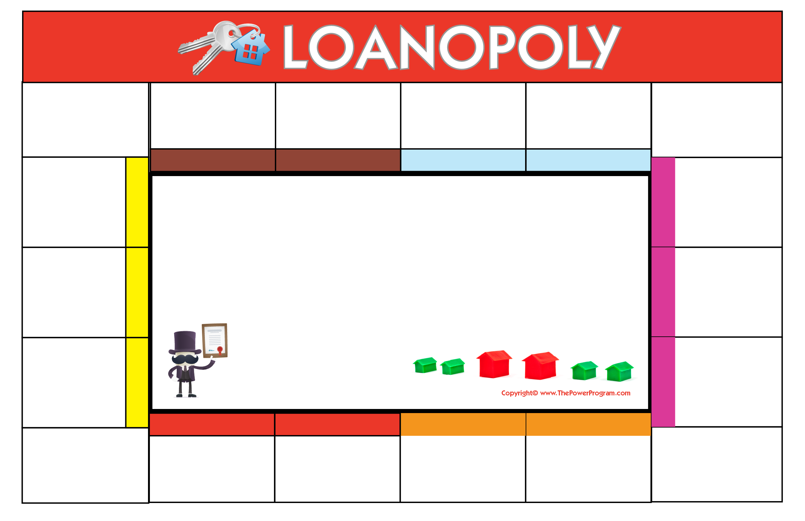
START HERE
PRE-APPROVAL
FIND A HOME
MAKE AN OFFER
APPLICATION PROCESS
CONTRACT-AGREEMENT OF SALE
Preliminary docs include: W2’s, bank statements, tax returns.
Access your wants and needs, then let your REALTOR® help you find a home.
Offer accepted, sign binder, schedule home inspection.
Submit updated pre-approval documents prior to obligating yourself to contract. KNOW YOUR NUMBERS.
Review and sign your contract with your REALTOR® and attorney.
FINISH
APPRAISAL ORDER
You can enjoy the tax advantages of owning your new home.
HELPFUL STRATEGY:
Save & submit all future pay stubs
Save & submit all future bank statements (all pages)
Keep copies of documents submitted to processing
Continue to pay off debts and loans on time
COMMON MISTAKES:
Don’t make cash deposits
Don’t make large purchases on credit cards
Don’t co-sign loans for anyone
Don’t change bank accounts
Don’t apply for new credit
Ordered within the first week of contract. Appraisal inspection completed.
CONGRATS!
PROCESSING
Processor completes all updated information, verifications for credit, employment, and assets.
Congratulations and welcome to your NEW HOME!
Your contact information here.
Add name, company, website, email and phone number.
CLOSING!
APPRAISAL REPORT
You’re at the finish LINE! All parties sign closing documents.
Received and reviewed: processor updates items needed for approval. This will be emailed to you within 3 days of receipt.
FINAL WALK THROUGH
CLEAR TO CLOSE
HOMEOWNER INS. POLICY
TITLE REPORT
COMMITMENT
UNDERWRITING
Borrowers do a final walk-through of the property to approve condition of the house prior to signing closing documents.
You are notified that your file is clear to close and a closing date is coordinated and scheduled by all parties.
Title report submitted for review and clearance.
Submit ALL outstanding condition items from commitment letter order to final clearance.
Processor submits your file to underwriting for review and commitment letter. Approval commitment letter sent to you and attorney for review.
Copy of appraisal & mortgage clause provided to you for securing homeowner’s insurance.

Slide 2
Let's play a game called Loanopoly!
A family-friendly way to walk you through every step of the home buying process. Call or text me today and I'm happy to drop off the game pieces and answer any questions you might have!
I'm here to help!
Name Here
Address
Email Address
Web Address
Call or text me at 555-555-5555!
Agent Name, Power Agent®
Email Address
Name Here
Address
City, State Zip
*As a Power Agent®, I am a member of an exclusive program (less than 1% of agents acrossNorth America) of dedicated real estate professionals who are committed to helping buyers andsellers reach their next level in life.

