Slide 1
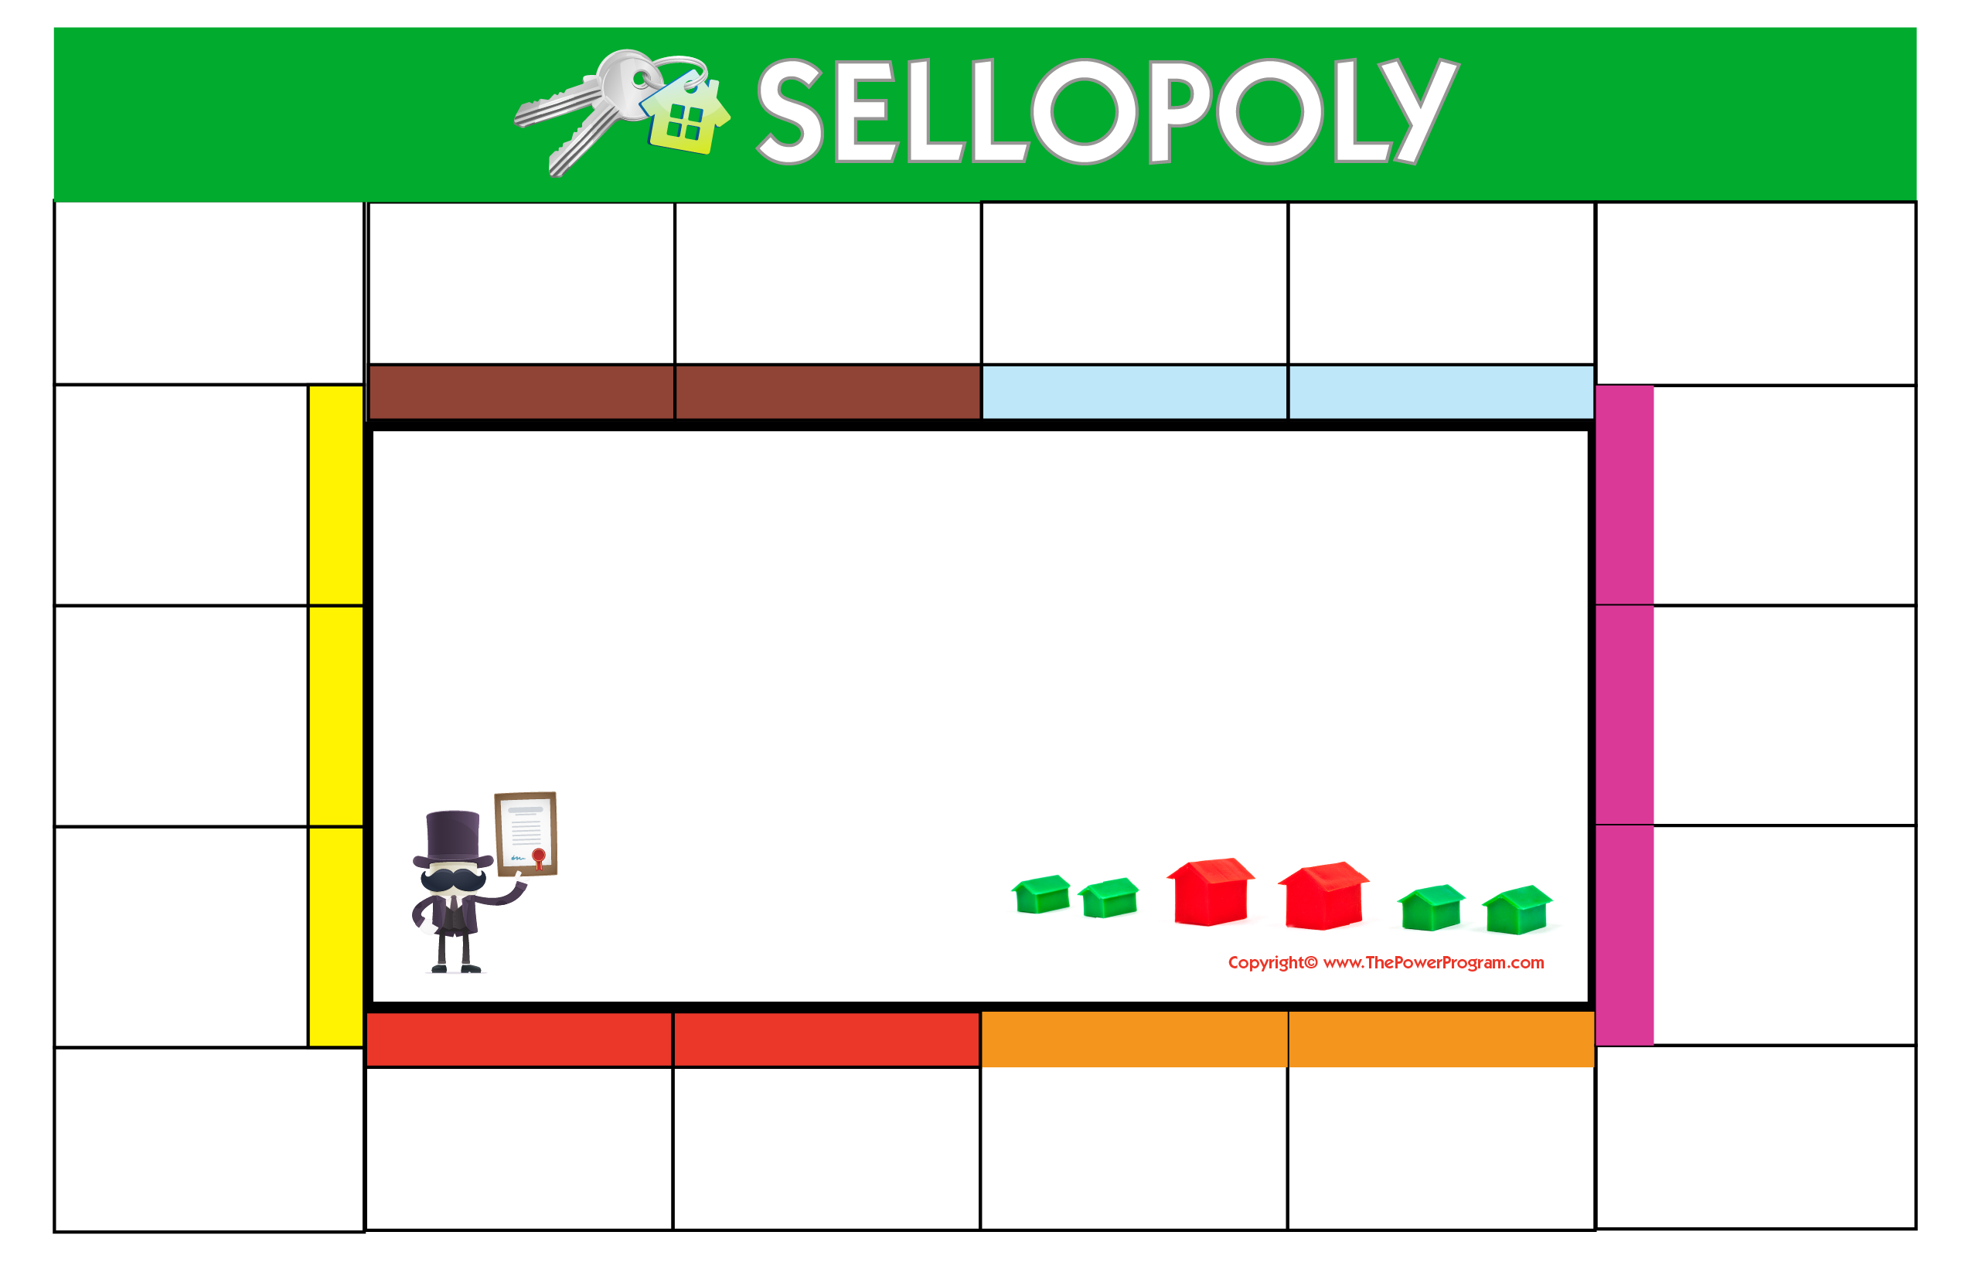




START HERE
DETERMINE
PREPARE
STAGE & PHOTOS
VERIFY
LAUNCH LISTING
The current value of your home on today’s market
Personalized marketing campaign.
Stage home to stand out from competition. Professional photography goes a long way in this game!
Taxes, certificate of occupancy, survey, and all other pertinent information.
Launch listing on MLS, National and Local real estate websites.
CONGRATULATIONS!
SHOWTIME
CELEBRATE! Closing occurs at lending institution or attorney’s office.
Start showing home and host open houses!
Your contact information here.
Add name, company, website, email and phone number.
FINAL WALK THROUGH SCHEDULED 24-48 HOURS PRIOR TO CLOSING
NEGOTIATE
Professional manage offers to obtain maximum value with your sales associate.
TRANSFER UTILITIES OIL, METER READ, CALL THE MOVERS!
QUALIFICATION
Confirm qualification of potential buyers.
TITLE SEARCH
MORTGAGE COMMITMENT
BANK APPRAISAL
SALE
INSPECTIONS
Title search ordered by purchaser’s attorney.
$$$
Execute contract of sale with attorney.
ACCEPTANCE
OF
OFFER!!!
Home and termite inspections take place.
Receive written mortgage commitment.

Slide 2



Let's play a game called Sellopoly!
A family-friendly way to walk you through every step of the home selling process. Call or text me today and I'm happy to drop off the game pieces and answer any questions you might have!
I'm here to help!
Name Here
Address
Email Address
Web Address
Call or text me at 555-555-5555!
Agent Name, Power Agent®
Email Address
Name Here
Address
City, State Zip
*As a Power Agent®, I am a member of an exclusive program (less than 1% of agents acrossNorth America) of dedicated real estate professionals who are committed to helping buyers andsellers reach their next level in life.

