Slide 1
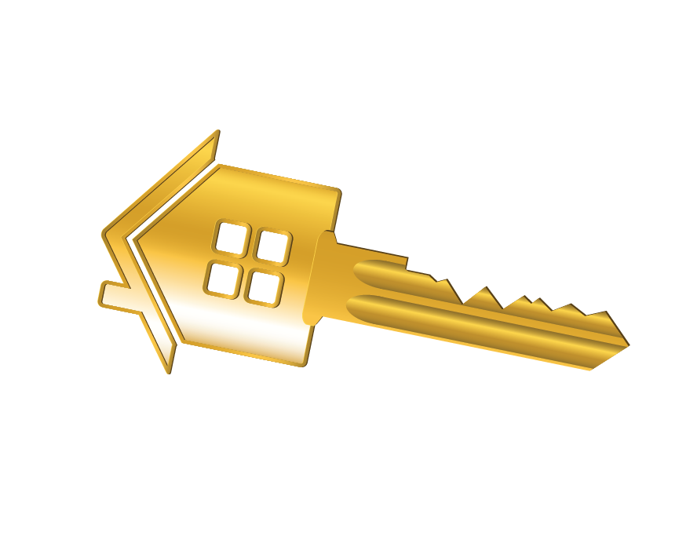
The real estate agent you choose to work with could be your most valuable resource. With more real estate information available online than ever before, it may seem as if buying and selling a home is an easy task. These 100 reasons will show you the extent of knowledge, experience and hard work that an agent provides to help you through a real estate transaction.
The 100 reasons listed here reflect actions, procedures and processes that a real estate agent may typically perform during a residential real estate transaction and are all things that you could avoid doing yourself!
TYPICAL PRE-LISTING
Selling the Property
Research Current Properties
Research Sales Activity from MLS and
Public Records Databases
Provide Average Days on Market Assessment
Review Property Tax Roll
Prepare a Comparable Market Analysis (CMA)
Verify Ownership and Deed Type
Verify County Public Property Records
Perform Curb Appeal Assessment
Provide Public School Value
Provide a Listing Presentation
Analyse Current Market Conditions
Present Credentials
Deliver CMA Results
Discuss Planning and Strategy
Explain Listing Contract, Disclosures & Addendum
Screen Calls from Buyers and Agents
Explain Homeowner Warranty
Order Plat Map
Create Showing Instructions
Obtain Mortgage Loan Information
Review Homeowner Association Fees and Bylaws
Submit Homeowner Warranty Application
Add Homeowner Warranty in MLS
Review Electricity Details
Arrange Inspections for City Sewer/Septic Tank Systems
Collect Natural Gas Information
Provide Security System Status
Determine Termite Bond Status
Analyze Lead-based Paint Status
Distribute Disclosure Packages
Prepare Property Amenities
Detail Inclusions & Conveyances with Sale
Compile Repairs Needed List
Send Seller Vacancy Checklist
Install Lockbox
Make Copies of Leases for Rental Units (if applicable)
Verify Rents, Utilities, Water, and Deposits for Rentals
Inform Tenants of Listing for Rentals
Install Yard Sign
Perform Interior Assessment
Perform Exterior Assessment

Slide 2
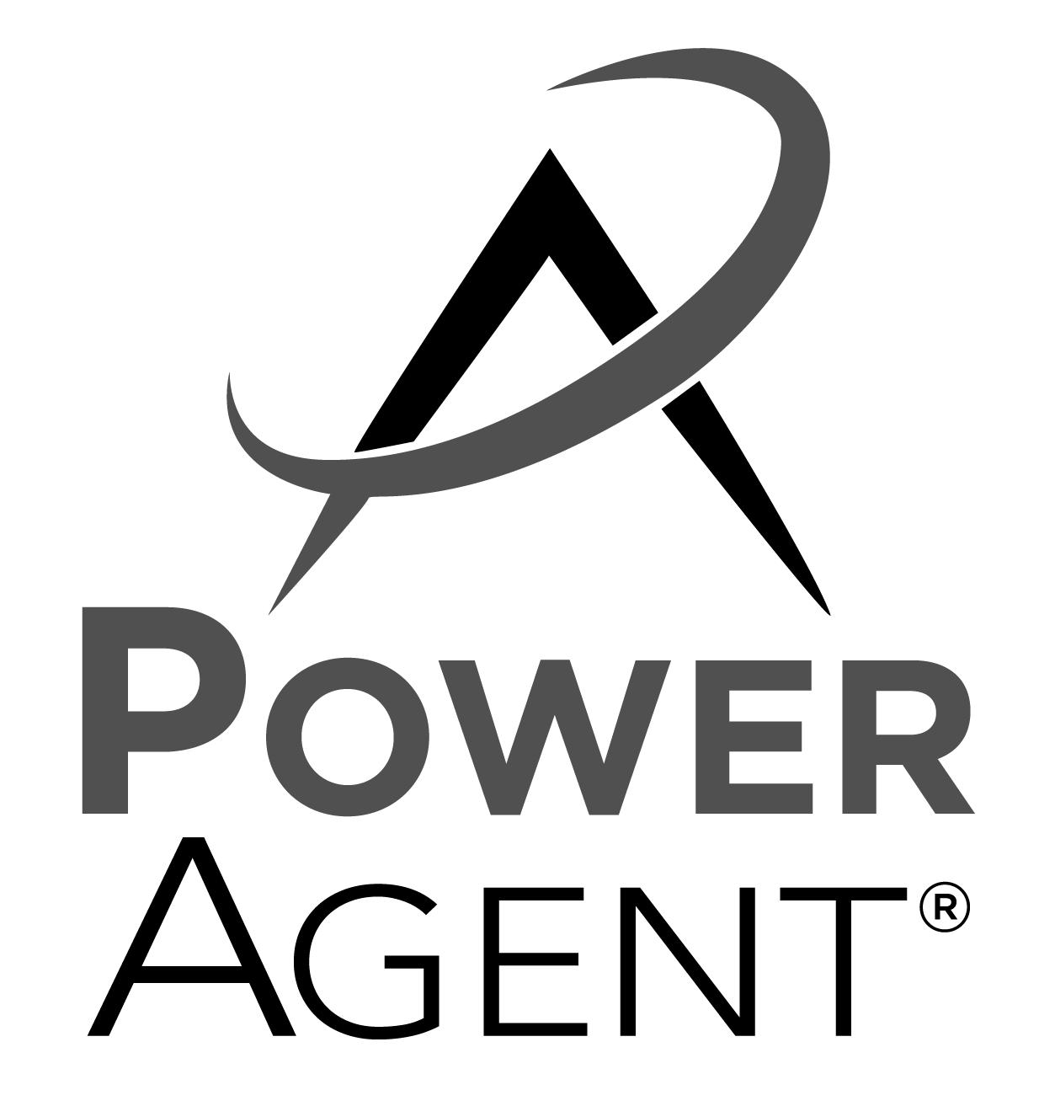
Advertising & Marketing
Enter a Profile Sheet into the MLS Listing Database
Provide Copies of MLS Agreement
Take Additional Photos for MLS and Marketing
Create and Advertise Property Listing in Publications
Coordinate Showing Times
Create and Mail Flyers
Advertise on Craigslist
Post to Other Real Estate Websites
Closing Preparations & Actions
Ensure Contract is Sealed
Coordinate Closing Process
Coordinate Closing Formal Procedure
Assist with Title Issues
Perform Final Walk-through
Verify Tax and Utility Preparations
Review and Distribute Final Closing Figures
Request Closing Document Copies
Confirm Receipt of Title Insurance
Handling Offers & Contract
Receive Offer to Purchase
Evaluate Net Sheet
Counsel and Mediate Offer(s)
Deliver Seller’s Disclosure
Obtain Pre-qualification Letter
Negotiate Offers on Seller’s Behalf
Mediate Counteroffers or Amendments
Fax or Email Contract Copies
Deliver ‘Offer to Purchase’ Copies
Assist with Escrow Account
Distribute Under - Contract Showing Restrictions
Update MLS to “Sale Pending”
Review Credit Report
Deliver Unrecorded Property Information
Order Well Flow Test Reports (if applicable)
Order Termite Inspection (if applicable)
Order Mold Inspection (if applicable)
Confirm Deposit and Buyer’s Employment
Follow Up with Loan Processing
Communicate with Lender
Confirm Approval of Loan
Remove Loan Contingency
COMMITMENT
Make Homeowners Warranty Available
Review Closing Documents
Confirm and Assist with Final Deposit
Coordinate on Closing Dare/Time
Ensure “No Surprises” Closing
Final MLS Update
Attend Closing if Applicable
Follow Up and Resolve Repairs
Documentation Follow Up
Hand the Keys to the New Owners
Stay in touch for all future needs
Appraisal & Home Inspection
Coordinate Buyer’s Home Inspection
Review Home Inspector’s Report
Interpret Loan Limits
Verify Home Inspection Clauses
Contractor Preparation
Confirm Repair Completion
Attend Appraiser Appointment
Provide Appraiser Information and Remove Contingency
Agent Contact Info Here.

