Slide 1
Rising Interest Rates and Slowing Sales: How to Double Your Production In this New Real Estate Reality
WELCOME
DARRYL DAVIS, CSP
TryThePowerProgram.com

Slide 2
Sales declines, price drops and the return of buyer incentives: Oh my!
Real Estate Expert Predicts Price Declines by Summer 2022
Mortgage rates hit 6.3%
the real cost to buy a house has officially spiked over 50% in just 6 months
Notes:
As you we had to reinvent ourselves

Slide 3
Housing “Market in Free-Fall” As New Construction Plummets
Fed’s biggest rate hike since 1994 means millions more homebuyers may be priced out of housing market, as 30-year mortgage rate spikes
Notes:
As you we had to reinvent ourselves

Slide 4
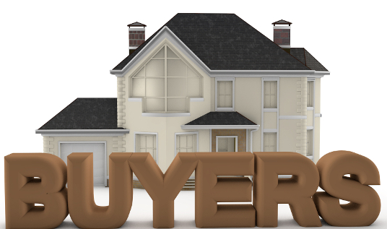

Slide 5
“Perhaps I should wait for a better time to buy real estate”

Slide 6
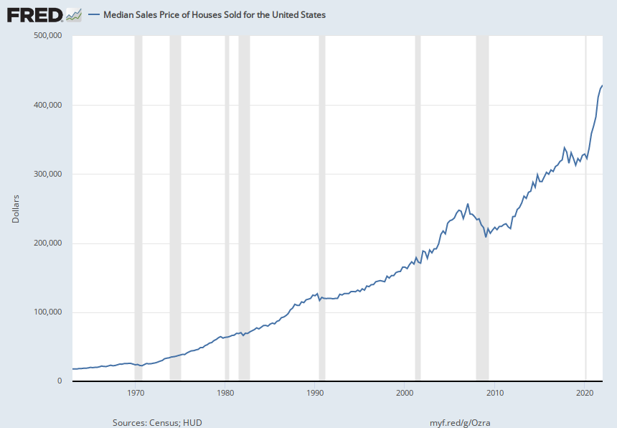
2022
$429,000
Do NOT Try &
Time The Market
Interest Rates
1981
18.63%
1990
10.05%
1975
9.49%
1970
7%
1990
$124,000
1981
$67,000
1975
$38,000
1970
$24,000
Notes:
Buyer
Power Agent® Point: Real estate ALWAYS goes up, regardless what the economy or interest rates do. There is no waiting or trying to time the market
Source: U.S. Census Bureau, U.S. Department of Housing and Urban Development,
https://fred.stlouisfed.org/series/MSPUS, July 3, 2022

Slide 7
TIMERS
LOSE TIME
TryThePowerProgram.com

Slide 8
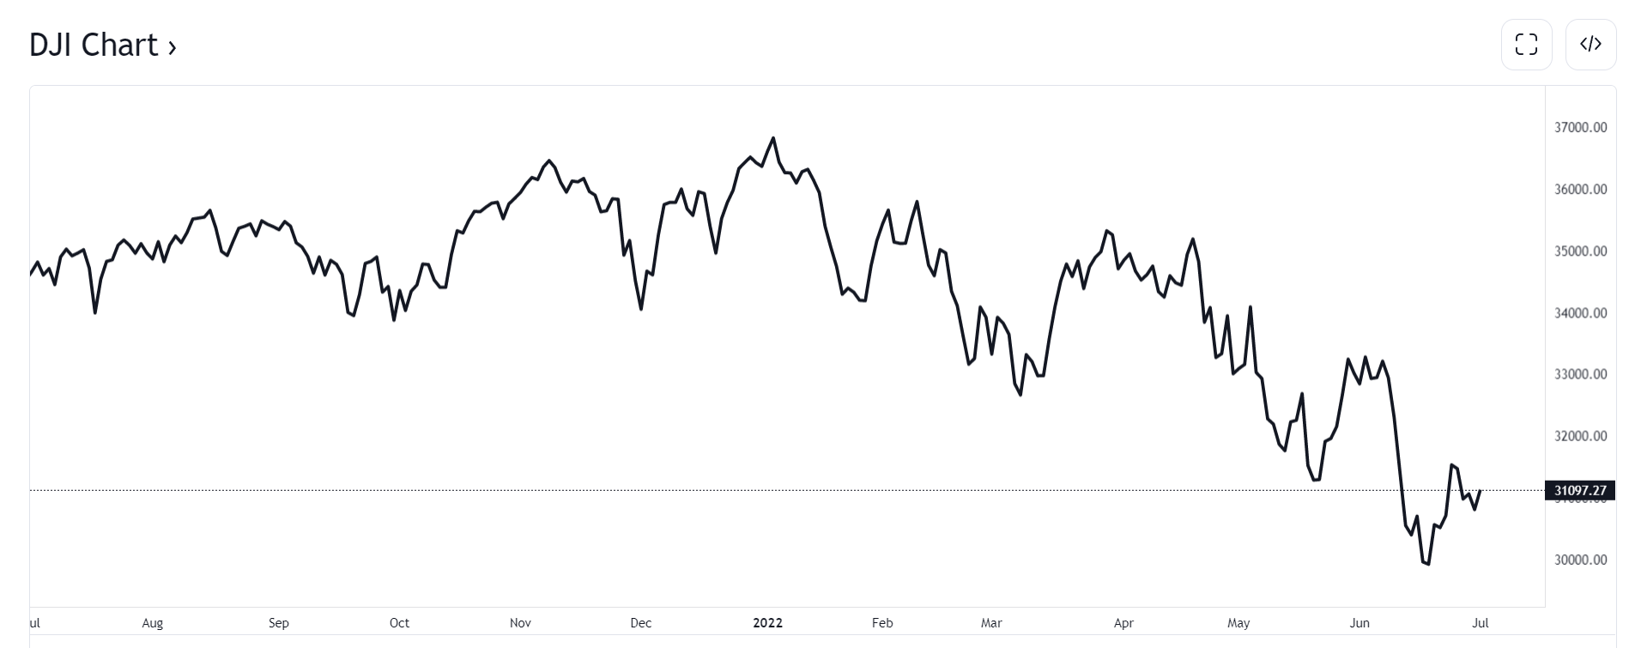
If You Were Going To Time The Market & Buy the Dip, Would You Buy Now?
Notes:
Buyer
Power Agent® Point: Doing a “roleplay” of what the buyer would do, will help them see they can not time the market because we can not see the future. If they buy now (like people in December) the market could go down further. If they wait, we may be at a bottom and now they lose as values go up.
Timers LOSE Time

Slide 9
If You Were Going To Time The Market & Buy the Dip, Would You Buy Now?
Notes:
Buyer
Power Agent® Point: Doing a “roleplay” of what the buyer would do, will help them see they can not time the market because we can not see the future. If they buy now (like people in December) the market could go down further. If they wait, we may be at a bottom and now they lose as values go up.
Timers LOSE Time

Slide 10
If You Were Going To Time The Market & Buy the Dip, Would You Buy Now?
Notes:
Buyer
Power Agent® Point: Doing a “roleplay” of what the buyer would do, will help them see they can not time the market because we can not see the future. If they buy now (like people in December) the market could go down further. If they wait, we may be at a bottom and now they lose as values go up.
Timers LOSE Time

Slide 11
If You Were Going To Time The Market & Buy the Dip, Would You Buy Now?
Notes:
Buyer
Power Agent® Point: Doing a “roleplay” of what the buyer would do, will help them see they can not time the market because we can not see the future. If they buy now (like people in December) the market could go down further. If they wait, we may be at a bottom and now they lose as values go up.
Timers LOSE Time

Slide 12
If You Were Going To Time The Market & Buy the Dip, Would You Buy Now?
Notes:
Buyer
Power Agent® Point: Doing a “roleplay” of what the buyer would do, will help them see they can not time the market because we can not see the future. If they buy now (like people in December) the market could go down further. If they wait, we may be at a bottom and now they lose as values go up.
Timers LOSE Time

Slide 13
“If held for a long period of time and purchased at low rates, houses are better than stocks.”
~Warren Buffett

Slide 14
TIMERS LOSE TIME
Notes:
Buyer
Power Agent® Point: Real estate ALWAYS goes up, regardless what the economy or interest rates do. There is no waiting or trying to time the market
Source: U.S. Census Bureau, U.S. Department of Housing and Urban Development,
https://fred.stlouisfed.org/series/MSPUS, July 3, 2022

Slide 15
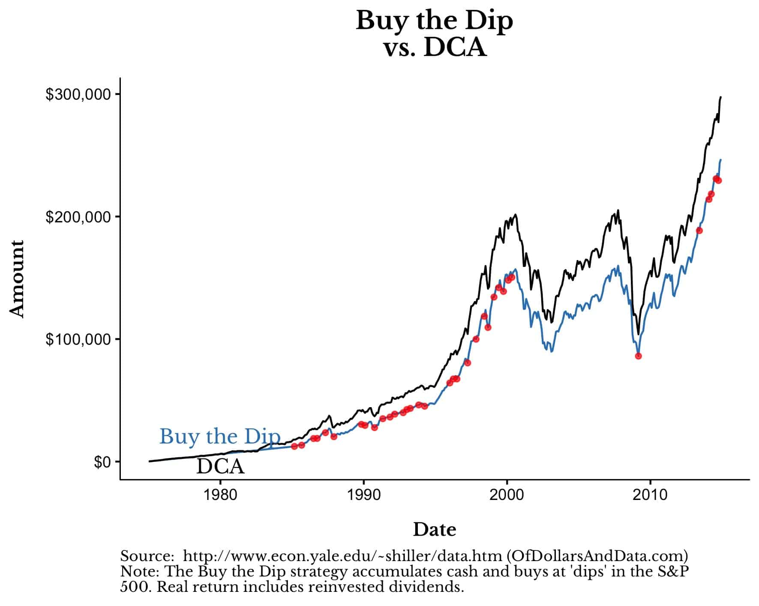
Notes:
Buyer
Power Agent® Point: Based on research, Timers trying to buy when they think it’s a dip lose more money than the buyer who uses Dollar Cost Averaging
Timers LOSE Time

Slide 16
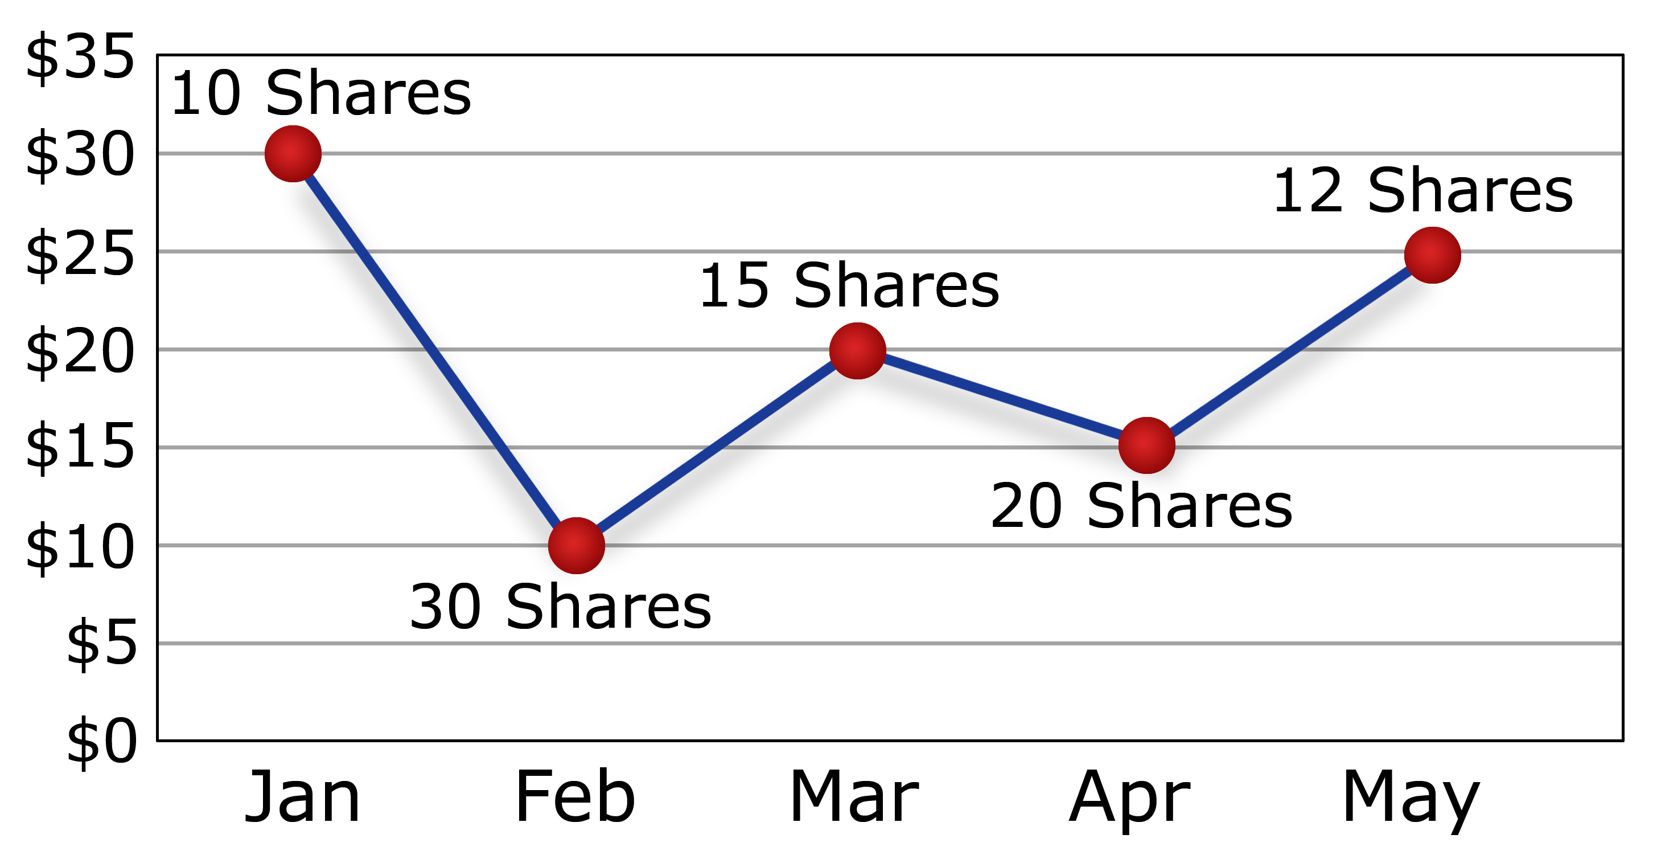
Dollar Cost Averaging
Investing $300 a month
Notes:
Buyer
Power Agent® Point: If you invested the same amount of money each month ($350 for example) the amount of shares you would buy will ,go up and down based on the price of the stock at that time. The point here is to explain Dollar Cost Averaging, to show them that this is better than trying to TIME the market.
Timers LOSE Time

Slide 17
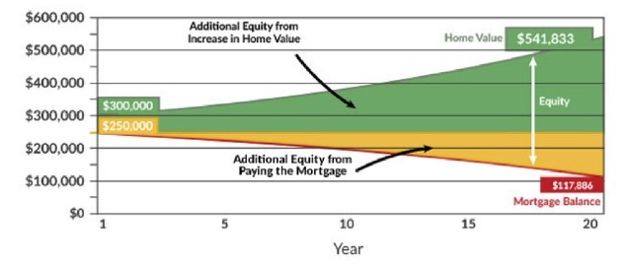
As You Make Your Monthly Payments, Your Portfolio Goes Up
Notes:
Buyer
Power Agent® Point: Owning a home is like Dollar Cost Averaging. Each monthly mortgage payment is like a monthly investment. BUT the buyer benefits 2 WAYS: There investment goes up with the house appreciation AND they pay down the mortgage (debt) which also increases their equity.
By waiting, they lose the times to start Timers LOSE Time

Slide 18
4 Ways To Build Wealth in Real Estate
Appreciation
Debt Reduction
Tax Savings
Security (It’s Your Home)

Slide 19
Notes:
High Cash Yield – The money a buyer puts down, and then the growth of the value of the home is yield on the cash invested
Equity Buildup – the value of the asset goes up
Leverage – The financing of 80-90% of the homes value is the leverage.
Hard Asset – You can touch the house
Tax Advantage – Real estate taxes and even though the house goes up in value, the IRS looks at it as if it were a refrigerator…it goes down in value

Slide 20
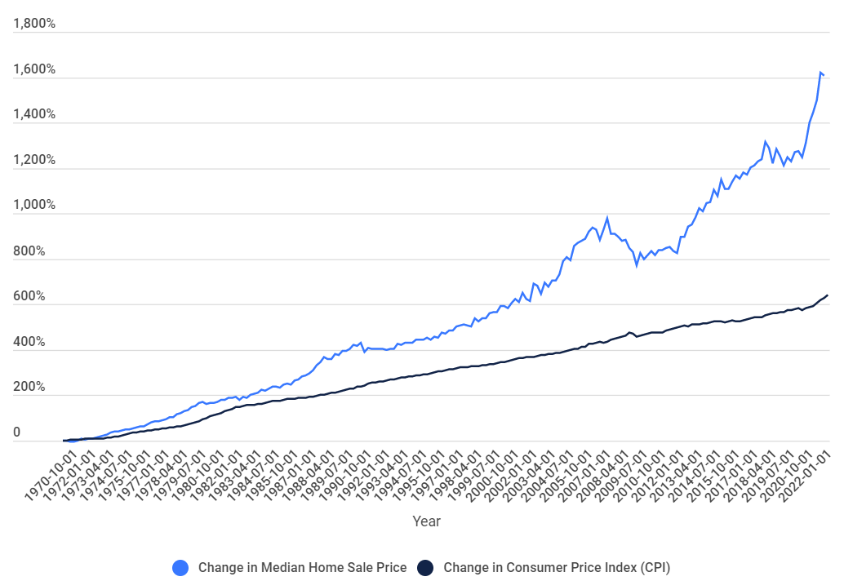
Housing Prices Outpace Inflation by 150% Since 1970
Home prices over the last five decades beat inflation by 150% since 1970. In fact, if home prices grew at the same rate as inflation since 1970, the median home price today would be just $177,788 – rather than $408,100.
Notes:
Buyer
Power Agent® Point: Real estate is the best choice to beat inflation
https://anytimeestimate.com/research/housing-prices-vs-inflation/
https://www.mpamag.com/us/news/general/which-major-city-is-seeing-home-prices-go-through-the-roof/400277#:~:text=Researchers%20found%20that%20home%20prices,mere%20%24177%2C788%20rather%20than%20%24408%2C100.

Slide 21
“Should I wait for house prices to come down?”

Slide 22
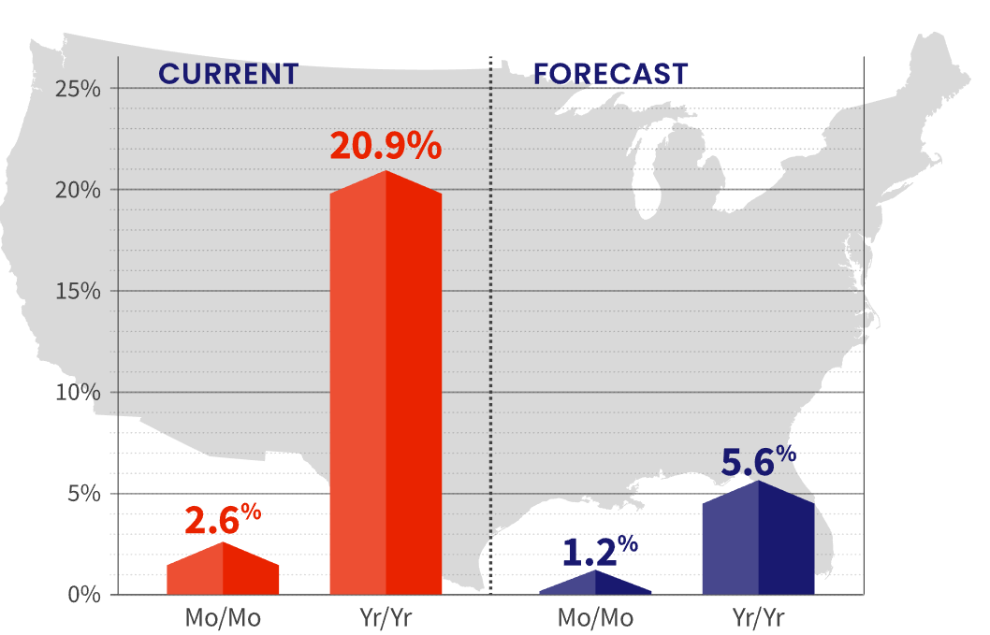
Should I wait to for prices to come down?
Providing financial, property, and consumer information, analytics, and business intelligence.
April 2022 to
May 2022
April 2022 to
April 2023
Notes:
Buyer
Power Agent® Point: The CoreLogic HPI Forecast indicates that home prices will increase on a month-over-month basis by 1.2% from April 2022 to May 2022 and on a year-over-year basis by 5.6% from April 2022 to April 2023. Therefore, prices are still going to rise…no point for buyers to wait for prices to come down.
https://www.corelogic.com/intelligence/u-s-home-price-insights/

Slide 23
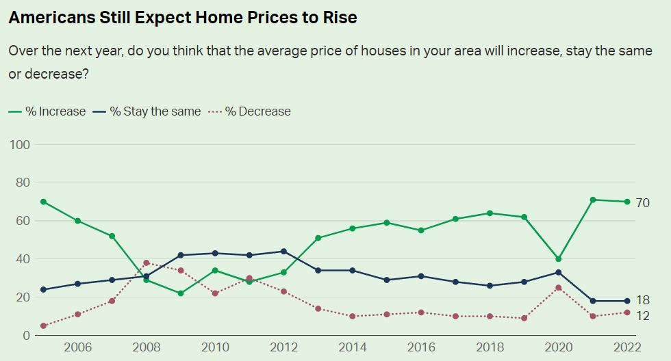
Notes:
Buyer
Power Agent® Point: The majority believe prices will continue to rise, therefore it doesn’t make sense to wait when considering buying a home
https://news.gallup.com/poll/392330/record-low-say-good-time-buy-house.aspx

Slide 24
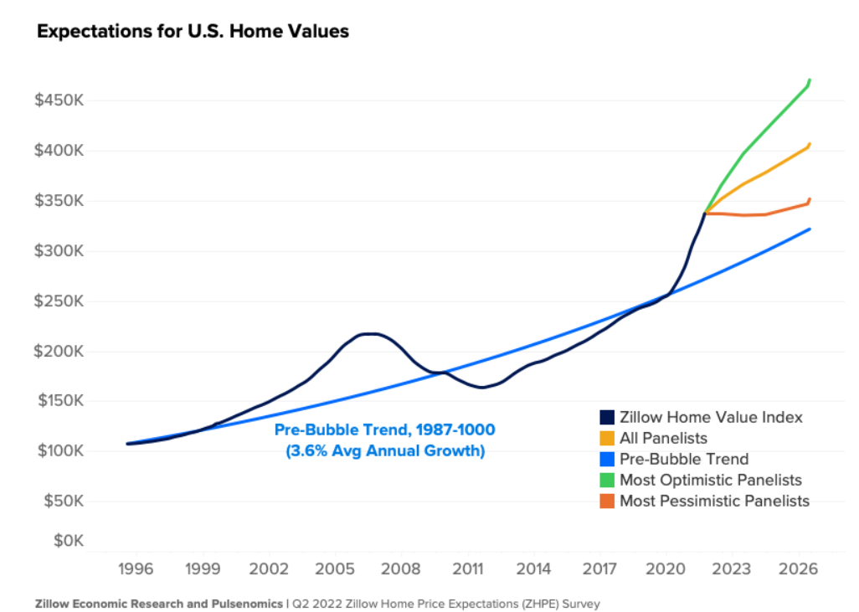
Notes:
Buyer
Power Agent® Point: Even the most pessimistic prediction shows prices to continue to rise
https://www.zillow.com/research/zhpe-q2-2022-not-a-bubble-31093/

Slide 25
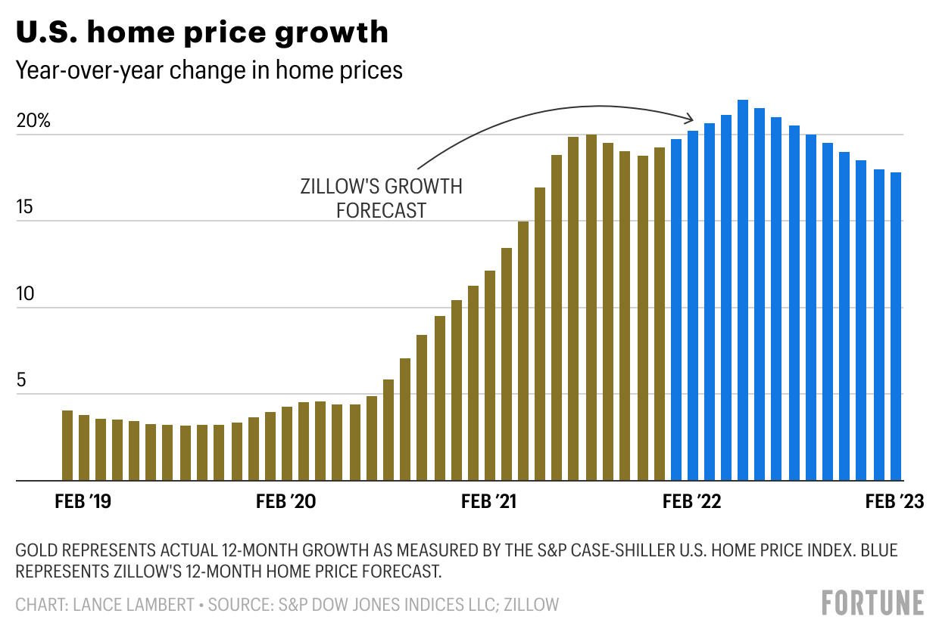
Notes:
Buyer
Power Agent® Point: Price increases may slow but it will not go negative. Prices will continue to go up 15%+ a year based on this projection

Slide 26
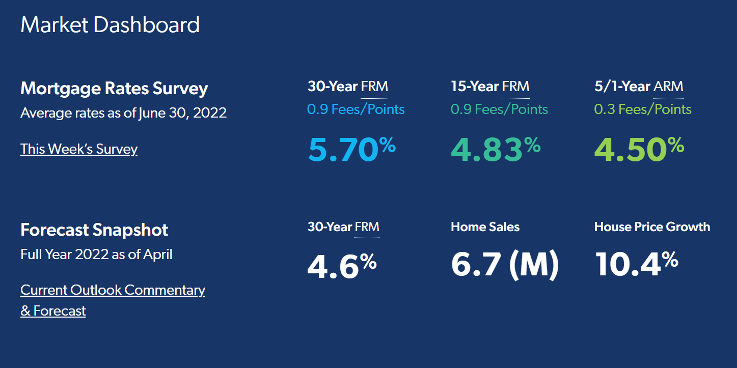
Notes:
Buyer
Power Agent® Point: The forecast (second line) suggest interest rates could come down to 4.6% but home prices will continue to rise 10.4% so there is no benefit to waiting.
https://www.freddiemac.com/research

Slide 27
“Should I wait for more houses to come to the market?”

Slide 28
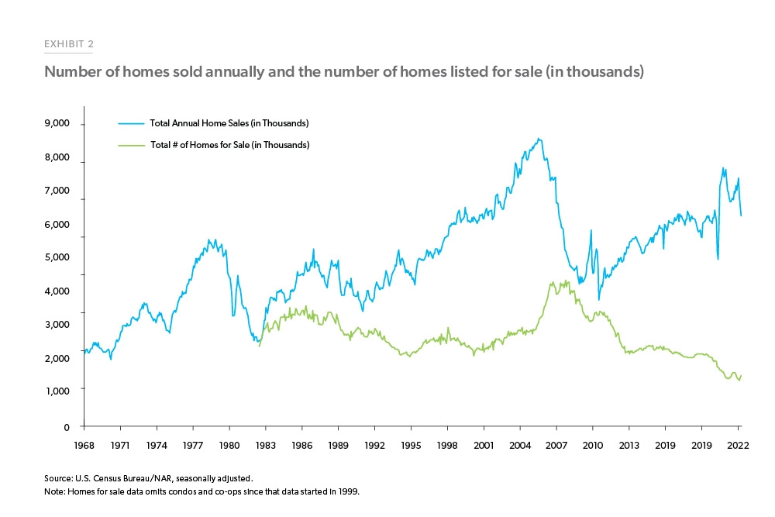
Notes:
Buyer
Power Agent® Point: Sales are strong and Inventory remains low and competitive.

Slide 29
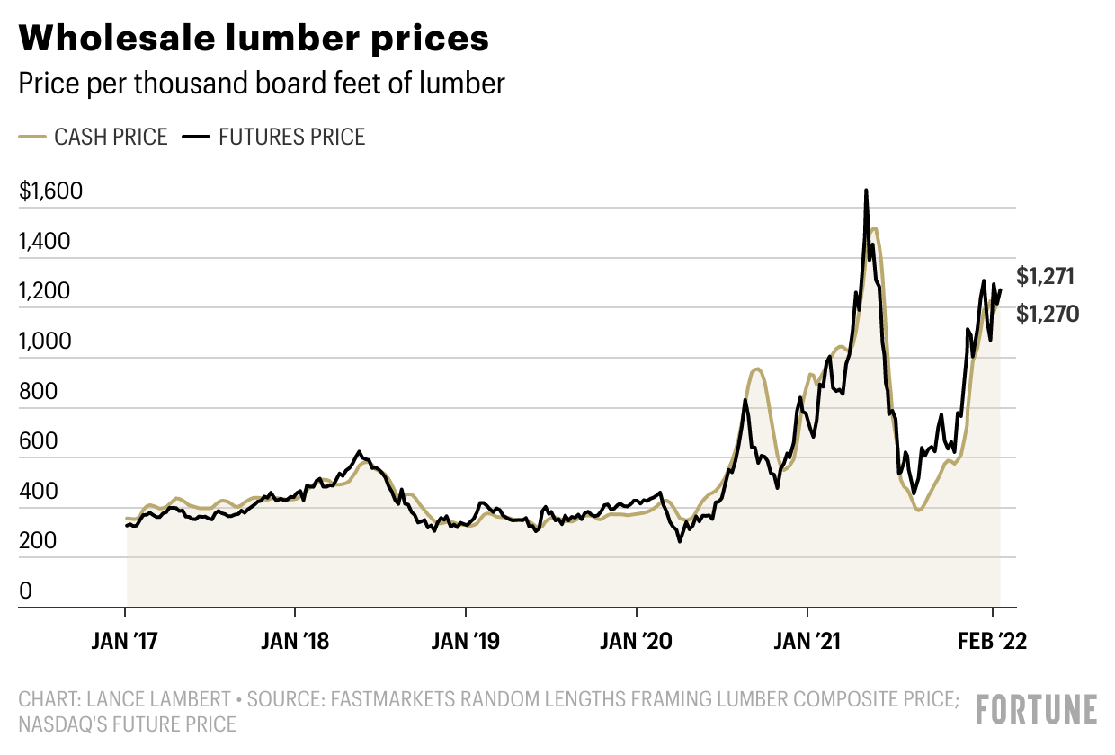
Notes:
Buyer
Power Agent® Point: Builders cost of building on the rise again which will slow up adding inventory to the market

Slide 30
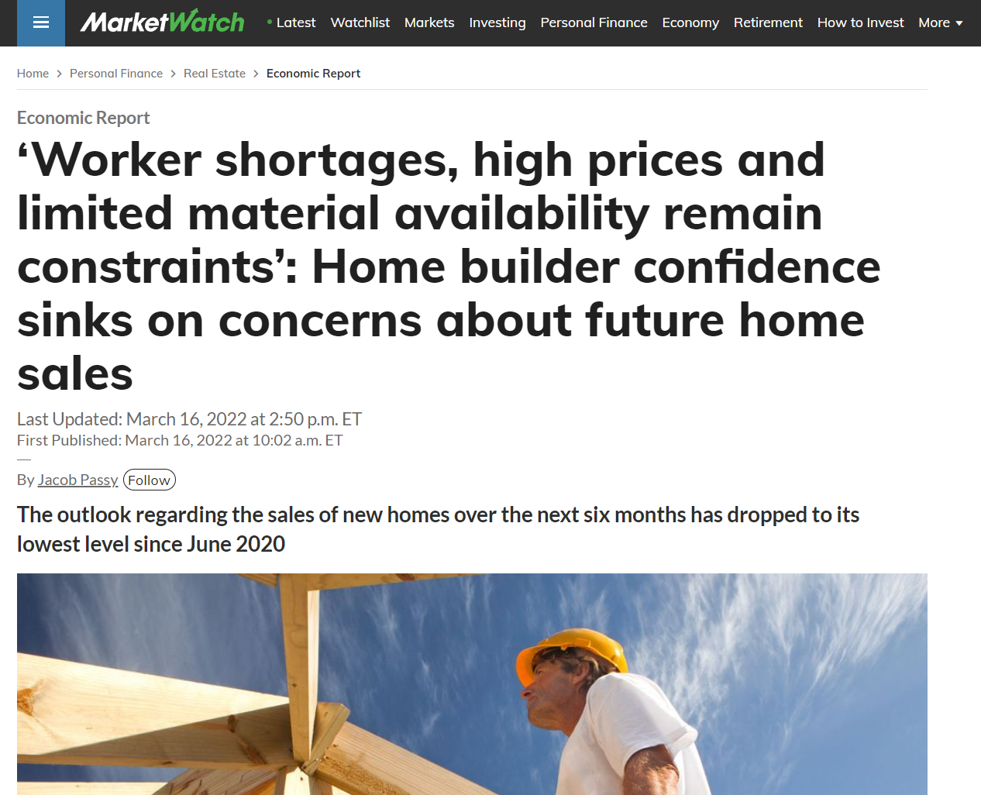
Notes:
Buyer
Power Agent® Point: Inventory will remain low and competitive.
https://www.marketwatch.com/story/home-builder-confidence-sinks-as-expectations-around-future-home-sales-worsen-11647439329

Slide 31
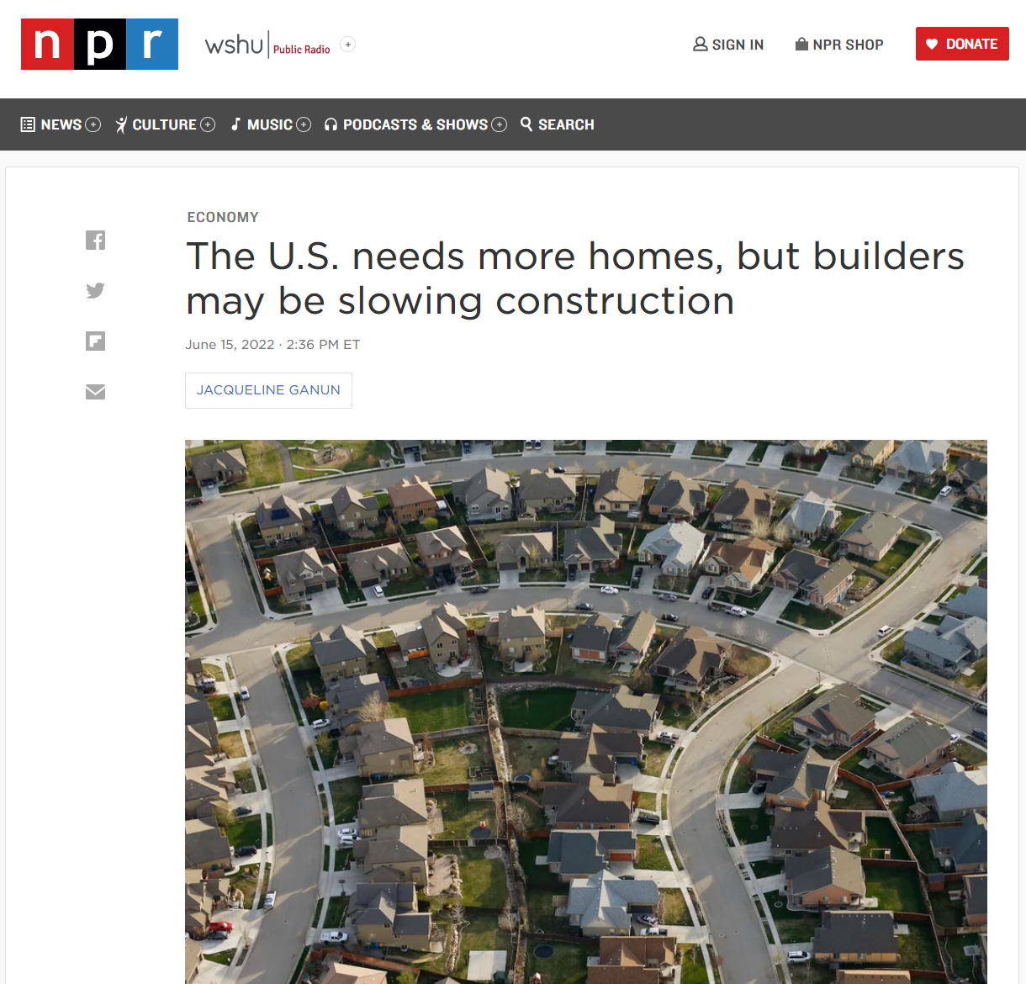
Notes:
Buyer
Power Agent® Point: Inventory will remain low and competitive.
https://www.npr.org/2022/06/15/1105240933/the-us-needs-more-homes-but-builders-may-be-slowing-construction

Slide 32
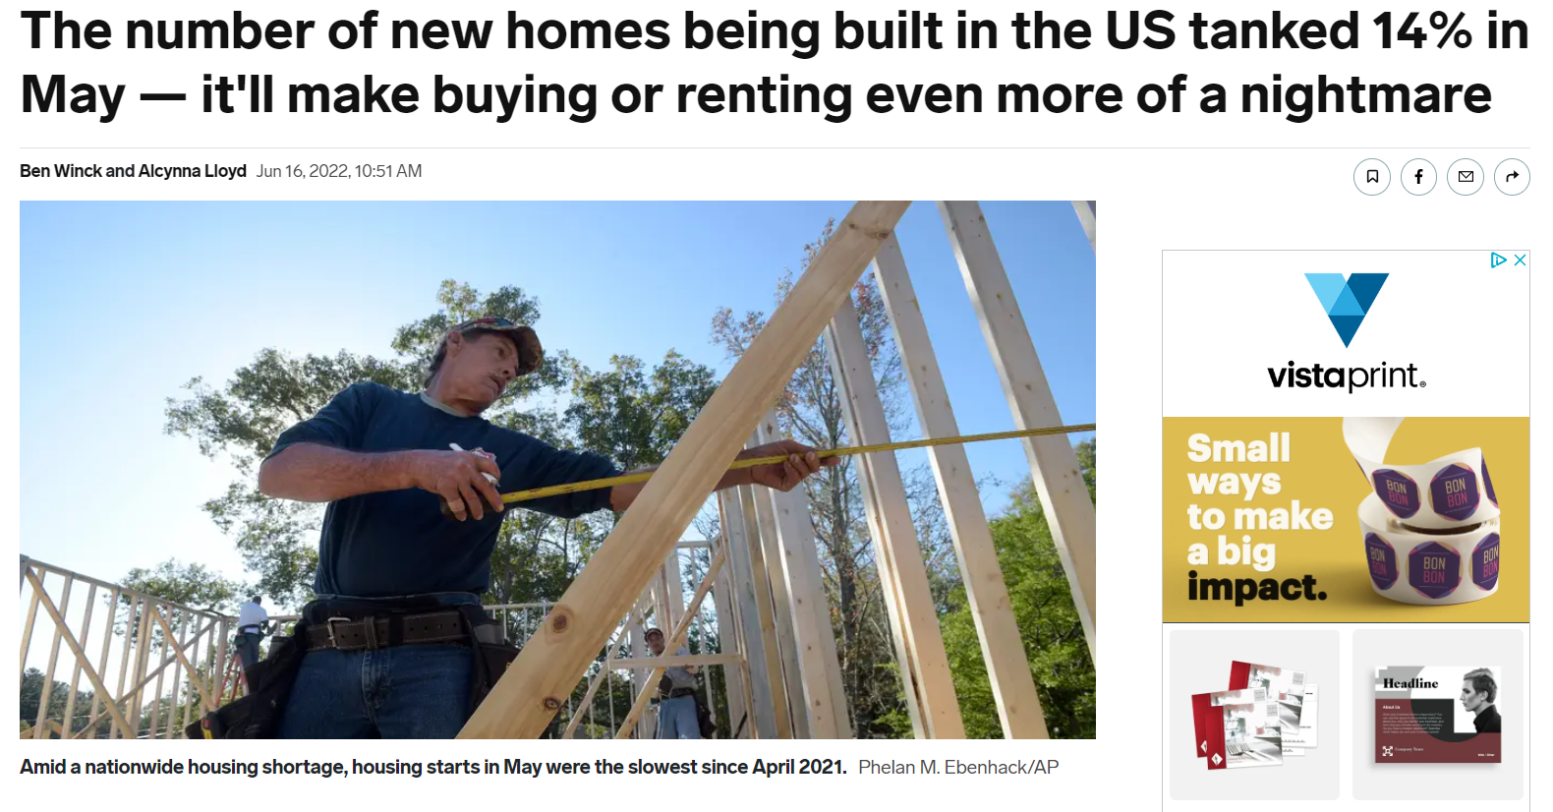
Notes:
Buyer
Power Agent® Point: Inventory will remain low and competitive.
https://www.businessinsider.in/policy/economy/news/the-number-of-new-homes-being-built-in-the-us-tanked-14-in-may-itll-make-buying-or-renting-even-more-of-a-nightmare/articleshow/92259896.cms#:~:text=of%20a%20nightmare-,The%20number%20of%20new%20homes%20being%20built%20in%20the%20US,even%20more%20of%20a%20nightmare&text=US%20housing%20starts%20slid%2014,slowest%20pace%20since%20April%202021.

Slide 33
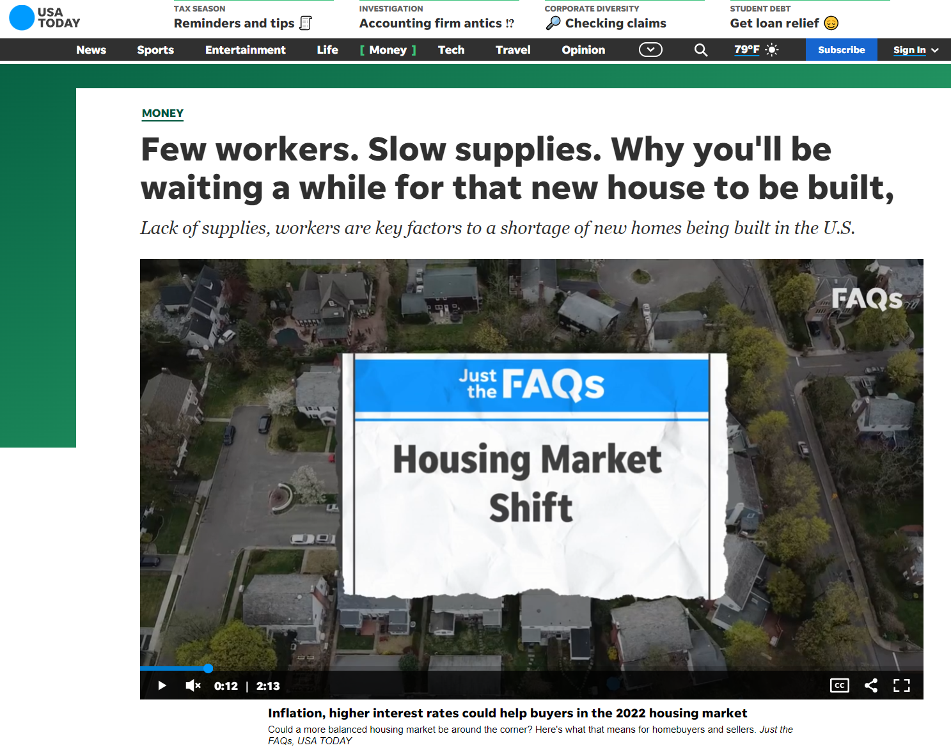
June 16, 2022
Notes:
Buyer
Power Agent® Point: Inventory will remain low and competitive.
https://www.usatoday.com/story/money/2022/06/16/new-houses-longer-build-housing-labor-shortages/7572802001/

Slide 34
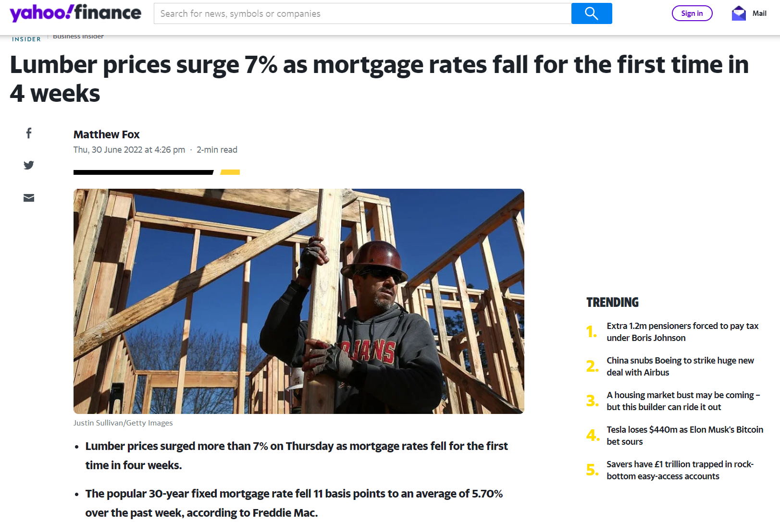
Notes:
Buyer
Power Agent® Point: Building may slow down which means higher demand for fewer listings
https://uk.finance.yahoo.com/news/lumber-prices-surge-7-mortgage-202606885.html?guccounter=1&guce_referrer=aHR0cHM6Ly93d3cuZ29vZ2xlLmNvbS8&guce_referrer_sig=AQAAAKnCzKYNjW_sF8RKkns2wf2O9CSHNOuhQ-0O6Vd57Ps11rLVhJBDD8qYlXIcOcpCaQ6PZx7XHP3gdzAilVJQY0DfFOL50AFnld0bz_b0SKZ_LiCaGFSngv34eR2SdNRqEmK8ycUIXhLP4Wwx-TT8fPUpfAOq4A_4bD-klXfTW008

Slide 36
Should I wait to for more houses to come to the market?
Len Kiefer
Deputy Chief Economist at Freddie Mac
“Given where starts and permits are, I would expect that housing construction is probably 2+ years of production away from filling in the gap. I think it’s going to be a slog to really bring balance back to the housing market.”
Notes:
Buyer
Power Agent® Point: Until builders can add enough homes to the market, there will always be strong competition for a buyer because there are more buyers than there are homes for sale.
https://themortgagereports.com/91026/housing-market-inventory-peak-summer-2022

Slide 37
Should I wait to for more houses to come to the market?
Danielle Hale
Chief Economist at Realtor.com
“The market will eventually get to balance; it’s just not going to happen overnight. We need to have more building. At the end of 2021, the U.S. was 5.8 million single family homes short. It essentially means we’re five years behind when it comes to construction.”
Notes:
Buyer
Power Agent® Point: Until builders can add enough homes to the market, there will always be strong competition for a buyer because there are more buyers than there are homes for sale.
https://themortgagereports.com/91026/housing-market-inventory-peak-summer-2022

Slide 38
“Should I wait for interest rates to come down?”

Slide 39
Mortgage Rate Predictions 2022
“Given current conditions and Federal Reserve guidance, mortgage rates are not likely to decline significantly in the near term.”
Paul Thomas, Zillow Vice President of Capital Markets
“I expect mortgage rates to be at 5.5% by the end of 2022
Danielle Hale, Chief Economist at Realtor.Com
“Mortgage rates bouncing along near 6% is certain for the remainder of the year. They could go up even close to 7%, especially if oil and gas supply further lags behind and pushes up energy prices during heating season.”
Lawrence Yun, Chief Economist for National Association of Realtors
Notes:
Buyer
Power Agent® Point: Forget waiting for interest rates to come down
https://www.forbes.com/advisor/mortgages/mortgage-interest-rates-forecast/

Slide 40
Notes:
Buyer
Power Agent® Point: The forecast (second line) suggest interest rates could come down to 4.6% but home prices will continue to rise 10.4% so there is no benefit to waiting.
https://www.freddiemac.com/research

Slide 41
2022
$429,000
Do NOT Try &
Time The Market
Interest Rates
1981
18.63%
1990
10.05%
1975
9.49%
1970
7%
1990
$124,000
1981
$67,000
1975
$38,000
1970
$24,000
Notes:
Buyer
Power Agent® Point: Real estate ALWAYS goes up, regardless what the economy or interest rates do. There is no waiting or trying to time the market
Source: U.S. Census Bureau, U.S. Department of Housing and Urban Development,
https://fred.stlouisfed.org/series/MSPUS, July 3, 2022

Slide 42
Work From Monthly Payments

Slide 43
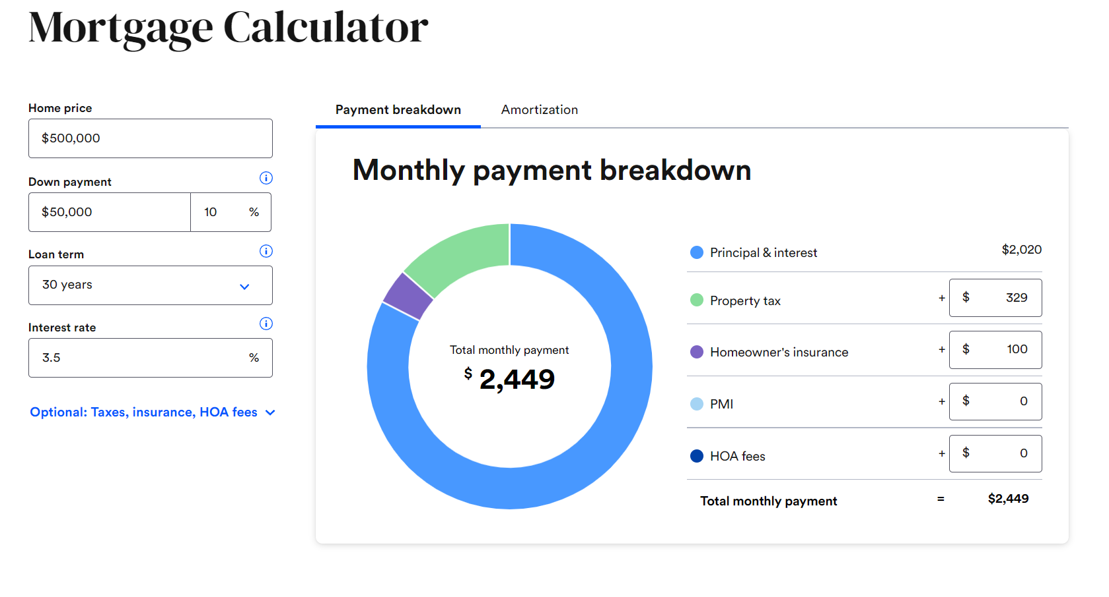

Slide 44
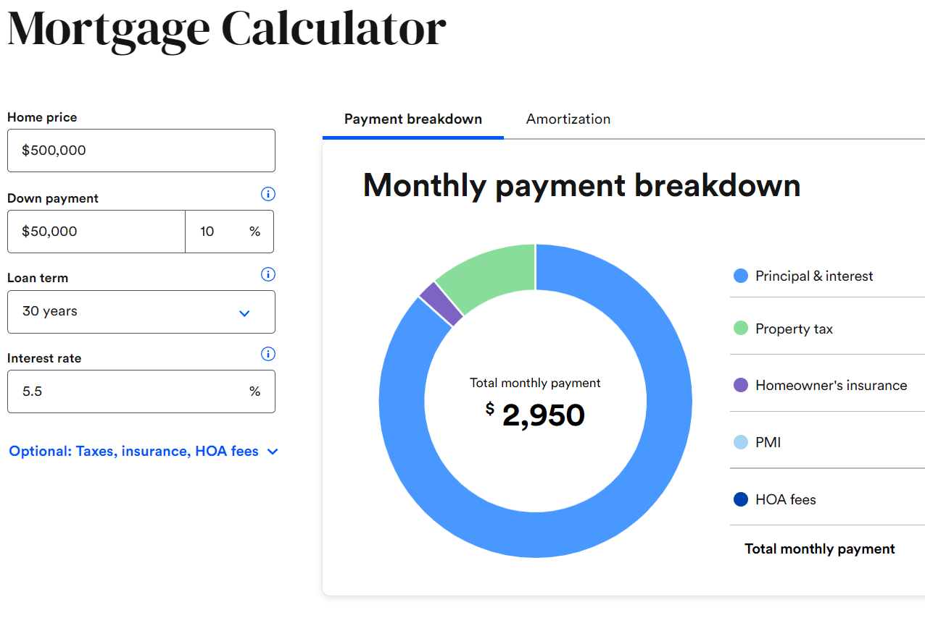
Goal: $2,449

Slide 45
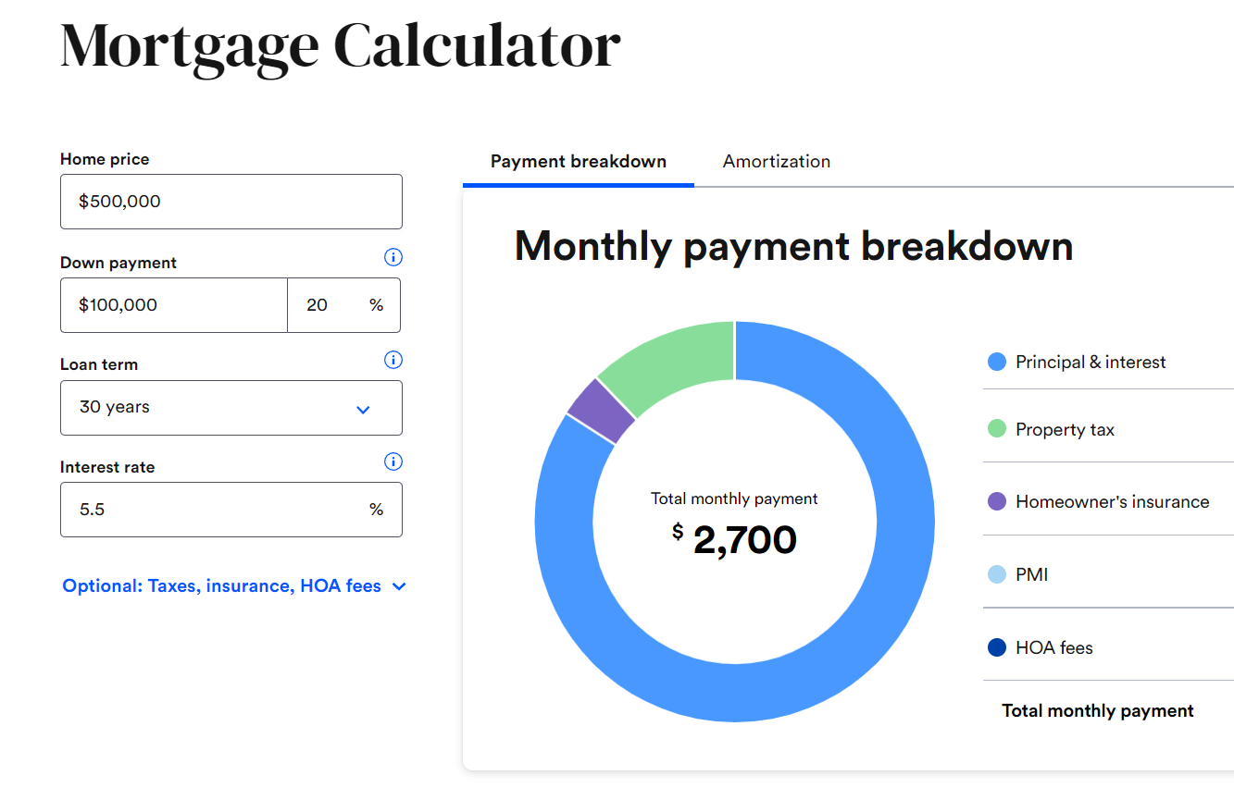
Goal: $2,449

Slide 46
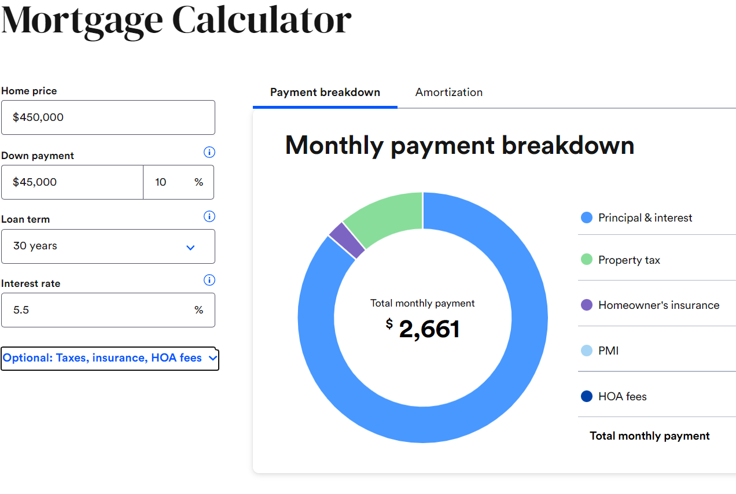
Goal: $2,449

Slide 47
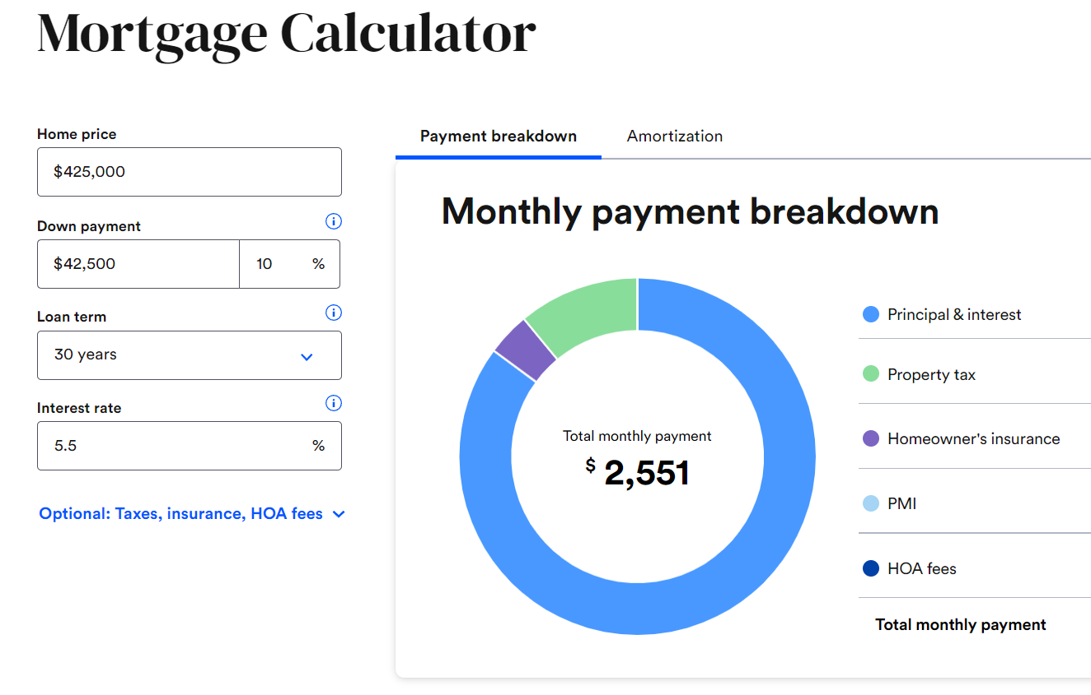
Goal: $2,449

Slide 48
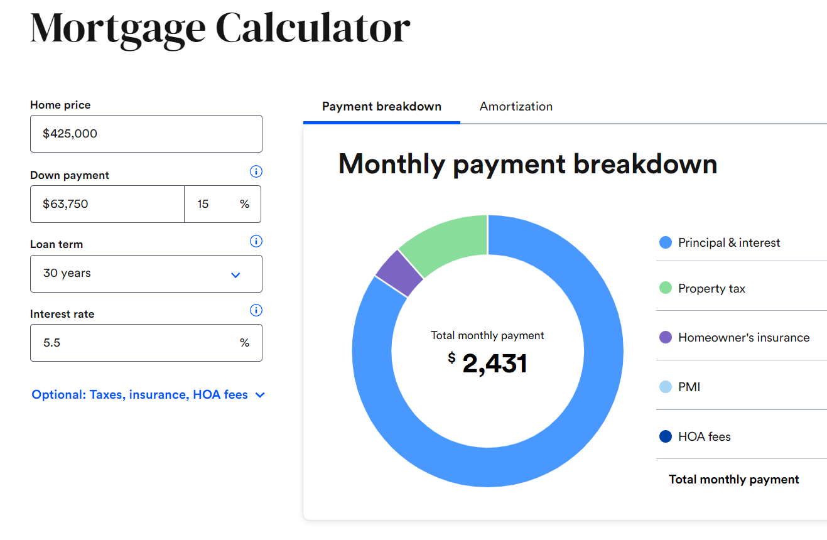
Goal: $2,449

Slide 49
https://downpaymentresource.com/

Slide 50
Notes:
https://realtorparty.realtor/community-outreach/housing-opportunity

Slide 51
Notes:
https://freddiemac.gcs-web.com/news-releases/news-release-details/freddie-mac-announces-landmark-equitable-housing-finance-plan?

Slide 52
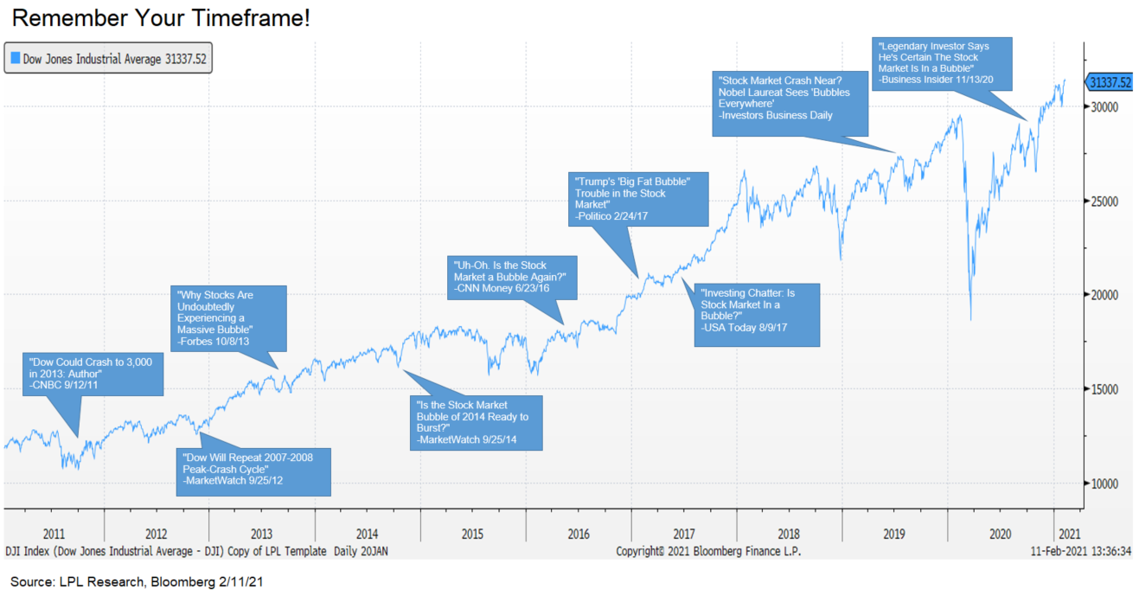
Ignore “We’re In a Bubble”
Notes:
Buyer
Power Agent® Point: Help them see not to listen to people’s opinions (wait for prices to come down, wait for interest rates to come down, don’t rush it, it’s not a sller’s market anymore, etc.)

Slide 53
Get a copy of these slides
www.TryThePowerProgram.com

Slide 55
There are 2 Types of Sellers
Seller #1: They are committed to moving because they know where they are going.
Seller #2: They have not found a place to move to, so they may be committed to price.
When dealing with Seller #2, you may need to get a buyer agency agreement and help them become Seller #1

Slide 56
Sales Are Down

Slide 57
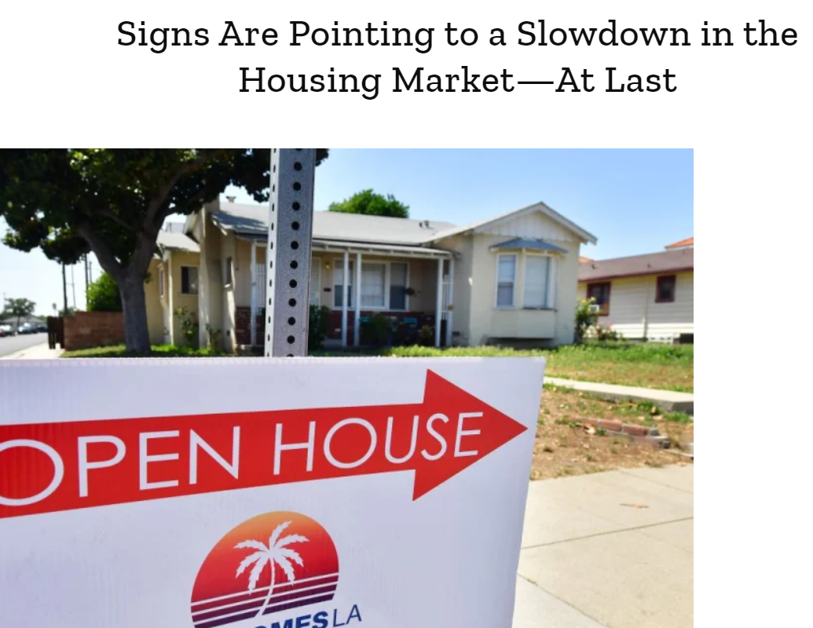
May 4, 2022
A decline in house prices
Dennis McGill, director of research at Zelman & Associates, says housing prices could fall as soon as 2023.
“Our research is saying there’s something significantly negative coming,” he says.
Notes:
Seller
Power Agent® Point: Now seems to be the best time to sell
https://time.com/6178366/house-prices-us/

Slide 58
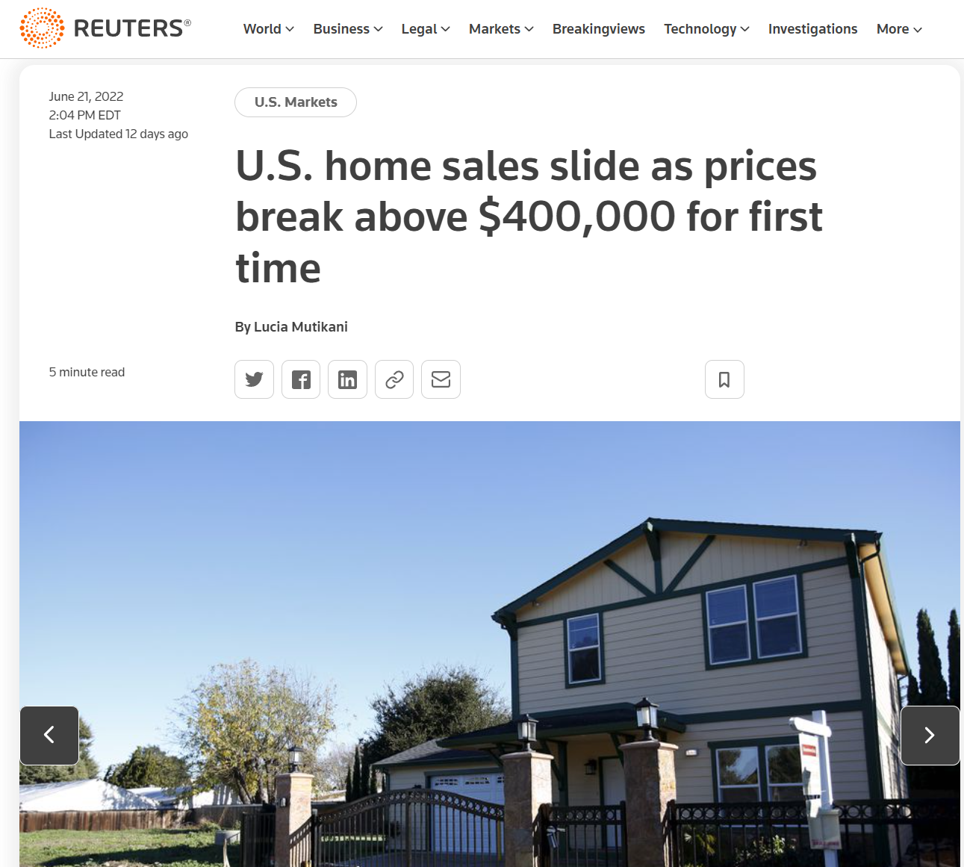
Notes:
Seller
Power Agent® Point: Signs of weakness
https://www.reuters.com/markets/us/us-existing-home-sales-drop-two-year-low-may-2022-06-21/

Slide 59
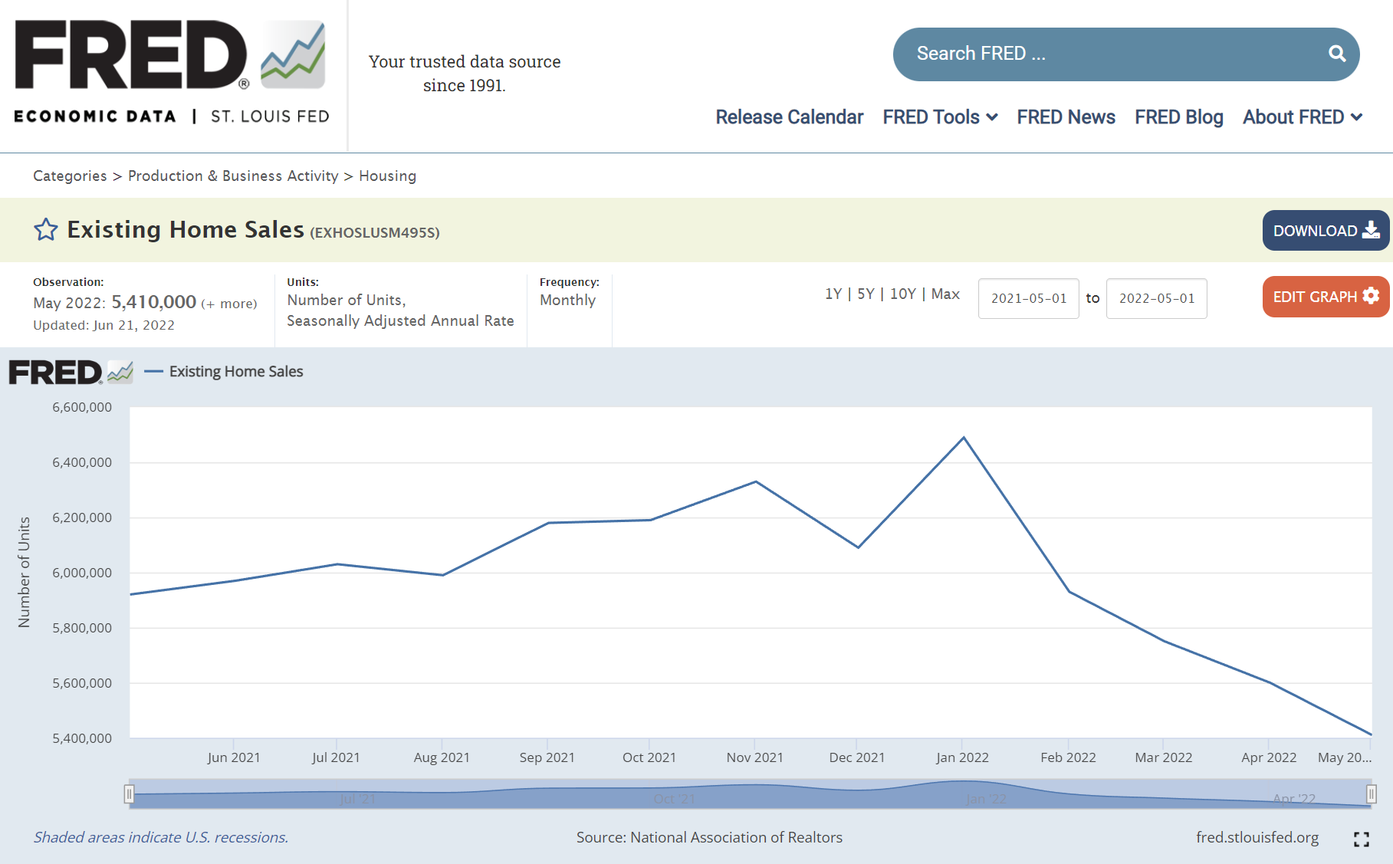
Notes:
Seller
Power Agent® Point: Sales are way down as we said earlier because of interest rates taking buyers out of the market
https://fred.stlouisfed.org/

Slide 60
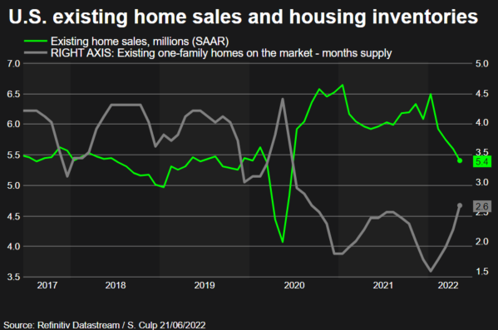
Sales down since January; inventory supply almost double
Notes:
Seller
Power Agent® Point: Signs of weakness. Sales are down to 5.4 millions and saturation rate (month supply of listings for sale) is at 2.6 months

Slide 61
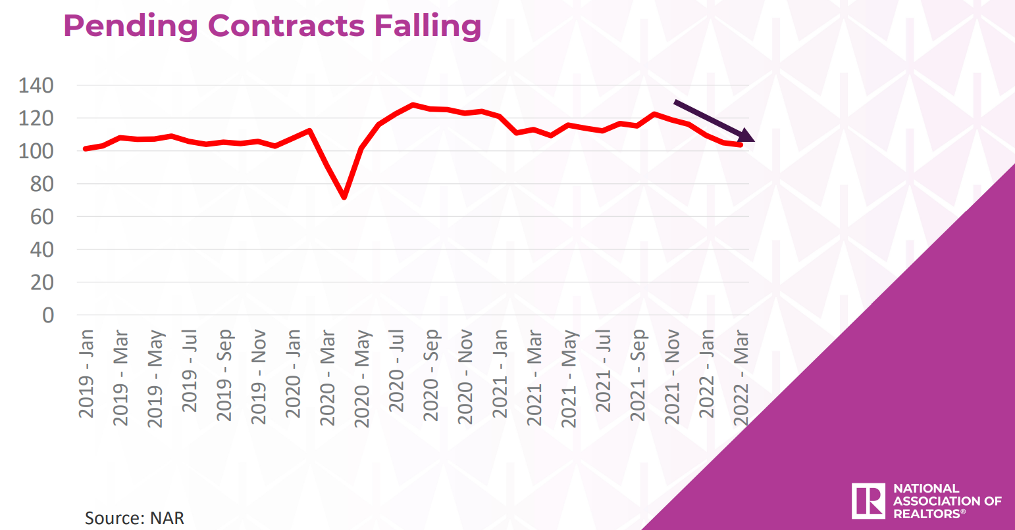
Notes:
Seller
Power Agent® Point: We are seeing less contracts because of interest rates
https://cdn.nar.realtor/sites/default/files/documents/2022-realtors-legislative-meetings-residential-economic-issues-and-trends-forum-lawrence-yun-presentation-slides-05-04-2022.pdf

Slide 62
Interest Rates Are Up

Slide 63
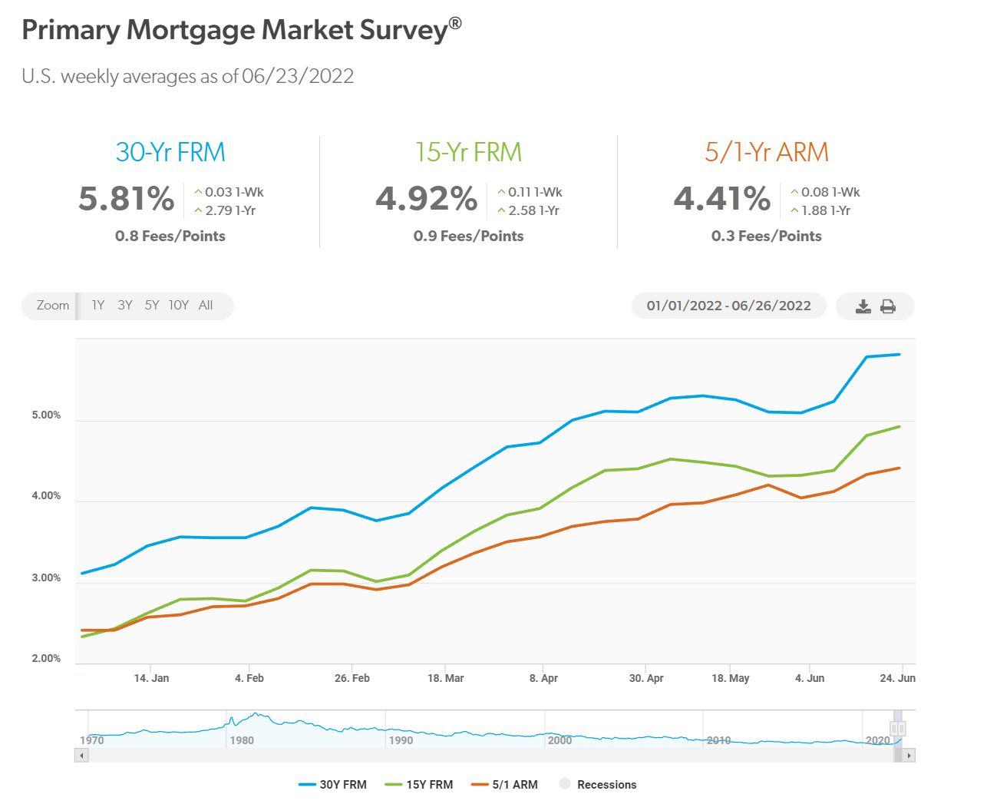

Slide 65
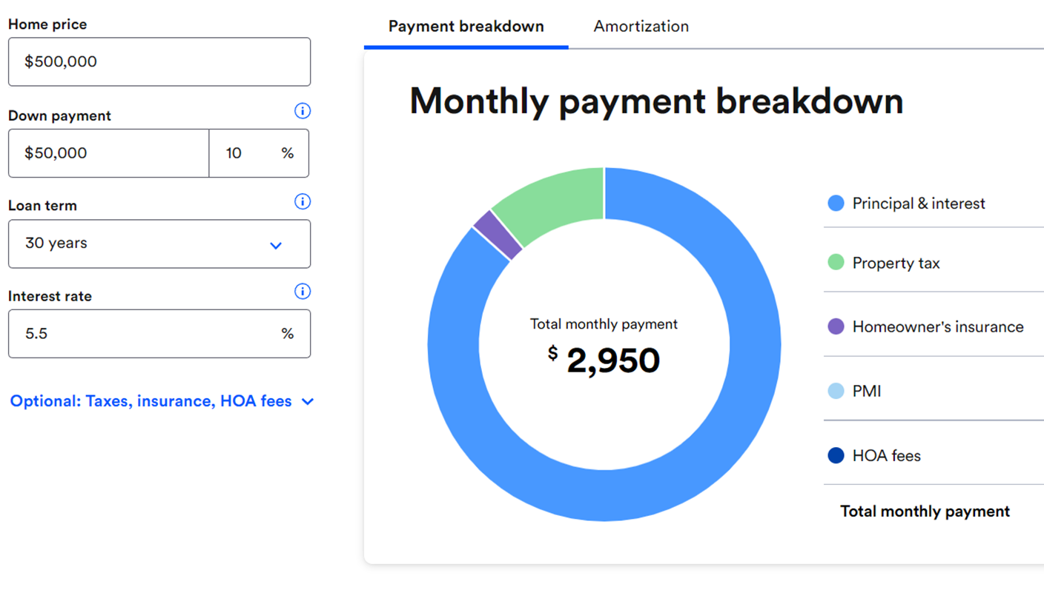

Slide 66
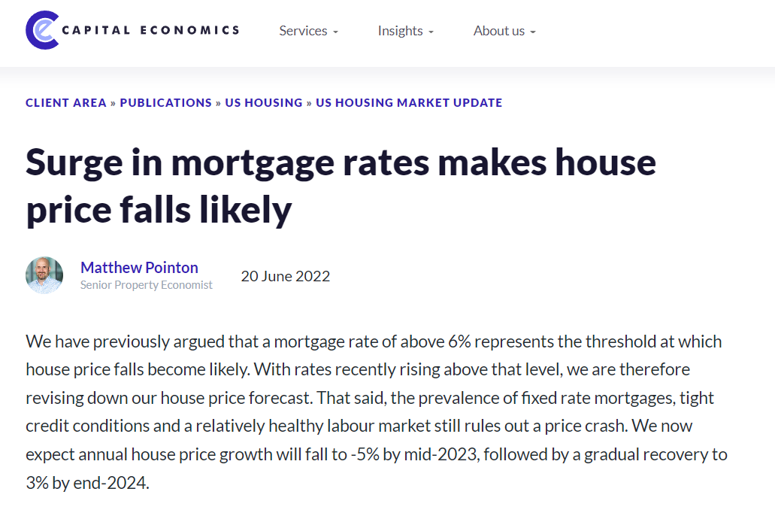
Notes:
https://www.capitaleconomics.com/publications/us-housing/us-housing-market-update/surge-in-mortgage-rates-makes-house-price-falls-likely/?login_time=d2b86056-1591-4b09-90c6-8302154afa00

Slide 67
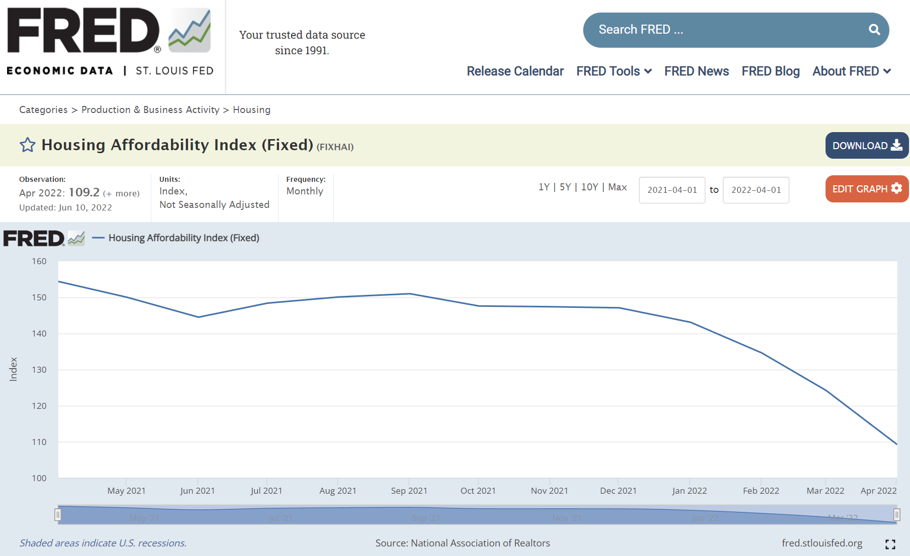
Notes:
Seller
Power Agent® Point: An index above 100 signifies that family earning the median income has more than enough income to qualify for a mortgage loan on a median-priced home, assuming a 20 percent down payment.
It has become less affordable for buyers since rates starting going up, taking buyers out of the market, which will make it harder to sell.
https://fred.stlouisfed.org/

Slide 68
Confidence Is Down

Slide 69
Notes:
Seller
Power Agent® Point: Not only do interest rates go up, but everything is more expensive, and buyers have to look at their monthly expenses
https://cdn.nar.realtor/sites/default/files/documents/2022-realtors-legislative-meetings-residential-economic-issues-and-trends-forum-lawrence-yun-presentation-slides-05-04-2022.pdf

Slide 70
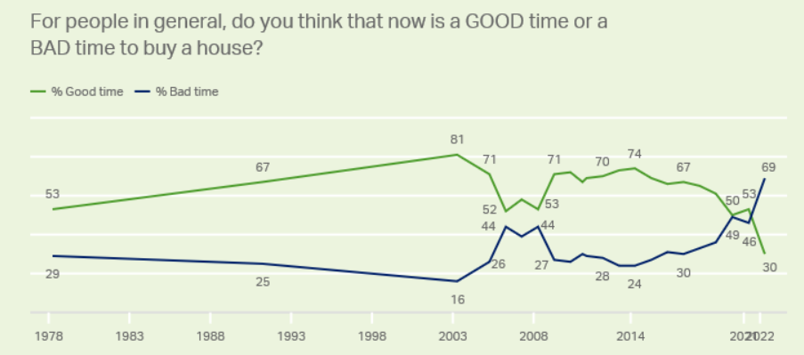
Notes:
Seller
Power Agent® Point: There has never been a time since 1978 where people are negative on buying a house. This could put pressure on pricing and how long it takes to sell.

Slide 71
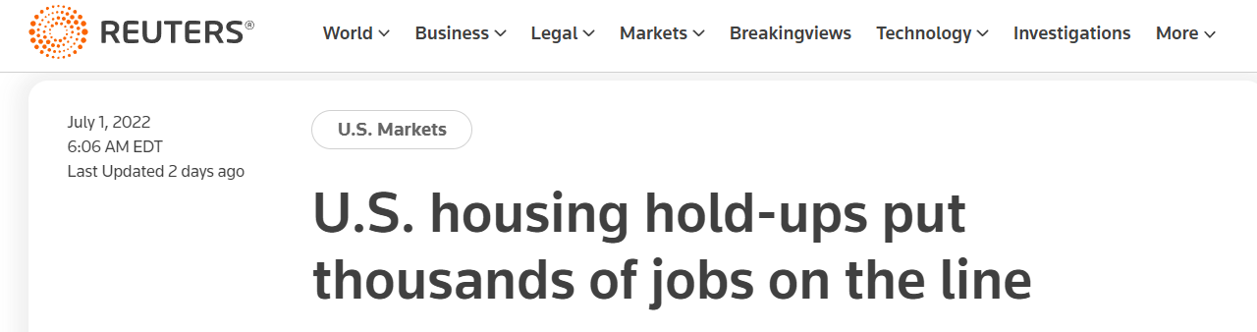
U.S. mortgage lenders, refinancing companies and real-estate brokers may lay off thousands of employees in the coming months, industry sources said, as many Americans put off buying a home.
Low interest rates, stimulus payments and working from home during the coronavirus pandemic had prompted many millennials to hunt for new homes, fueling a red-hot U.S. housing market.
But the market is now cooling amid economic uncertainty resulting from the Ukraine conflict and a jump in mortgage rates as the Federal Reserve raises the cost of borrowing.
Notes:
Seller
Power Agent® Point: Signs of weakness
https://www.reuters.com/markets/us/us-housing-hold-ups-put-thousands-jobs-line-2022-07-01/

Slide 72
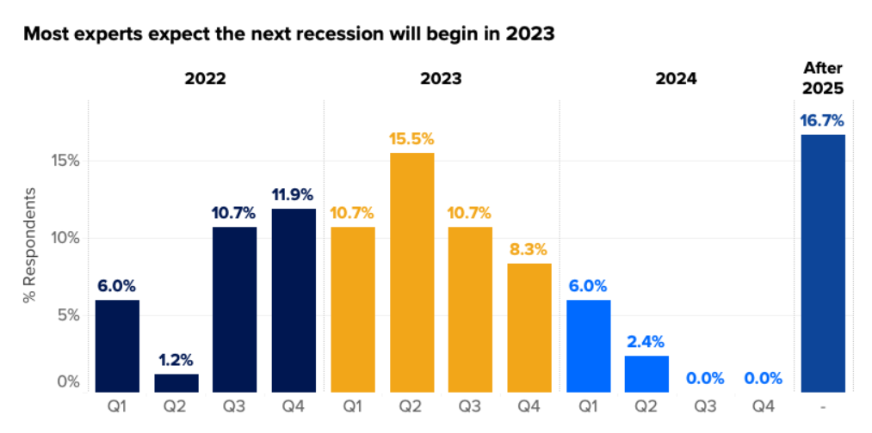
Notes:
Seller
Power Agent® Point: If a recession hits, that might negatively impact a seller.
https://www.zillow.com/research/zhpe-q2-2022-not-a-bubble-31093/

Slide 73
Property Values are Decelerating

Slide 74
Is the housing market about to crash? Here’s what the experts say
June 24, 2022
“Our view is that house prices are somewhere in the 15 percent range above what the long-term fundamentals suggest.”
Doug Duncan, Chief Economist at Fannie Mae
“I would not be surprised if some markets do see some minor price declines.”
Lawrence Yun, Chief Economist for National Association of Realtors
Notes:
Seller
Power Agent® Point: Price to sell now before the market changes
https://www.bankrate.com/real-estate/is-the-housing-market-about-to-crash/#:~:text=Home%20sales%20fell%208.6%20percent,May%202021%20to%20May%202022.

Slide 75
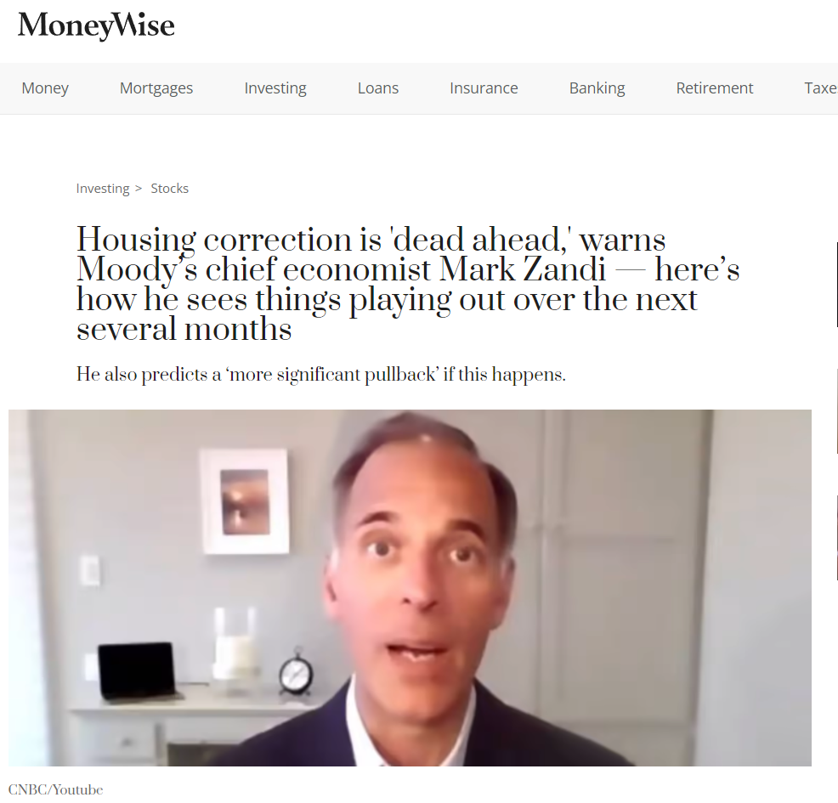
Notes:
Seller
Power Agent® Point: Now is the time to sell
https://moneywise.com/investing/stocks/housing-correction-is-dead-ahead-warns-moodys-chief-economist

Slide 76
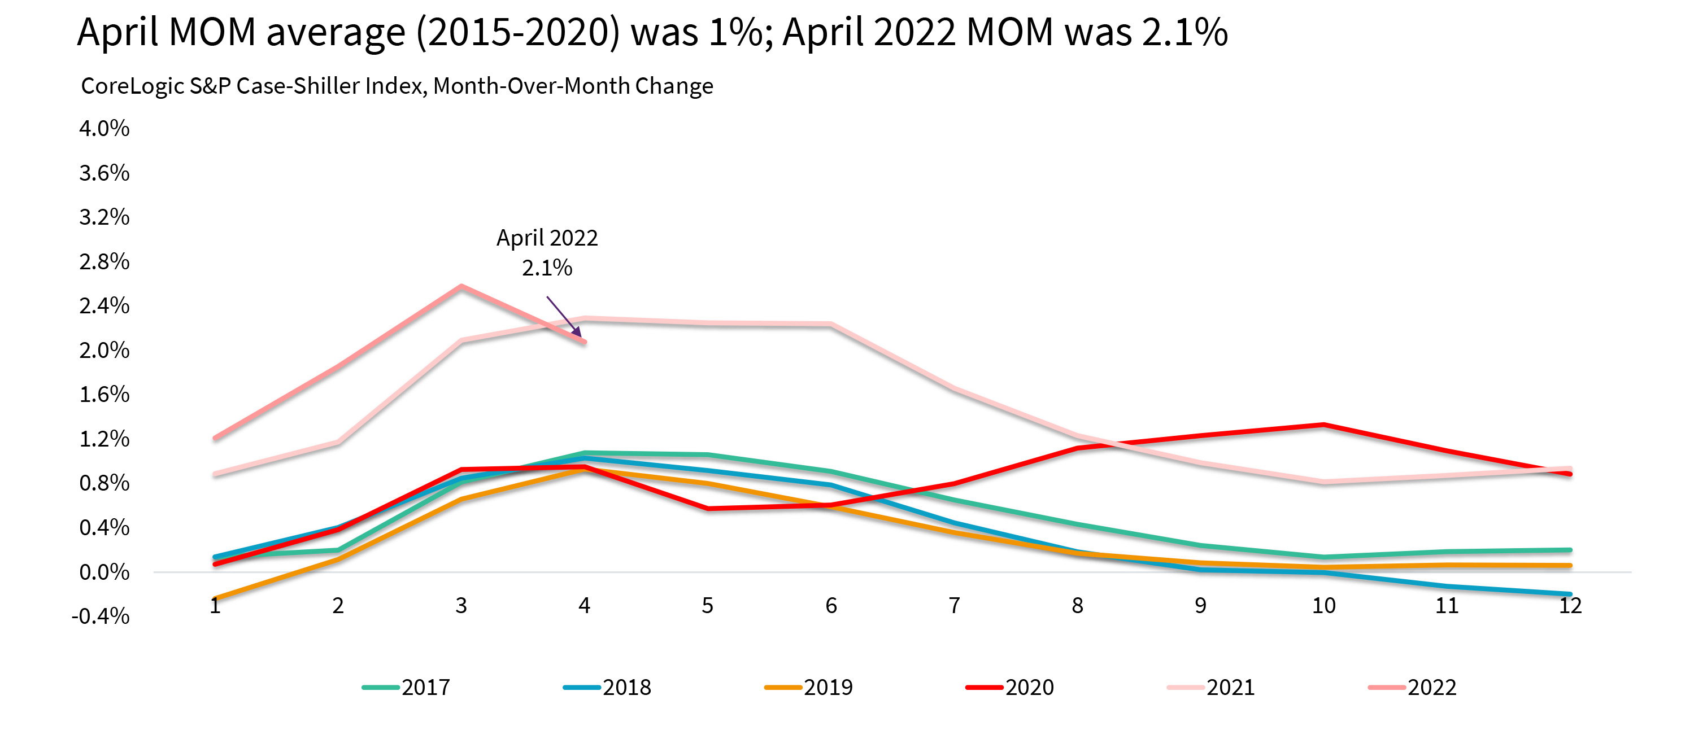
Month-to-Month Price Growth
Notes:
Seller
Power Agent® Point: Prices going up are slowing down
Month-to-Month Price Growth Slowing in April but Still Second Highest in Data History for April
https://www.corelogic.com/intelligence/reports/case-shiller-index/us-sp-corelogic-case-shiller-index-turns-the-corner-again-up-20-4-annually-in-april-but-down-from-march/

Slide 77
Notes:
Seller
Power Agent® Point: The CoreLogic HPI Forecast indicates that home prices will increase on a month-over-month basis by 1.2% from April 2022 to May 2022 and on a year-over-year basis by 5.6% from April 2022 to April 2023. Therefore, prices are still going to rise but much slower than what we have seen
https://www.corelogic.com/intelligence/u-s-home-price-insights/

Slide 78
Notes:
Seller
Power Agent® Point: Notice the possible decline in price growth

Slide 79
Taking Longer To Sell

Slide 80
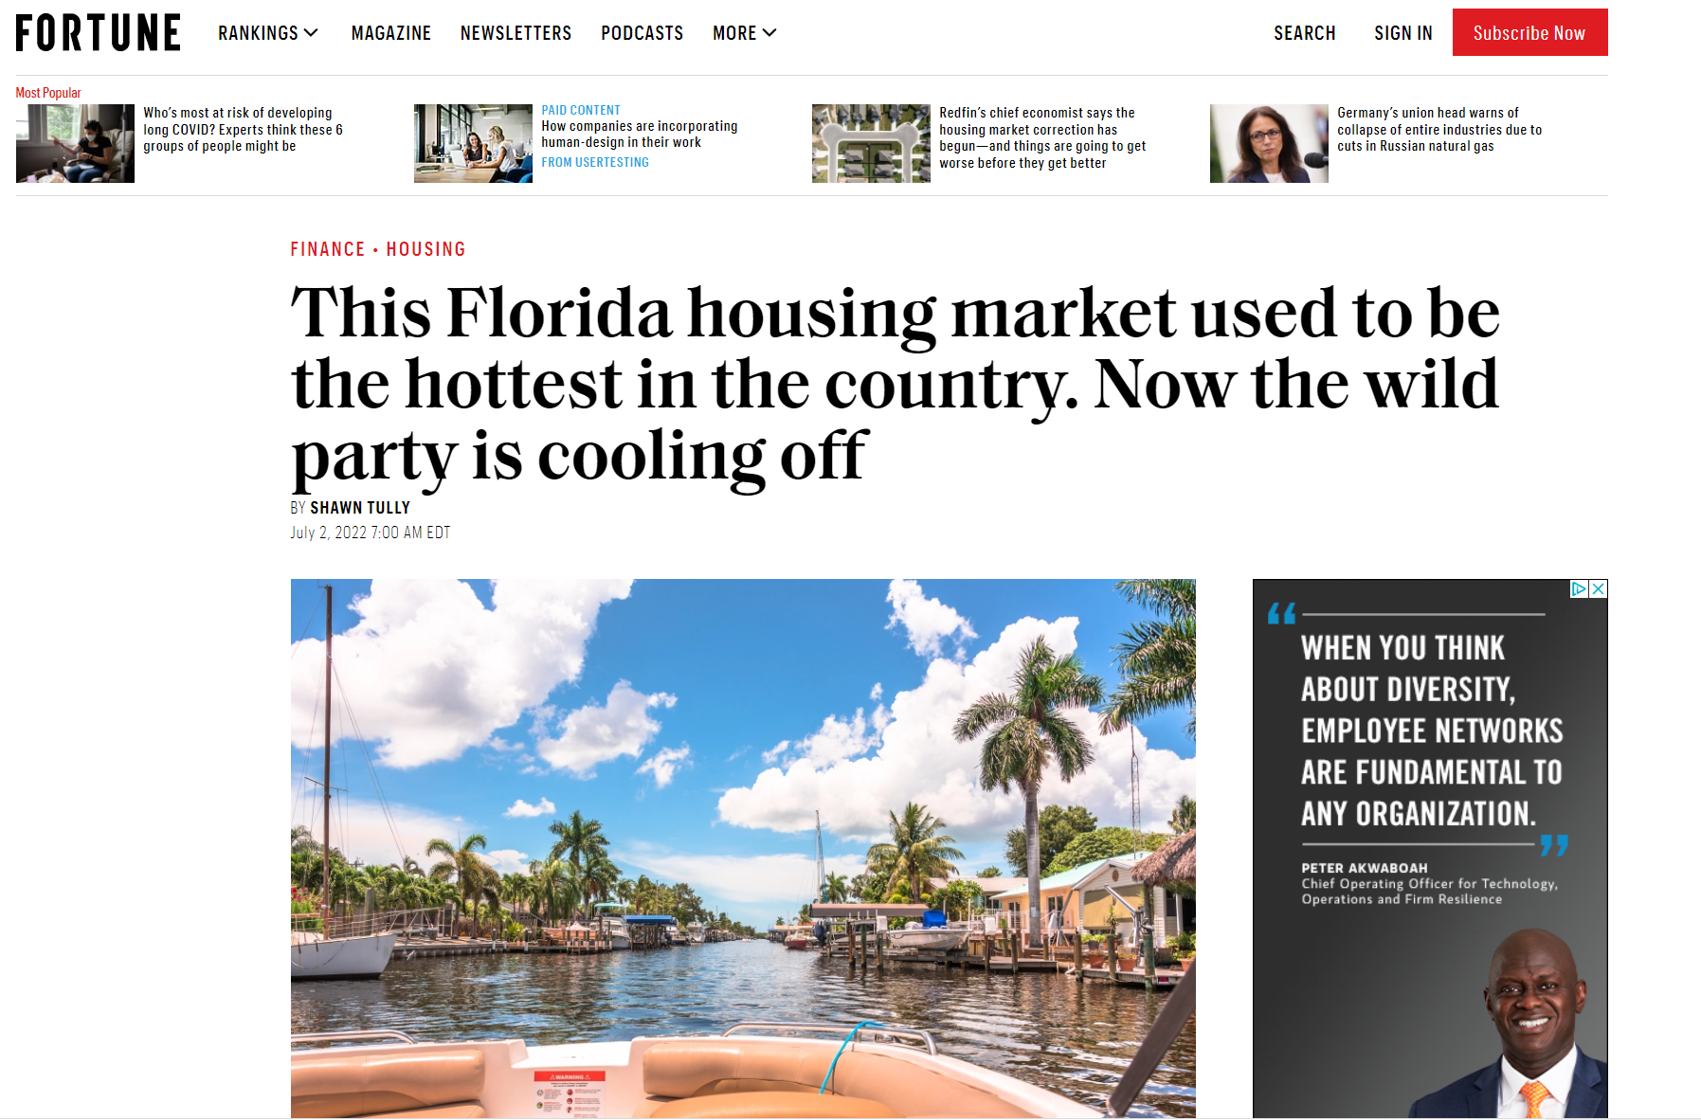
Notes:
Seller
Power Agent® Point: Even Florida is showing signs of weakness
https://fortune.com/2022/07/02/this-florida-housing-market-used-to-be-the-hottest-in-the-country-now-the-wild-party-is-cooling-off/

Slide 81
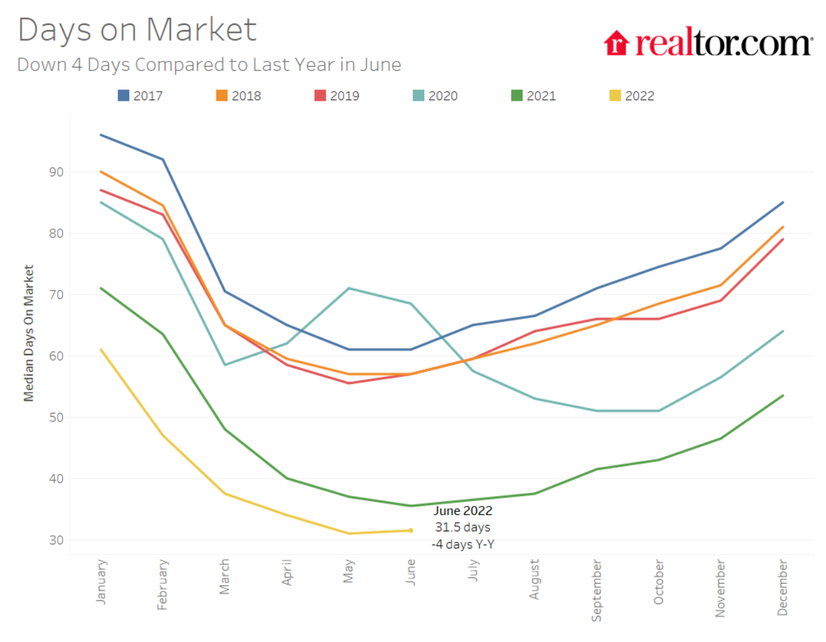
We are entering months where it takes longer to sell a house
Notes:
Seller
Power Agent® Point: You will notice that it always takes longer to sell a house after August (except for pandemic year of 2020)
https://www.realtor.com/research/june-2022-data

Slide 82
More Listings Means More Competition

Slide 83
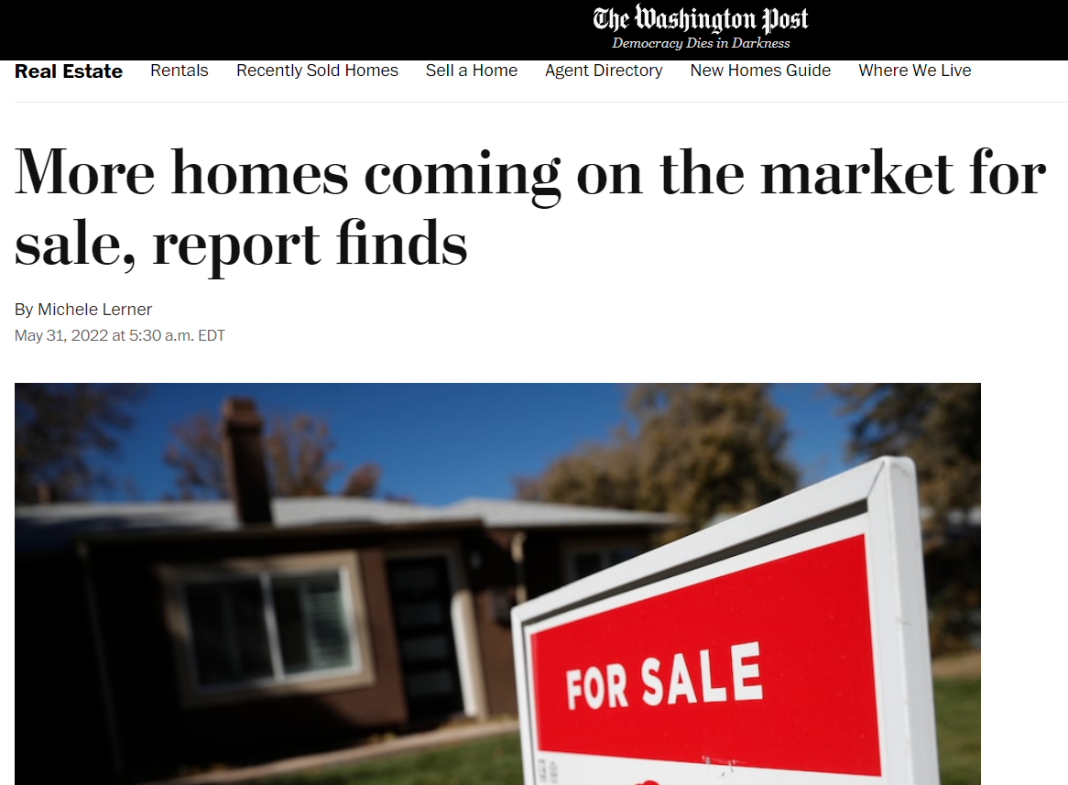
Notes:
Seller
Power Agent® Point: You More houses, more competition which forces sellers to lower prices
https://www.washingtonpost.com/business/2022/05/31/more-homes-coming-market-sale-report-finds/

Slide 84
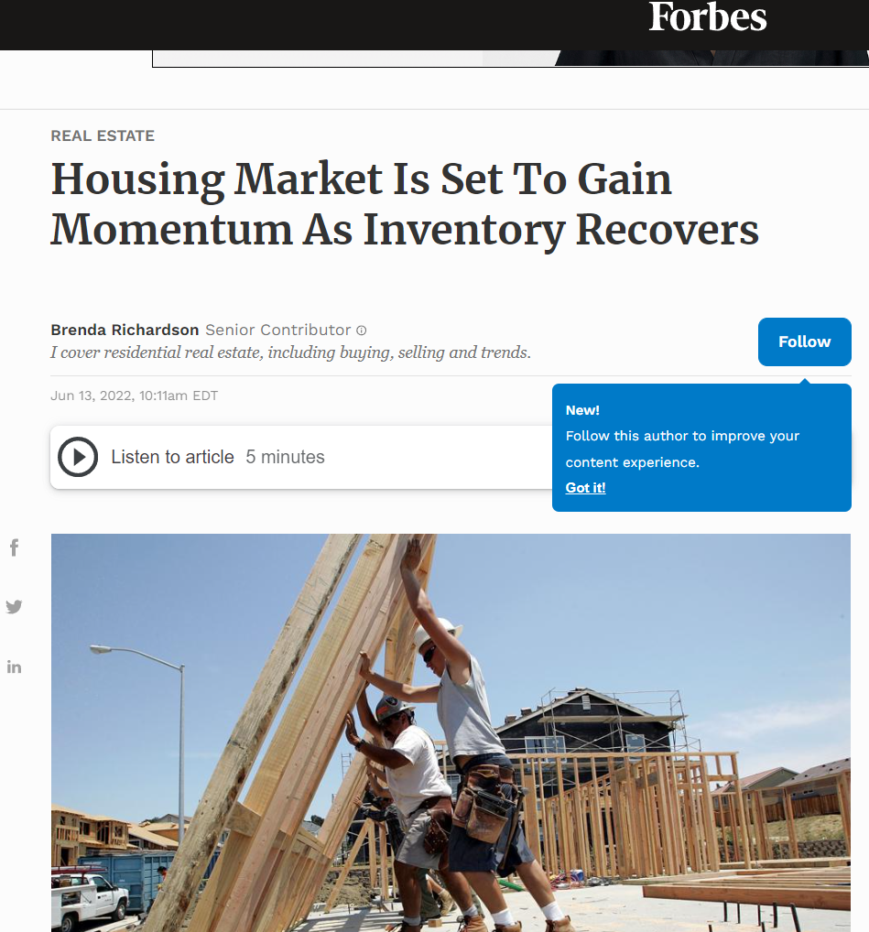
Notes:
Seller
Power Agent® Point: You More houses, more competition which forces sellers to lower prices
https://www.forbes.com/sites/brendarichardson/2022/06/13/housing-market-is-set-to-gain-momentum-as-inventory-recovers/?sh=1e351a094159

Slide 85
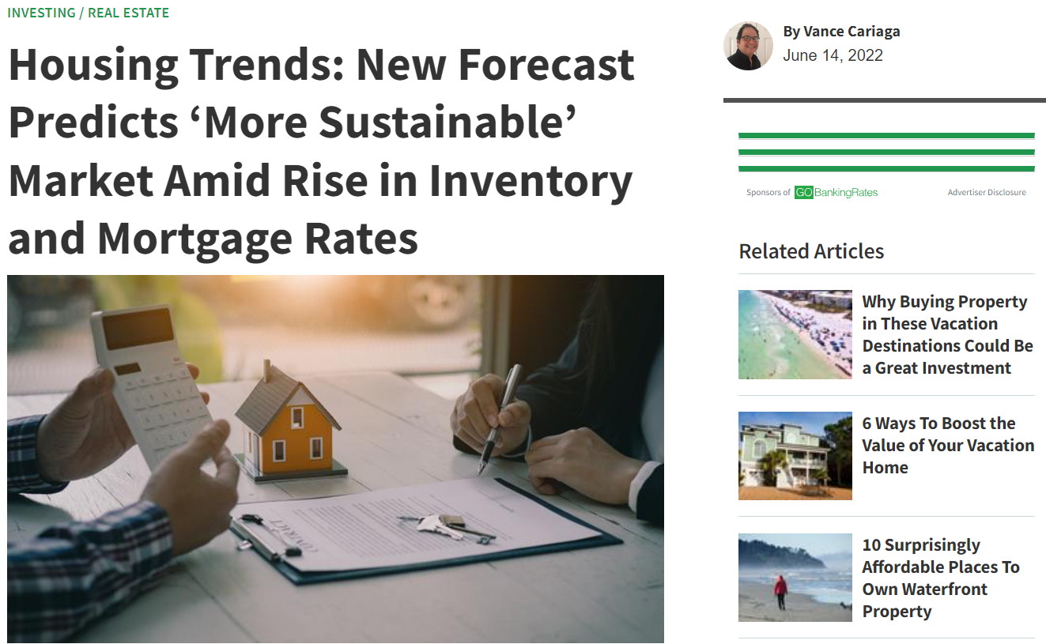
Notes:
Seller
Power Agent® Point: “More Sustainable” means slowing down to normal pace
https://www.gobankingrates.com/investing/real-estate/housing-trends-new-forecast-predicts-more-sustainable-market-amid-rise-in-inventory-and-mortgage-rates/

Slide 86
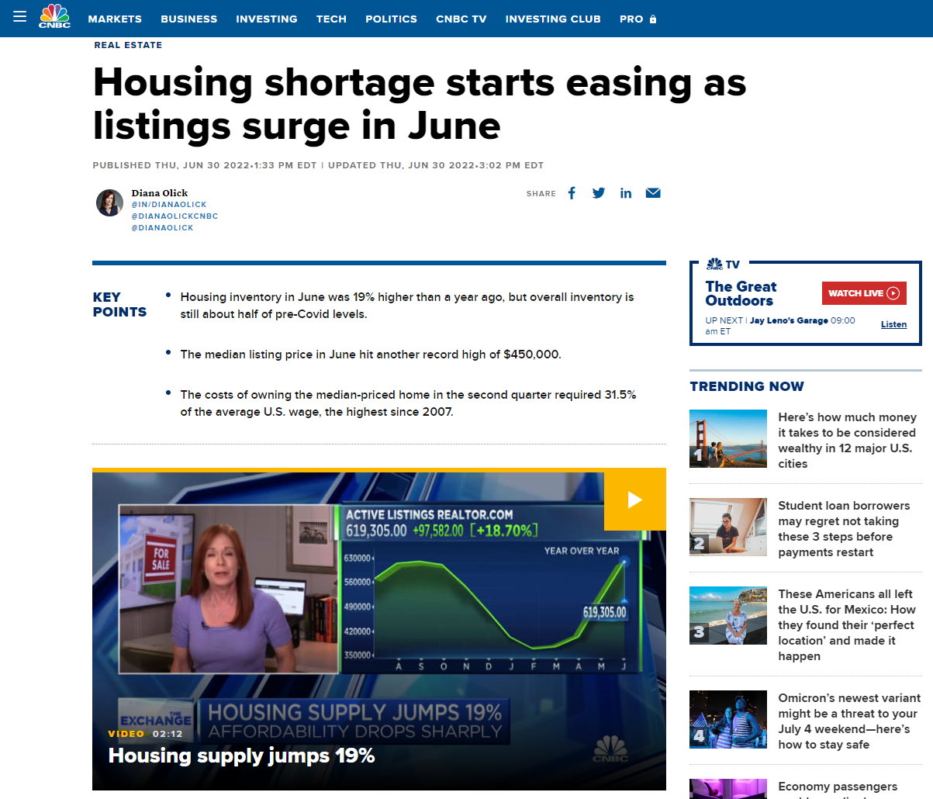
Notes:
Seller
Power Agent® Point: Still a great time to sell but there is an increase in listings
https://www.cnbc.com/2022/06/30/housing-shortage-starts-easing-as-listings-surge-in-june.html

Slide 87
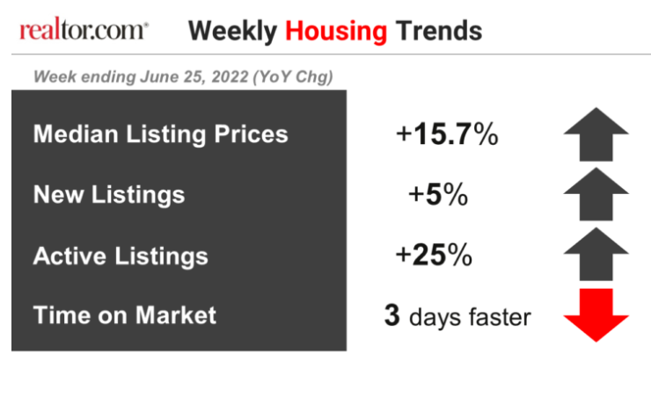
This Year Compared To Last Year
Notes:
Seller
Power Agent® Point: Still a great time to sell but there is an increase in listings
https://www.realtor.com/research/weekly-housing-trends-view-data-week-june-25-2022/

Slide 88
Notes:
Seller
Power Agent® Point: Builders are building more which means more competition for you the seller
https://cdn.nar.realtor/sites/default/files/documents/2022-realtors-legislative-meetings-residential-economic-issues-and-trends-forum-lawrence-yun-presentation-slides-05-04-2022.pdf

Slide 89
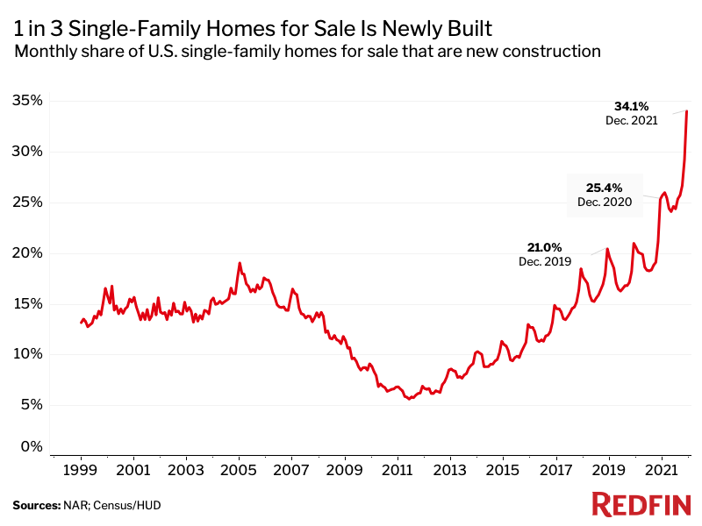
Notes:
Seller
Power Agent® Point: Builders are building more which means more competition for you the seller

Slide 90
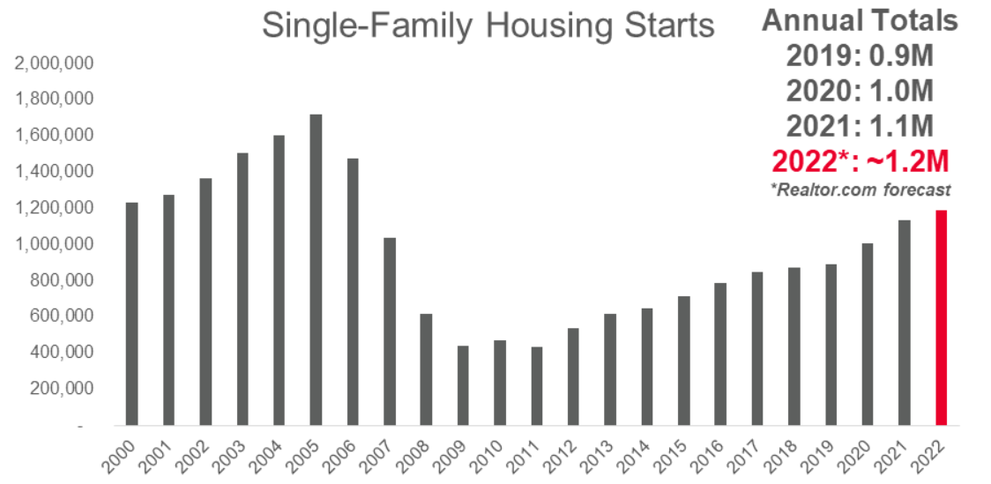
Notes:
Seller
Power Agent® Point: More new homes, more newer homes to compete against.
https://www.realtor.com/research/2022-national-housing-forecast-midyear-update/

Slide 91
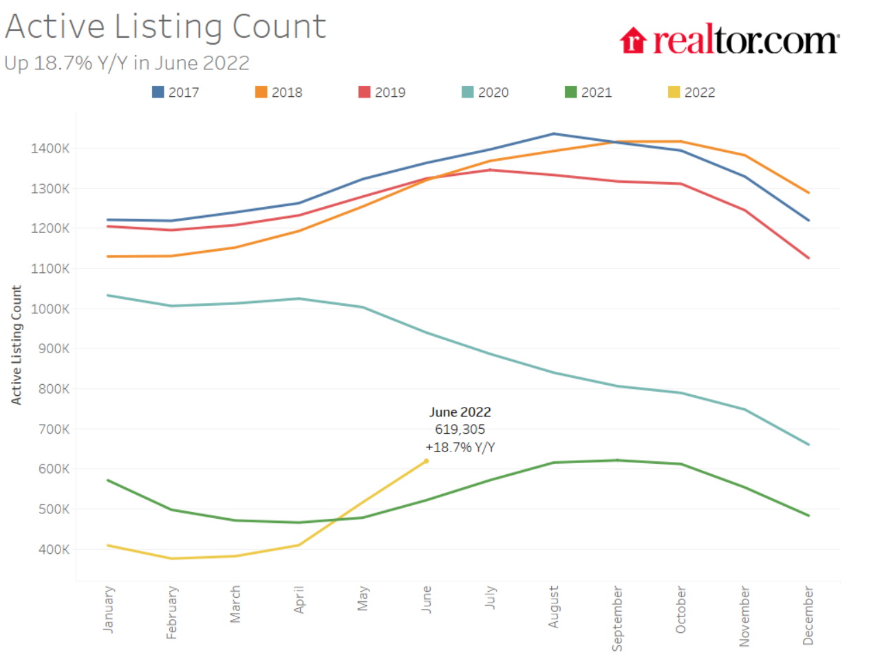
Notes:
Seller
Power Agent® Point: Still a great time to sell but there is an increase in listings
https://www.realtor.com/research/june-2022-data

Slide 92
“I would say if you’re a homebuyer, or a young person looking to buy a home, you need a bit of a reset.”
— Jerome Powell
Federal Reserve Chairman
Notes:
Seller
Power Agent® Point: The Fed is telling buyers not to buy now and wait!!
https://www.bankrate.com/real-estate/june-2022-fed-housing-comments/

Slide 93
Buyer & Seller SLIDES

Slide 95
Your 30-Day
PLAN For Success
Everyday, Focus On Prospecting

Slide 97
Pick Just a Few Activities & Do Them Everyday
FSBOs
Expireds
Houses for Rent
Past Clients
Orphans
Farming

Slide 100
Dialogue

Slide 101
Your 30-Day
PLAN For Success
Keep Improving Your
Listing Conversation

Slide 105
Market Saturation Equation
# of listings available
1,000
# of monthly sales
100
10 months
Market Saturation

Slide 106
“Our house is better; we did all these improvements”

Slide 107
Investment vs. Pleasure
The return on investment
50% - increased the value of your home
50% - your personal enjoyment
If you were going to improve the house to flip it as an investor, would you spend the same amount of money today?

Slide 108
Location & Size determine
“Price”
How nice a house looks determines
“Time to Sell”

Slide 109
I need the money for the house we are buying

Slide 111
Run Ahead of The Ball

Slide 112
Stale Bread

Slide 113
Advantages Of Pricing Aggressively
Creates excitement on the market because it’s new
Buyers think, “I better buy this one before someone else does”
Generates higher offers because several people are interested in the house because of its good value.
More convenient for you because you have less headaches of showing the house

Slide 114
When Moving Up
Previous price
$ 450,000
$ 650,000
Today’s price (-10%)
$ 405,000
$ 585,000
$ 45,000 Loss
$ 65,000 Gain
$ 20,000 ahead

