Slide 1
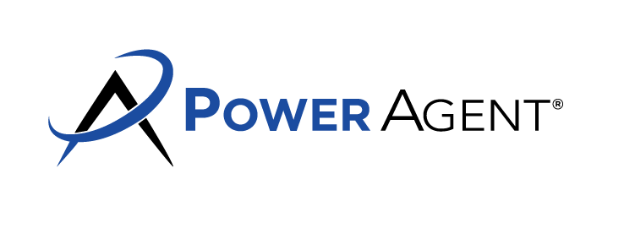
Agent Anchor Moments
Here's a list of potential anchor moments for agents:
When Working with a Seller:
Initial Consultation: When the realtor meets the seller for the first time and discusses the potential listing.
Home Evaluation: Providing the seller with an honest assessment of the home's value.
Listing Presentation: Discussing pricing, marketing strategies, and the sales process.
Signing the Listing Agreement: The moment of formalizing the professional relationship.
Staging & Photography: Preparing the home for showings and capturing its best features.
Listing the Property: The moment the property goes live on the market.
Open Houses: Interacting with potential buyers and getting feedback.
Research on Comparable Sales: Presenting the seller with current market data.
Feedback Collection: After each showing, collecting feedback and communicating it to the seller.
Marketing Updates: Updating the seller on marketing strategies, website hits, and advertising results.
Social Media Engagement: Sharing the listing on social platforms and noting interactions.
Price Adjustments: Discussing and suggesting price changes based on market feedback.
Vendor Recommendations: Suggesting trusted vendors for repairs, staging, or other needs.
Legal Requirements: Guiding the seller on disclosures or any mandatory legal requirements.
Community Engagement: Involvement in local events or networks to promote the listing.
Market Shifts: Educating the seller on any changes in the market environment.
Regular Updates: Providing the seller with updates on showings, feedback, and market changes.
Negotiating Offers: Representing the seller's best interests during negotiations.
Sale Agreement: Finalizing the terms and conditions of the sale.
Inspection & Appraisal: Navigating potential challenges and addressing issues.
Closing Process: Ensuring all paperwork and processes are completed efficiently.
Final Walk-through: Ensuring the home is in agreed-upon condition before the sale.
Closing Day: Handing over the keys and celebrating the sale.
Post-Sale Check-in: Touching base after the sale to ensure satisfaction.
© Darryl Davis Seminars • DarrylSpeaks.com • 631.929.5555

Slide 2
Agent Anchor Moments
When Working with a Buyer:
Buyer Consultation: Understanding the buyer's needs, preferences, and budget.
Pre-Approval Guidance: Assisting the buyer in understanding the importance of mortgage pre-approval.
Property Search: Curating a list of properties that match the buyer's criteria.
Neighborhood Tours: Introducing the buyer to potential neighborhoods of interest.
School and Community Info: Sharing information about local schools, amenities, and community events.
Property History: Providing the buyer with information about the history of the property.
New Listings Alert: Notifying the buyer of new properties on the market.
Financing Options: Providing insights on different mortgage types and suggesting trusted lenders.
Property Showings: Touring homes and getting buyer feedback.
Offer Strategy: Crafting a compelling offer based on the competition and market demand.
Backup Offers: Discussing the possibility and strategy behind making a backup offer.
Negotiating: Working on the buyer's behalf to get the best possible terms.
Offer Acceptance: Celebrating when an offer is accepted.
Inspection & Appraisal: Helping the buyer understand the process and potential issues.
Closing Process: Guiding the buyer through the paperwork and procedures.
Final Walk-through: Checking the property to ensure it meets the agreed-upon conditions.
Closing Day: Handing over the keys to the buyer's new home.
Move-in Assistance: Offering guidance on moving services, local facilities, and initial setup.
Utilities and Local Services: Informing the buyer about utility providers, local services, and other essentials.
Post-Purchase Check-in: Ensuring the buyer is satisfied and settled in.
© Darryl Davis Seminars • DarrylSpeaks.com • 631.929.5555

Slide 3
Agent Anchor Moments
Both for Buyers and Sellers:
Communication: Every phone call, email, text, or other form of communication.
Problem Solving: Addressing any unexpected challenges or issues.
Recommendations: Providing advice on other professionals, like home inspectors, attorneys, or contractors.
Market Education: Informing the client about the current market conditions.
Trust Building: Demonstrating integrity, honesty, and expertise in every interaction.
Emotional Support: Recognizing the emotional aspects of buying/selling and providing support.
Referrals: Asking for or providing references from past clients.
Celebratory Moments: Recognizing milestones, like a first home purchase or a profitable sale, and the anniversaries of these events.
Post-Transaction Assistance: Offering help with post-closing tasks like address changes, utility transfers, etc.
Seasonal Check-ins: Reaching out during holidays or special occasions to maintain a relationship.
Seminars/Workshops: Inviting or informing clients about relevant real estate seminars or workshops.
Newsletter Updates: Sending market updates, real estate news, or home maintenance tips.
Asking for Reviews: Encouraging satisfied clients to leave reviews on platforms or the realtor's website.
© Darryl Davis Seminars • DarrylSpeaks.com • 631.929.5555

