Slide 1
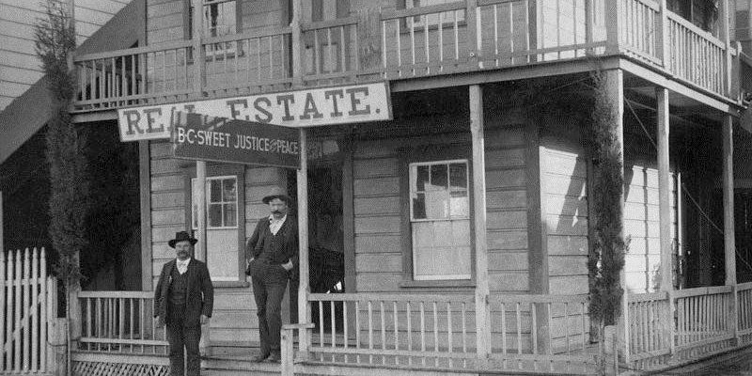
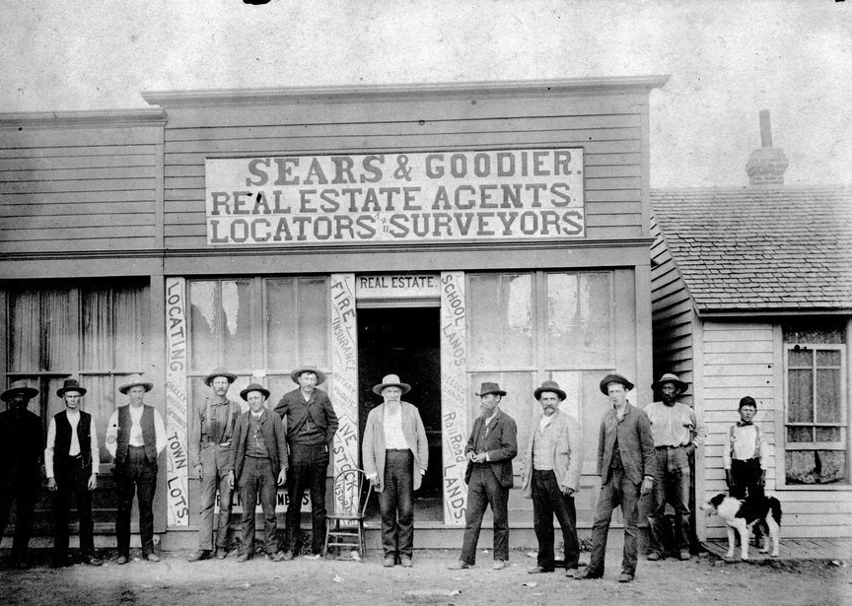

Slide 2
Practicing Real Estate
Any time you act on someone else’s behalf when buying or selling real estate in order to receive a fee, commission, or other type of compensation, you have engaged in the practice of real estate. To do this legally you must be properly licensed. If you are not licensed, you have committed a crime. Also, you cannot engage in real estate negotiations on someone else’s behalf or even attempt to conduct a real estate transaction for another person or organization unless you are properly licensed.
www.TryThePowerProgram.com

