Slide 1
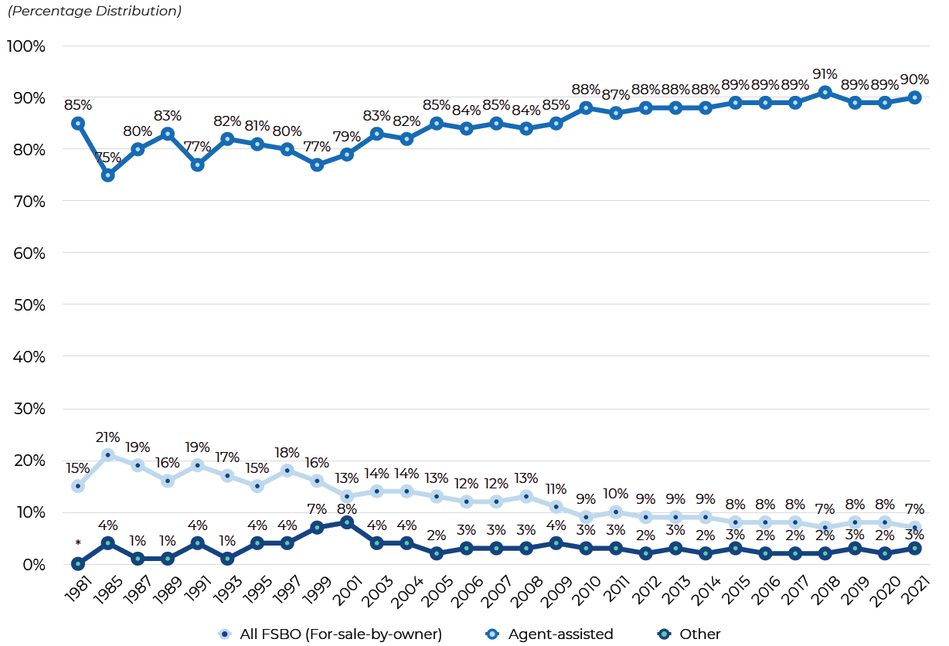
Notes:
https://www.nar.realtor/sites/default/files/documents/2021-highlights-from-the-profile-of-home-buyers-and-sellers-11-11-2021.pdf

