Slide 1
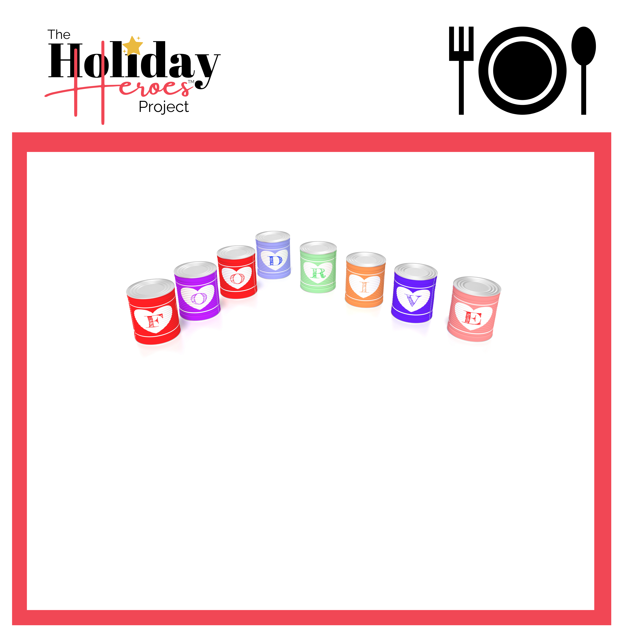
Most Requested Food Items
Stuffing
Green Beans (c)
Corn (c)
Dry Mashed Potatoes
Mac and Cheese
Gravy
Cranberries (c)
Yam or Sweet Potato (c)
Pumpkin (c)
Tuna and Meat (c)
Peanut Butter
Soups & Stews (c)
Rice and Dry Beans
Cereal
Fruits & Veggies (c)
Protein Bars
Helping Families In Need
(c) = Canned

